Slide 1

PAC ANNUAL CONFERENCE
October 28 & 29, 2021
Professional Accounting Futures
Begins at 1:00 PM

Slide 2
PAC ANNUAL CONFERENCE on Professional Accounting Futures
October 28 & 29, 2021
Covid-19 Impacts:
Financial reporting, investing, auditing & governance challenges in a fast changing & chaotic Environment

Slide 3
PAC ANNUAL CONFERENCE
Professional Accounting Futures
October 29, 2021
Research Presentation:
COVID-19 Uncertainty & Society
John M. Barrios, PhD,
Washington University in St. Louis

Slide 4

COVID-19
Uncertainty
&
Society
John M. Barrios
Washington University at St Louis
NBER

Slide 5
The COVID-19 Pandemic
Changed our collective calculus of uncertainty
  No reference case for the COVID-19 crisis in living memory
The COVID-19 crisis erupted and unfolded with tremendous speed.
  The US case as an example.
  In February 2020, the unemployment rate stood at 3.5%, the lowest rate in the past 67 years.
  Six weeks later, the outlook has shifted profoundly:
    Nearly ten million Americans filed for unemployment benefits in the first two weeks of April 2020 (Chaney and Morath 2020). Millions more lost jobs but did not file.
The suddenness in the change which not only was a health event but also introduced a massive amount of economic uncertainty. Affecting all aspects of society !

Slide 6
The COVID-19 Pandemic
Major uncertainties surround almost every aspect of our society:
  the infectiousness, prevalence, and lethality of the virus
  the availability and deployment of antigen and antibody tests
  the capacity of healthcare systems to meet an extraordinary challenge
  how long it will take to develop and deploy safe, effective vaccines
  the ultimate size of the mortality shock
  the duration and effectiveness of social distancing, market lockdowns, and other mitigation and containment strategies
  the near-term economic impact of the pandemic and policy responses
  the speed of recovery as the pandemic recedes; whether ‘temporary’ government interventions and policies will persist
  the extent to which pandemic-induced shifts in consumer spending patterns will persist
  the impact on business survival, new business formation, R&D, human capital investment, and other factors that affect productivity over the medium and long term.
Notes:
Exceptional circumstances, such as those of COVID-19, require a blend of courage, clarity, and humility. The biggest enemies of good decision-making in times of crisis are neither uncertainty nor ambiguity; they are, rather, over-confidence, procrastination, and incomplete or biased data.

Slide 7
The COVID-19 Pandemic
Because the outlook changed with such suddenness, methods based on backward-looking statistical analyses and historic data are not suitable to gauge uncertainty
Many of the forward-looking measures of uncertainty reflected this great deal of uncertainty
Notes:
Exceptional circumstances, such as those of COVID-19, require a blend of courage, clarity, and humility. The biggest enemies of good decision-making in times of crisis are neither uncertainty nor ambiguity; they are, rather, over-confidence, procrastination, and incomplete or biased data.

Slide 8
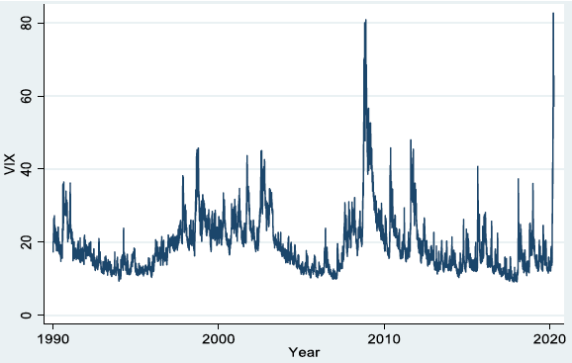
The COVID-19 Pandemic: Stock market volatility
BOW Volatility Index (VIX), which reflects the forward-looking volatility implied by options on the S&P 500 index.
the COVID-19 shock increased the VIX by about 500% from 15 January 2020 to 31 March 2020
Figure: Baker et al 2020
Notes:
BOW Volaitility Index (VIX), which reflects the forward-looking volatility implied by options on the S&P 500 index. Figure 1 shows that the COVID-19 shock increased the VIX by about 500% from 15 January 2020 to 31 March 2020. This forward-looking measure starts in 1990 and is available daily in real time. Realized volatility can be calculated on short look-back windows to quickly reflect abrupt changes in economic circumstances. The realised volatility of daily returns stretches back to the late 19th century.

Slide 9
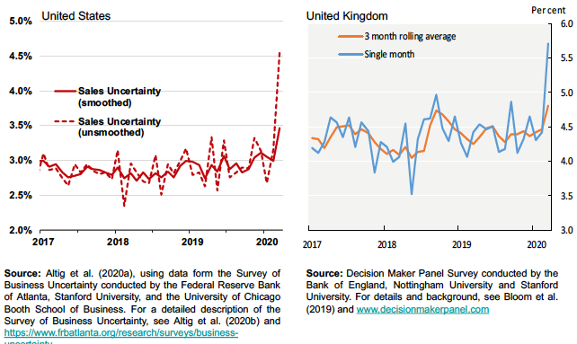
The COVID-19 Pandemic: Business Expectations Surveys
US monthly panel Survey of Business Uncertainty and the UK monthly Decision Maker Panel
Both countries exhibit a pronounced spike in uncertainty in March 2020, well above any previous peak in their (short) histories.
Notes:
These surveys elicit five-point probability distributions (mass points and associated probabilities) over each firm’s own future sales growth rates over a one-year horizon. By calculating each firm’s subjective standard deviation about its own future growth rate forecast in a given month, and aggregating over all firms in that same month, we obtain an aggregate measure of subjective uncertainty about future sales growth rates.

Slide 10
The COVID-19 Pandemic
The pandemic was not only a health event for society it also has led to massive economic changes in our economy
    generated both demand and supply shocks reverberating across the global economy
The pandemic has transformed many facets of our markets
Notes:
Exceptional circumstances, such as those of COVID-19, require a blend of courage, clarity, and humility. The biggest enemies of good decision-making in times of crisis are neither uncertainty nor ambiguity; they are, rather, over-confidence, procrastination, and incomplete or biased data.

Slide 11
Outline
Review various facts of the pandemic when it comes to individuals’ behavior from both a healthcare and economic perspective
Health and the Pandemic
  Social Distancing & Stay at Home Mandates
  Uncertainty, risk : the role or partisanship and culture
Economic Implications of the Pandemic
    Business
    Labor Market
Technological Change, the pandemic and the future of work
Finish off with some general insight about the pandemic and what it means for the accounting and the financial sector

Slide 12
Health Uncertainty
At the onset of the pandemic the main intervention for the virus were non-pharmaceutical. Governments worked to control the spread relying on individuals' behaviors with respect to social distancing.
The uncertainty of the spread affected individuals risk perceptions leading to differences in individuals' behaviors based:
political leaning
cultural determinants (civic engagement).
Externalities
Notes:
The success of non-pharmaceutical interventions to contain pandemics often depends greatly upon voluntary compliance with government guidelines. What explains variation in voluntary compliance?
Since the purpose of social distancing is to reduce the spread of a virus, in this case COVID-19, it matters greatly whether people believe in the need to take such precautions. If people infer lower risk from the same set of facts (e.g., population density, case counts and deaths), they may impose unnecessary health risks on others.

Slide 13
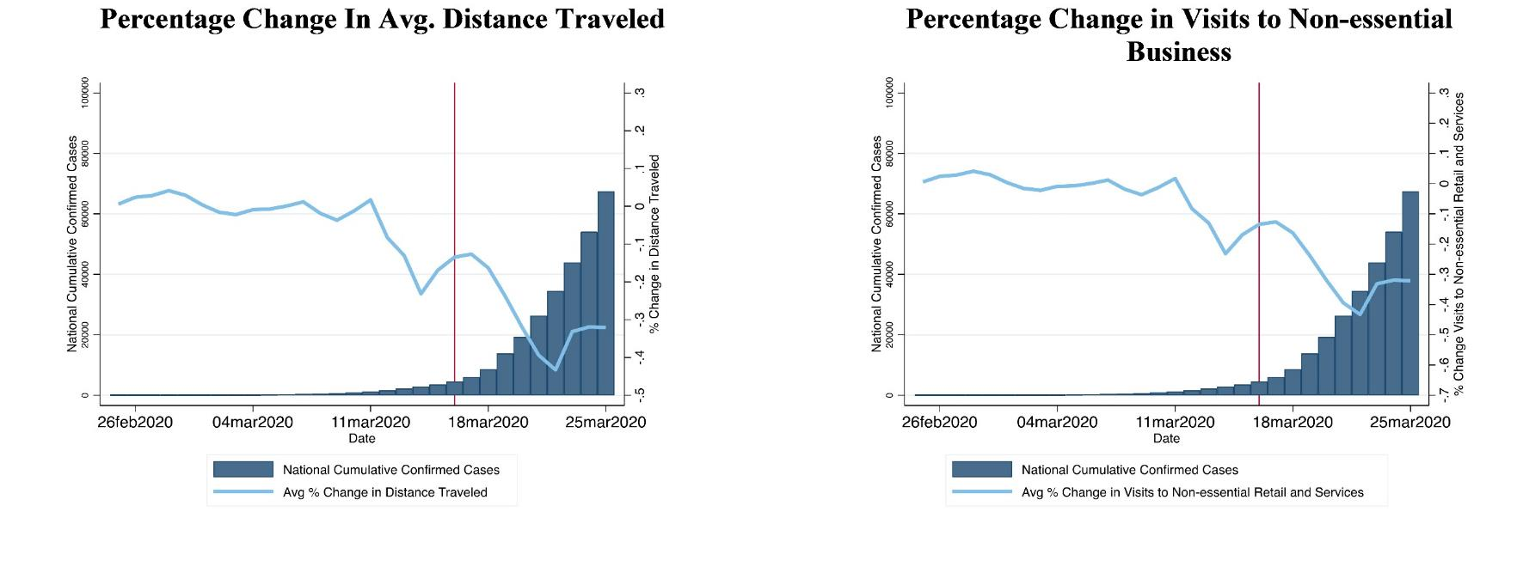
Trends in social distancing as the pandemic began

Slide 14
Social distancing and Partisanship
while a higher incidence of confirmed COVID-19 cases results in a reduction in daily distance traveled
the effect is muted in counties that favored Donald Trump in the 2016 presidential election.
For example, with a doubling of the number of confirmed COVID-19 cases in a county, the percent change in average daily change in distance traveled falls by 4.75 percentage points.
However, a one standard deviation increase in Trump voter share mutes this effect by 0.5 percentage points.
Figure: Barrios and Hochberg 2020
Notes:
Given the political divide in the US and how individuals consume news and information, the authors of this new research examine whether political partisanship affects the risk perceptions of individuals during the ongoing COVID-19 pandemic of 2020.
explore the effects of political partisanship on pandemic risk perceptions and, among other revealing insights (regarding, for example, pandemic-related internet searches), they find that while a higher incidence of confirmed COVID-19 cases results in a reduction in daily distance traveled, this effect is muted in counties that favored Donald Trump in the 2016 presidential election. For example, with a doubling of the number of confirmed COVID-19 cases in a county, the percent change in average daily change in distance traveled falls by 4.75 percentage points. However, for this same doubling in cases in a county, a one standard deviation increase in Trump voter share mutes this effect by 0.5 percentage points. Similar patterns are revealed when the authors examine the change in daily visits to non-essential businesses—residents in counties that favored Trump took more non-essential trips.
This result has been shown in many other countries and setting

Slide 15
Social Distancing and civic capital
Percentage changes in visits to non-essential businesses
Civic capital - the level of trust people have for one another and their willingness to engage in activities that benefit the collective more than the individual—like voting, volunteering, or donating blood.
Contagion avoidance is a public good: any individual behavior that limits contagion contributes to slowing the spread of the virus, lowering the probability of infection for all members of the community – a positive externality.
Using mobile phone and survey data, the researchers find that during the early phases of COVID-19, voluntary social distancing was higher when individuals exhibit a higher sense of civic duty.
  This is true for U.S. individuals, U.S. counties, and European regions.
Percentage changes in distance traveled daily
Figure: Barrios et al 2020
Notes:
he rapid spread of COVID-19 has left countries hit by the pandemic with very little choice but to shut down their economies.
The almost uniform effort to ‘flatten the curve’ and preserve hospital viability has been to impose lockdowns and strict forms of social distancing: ‘stay home’ is the motto that governments – from Wuhan to Milan, from Madrid to New York – have promoted to break the chain of contagion.
In many countries, campaigns to convince citizens to comply with social distancing have been put in place and popular actors, religious leaders, even football players have been mobilized to spread the message and raise awareness throughout the population.
What’s become apparent, however, is that adherence to these recommendations varies widely, both across geographies and among individuals. But what factors explain this variation?
The goal is to persuade people to internalize the externality they would impose on the community by not reducing their mobility. Indeed, given the limited capacity of the state to enforce lockdowns on a large scale, persuasion seems crucial to achieving social distancing and reaping its potentially vast benefits in terms of lives saved (Greenstone and Nigam 2020, Stock 2020).
The internalization of the externality created by personal mobility is likely to depend on citizens’ capacity to contribute to the ‘public good’. Indeed, contagion avoidance is a public good: any individual behaviour that limits contagion contributes to slowing the spread of the virus, thus lowering the probability of infection for all members of the community – a positive externality.

Slide 16
Social Distancing and civic capital
Moreover, after U.S. states began re-opening, social distancing remained more prevalent in high civic capital counties.
Figure: Barrios et al 2020
Notes:
he rapid spread of COVID-19 has left countries hit by the pandemic with very little choice but to shut down their economies. T
he almost uniform effort to ‘flatten the curve’ and preserve hospital viability has been to impose lockdowns and strict forms of social distancing: ‘stay home’ is the motto that governments – from Wuhan to Milan, from Madrid to New York – have promoted to break the chain of contagion.
In many countries, campaigns to convince citizens to comply with social distancing have been put in place and popular actors, religious leaders, even football players have been mobilized to spread the message and raise awareness throughout the population.
What’s become apparent, however, is that adherence to these recommendations varies widely, both across geographies and among individuals. But what factors explain this variation?
The goal is to persuade people to internalize the externality they would impose on the community by not reducing their mobility. Indeed, given the limited capacity of the state to enforce lockdowns on a large scale, persuasion seems crucial to achieving social distancing and reaping its potentially vast benefits in terms of lives saved (Greenstone and Nigam 2020, Stock 2020).
The internalization of the externality created by personal mobility is likely to depend on citizens’ capacity to contribute to the ‘public good’. Indeed, contagion avoidance is a public good: any individual behaviour that limits contagion contributes to slowing the spread of the virus, thus lowering the probability of infection for all members of the community – a positive externality.

Slide 17

Health and Economic
The pandemic a health crisis led to uncertainty in much of our everyday economic activity
Health risk translates to economic risks

Slide 18
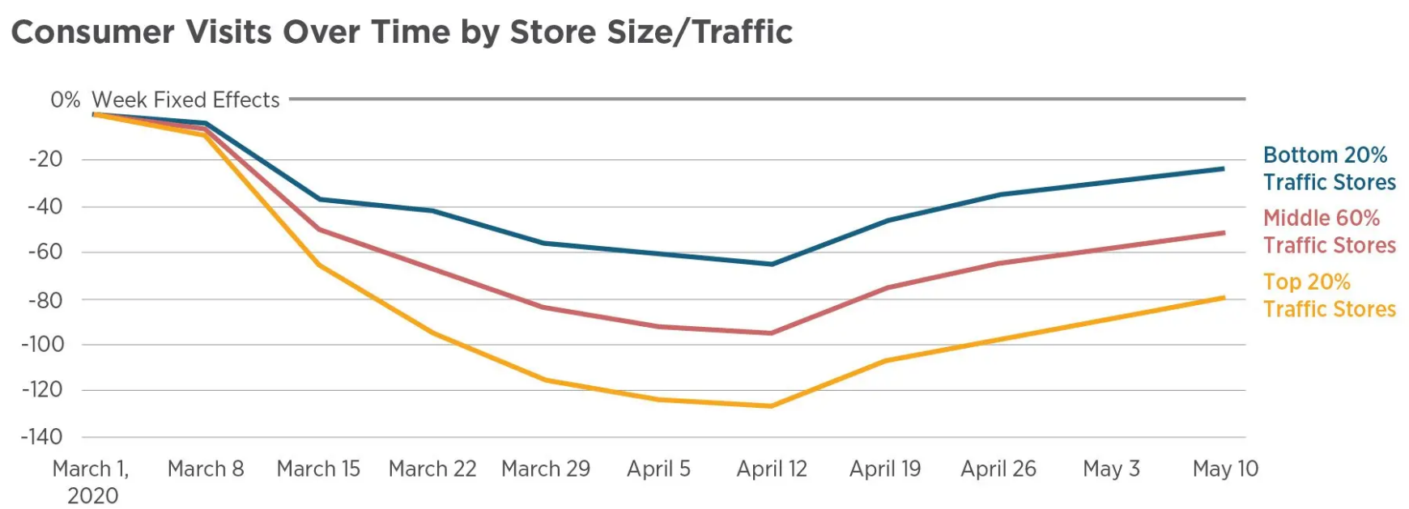
Business Closures Stay at Home Mandates
Total foot traffic fell by 60 percentage points,
  legal restrictions explain only around 7 % points of this decline.
In other words, people were staying home on their own, and when they did go shopping, the authors found that consumers avoided larger, high-traffic businesses.
Supporting a modest size of the estimated stay at home policy effects
Figure: Goolsbee and Syverson 2020

Slide 19

Economic Uncertainty
Labor Market Effects
Technological Changes

Slide 20
US employment declined by about 21% between mid-February and late-April, 2020
Employment declines were disproportionately concentrated among lower-wage workers:
  30% of all workers in the bottom quintile of the wage distribution lost their job
  workers in the top quintile was only 5%
Figure: Bartik et al 2020
Notes:
Using data from ADP¹ one of the world’s largest human resources management companies, a group of authors measure changes in the US labor market during the early stages of this “Pandemic Recession,”
the authors find that paid US employment declined by about 21% between mid-February and late-April, 2020. Given that US private employment in February was 128 million workers (on a non-seasonally adjusted basis), the ADP data suggest that total paid employment in the US fell by about 26.5 million through late April. As of late May, paid employment is still about 19.5 million jobs below its mid-February levels.
The authors reveal that employment declines were disproportionately concentrated among lower-wage workers: 30% of all workers in the bottom quintile of the wage distribution lost their job, at least temporarily, through May. The comparable number for workers in the top quintile was only 5%. Finally, the authors reveal that businesses have cut nominal wages for about 10 percent of continuing employees, about twice the rate during the Great Recession, while forgoing regularly scheduled wage increases for others.

Slide 21
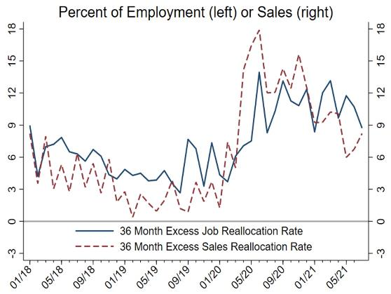
Labor market reallocation in the wake of Covid-19
The Covid shock was asymmetric across sectors, contributing to a sharp recession (Guerrieri et al. 2020).
  sales and employment fell sharply in particular sectors (Bloom et al. 2020).
Excess reallocation
  quantifies the amount of firm-level employment or sales changes over and above the amount required to accommodate the net change in aggregate employment or sales
Since the inception of the Covid pandemic, excess job reallocation rates have approximately doubled in both countries.
Notes:
The Covid-19 pandemic hit some firms and sectors especially hard. As economies bounce back, a key question is whether the recovery will re-employ all of the workers shed during the downturn, and whether they will go back to similar jobs.
Using data from the Decision Maker Panel survey of UK businesses and the Survey of Business Uncertainty in the US, this column examines the ongoing impact of the Covid shock on cross-firm resource reallocation, summing the pandemic’s effects thus far and firms’ expectations for future reallocation of jobs and sales. The combined backward and forward-looking rate of job reallocation has roughly doubled in both countries, and sales reallocation has risen by even more, particularly in the UK. Businesses expect this accelerated pace of reallocation to persist into 2022, which raises the chance that mismatch unemployment will slow recovery in the medium term.
shows our 36-month job and sales reallocation series for the UK and the US. Since the inception of the Covid pandemic, excess job reallocation rates have approximately doubled in both countries. Excess reallocation rates for sales revenue have increased even more, particularly in the UK. We suspect that the UK’s large furlough scheme, which prevented job destruction via significant payroll subsidies, limited the rise in job reallocation. Our latest data, from July 2021, show that job and sales revenue reallocation remain well above pre-pandemic levels, so firms expect the reallocative impact of Covid-19 to persist at least as far as the middle of next year. This confirms the key result from Barrero et al. (2021), who argue the Covid reallocation shock is persistent based on SBU data as of December 2020.

Slide 22
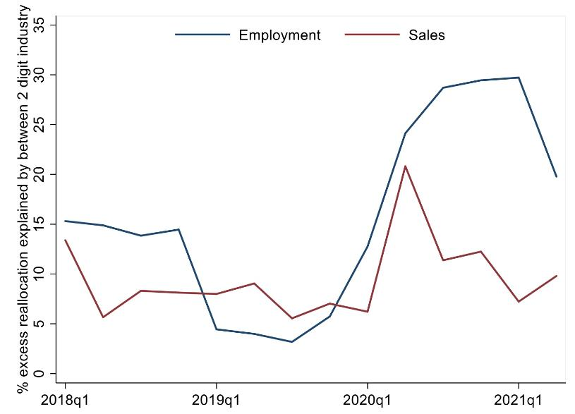
Labor market reallocation in the wake of Covid-19
Reallocation can take place between industrial sectors
  for example as the economy industrializes
Or between firms in the same sector,
  as resources flow from less to more efficient firms producing similar goods or services
As the pandemic unfolded, job and sales reallocation rose sharply
The between-industry share of excess job reallocation more than doubled relative to its pre-Covid average of around 10% in 2018 and 2019. The between-industry share of excess sales reallocation also rose, but more modestly.
Notes:
The figure shows how much of the 36-month reallocation in our UK data comes from reallocation between two-digit industries. We focus on the UK because we have a larger sample with over 3000 firms, which is useful for distinguishing the between and within-sector components of excess reallocation. As the pandemic unfolded, job and sales reallocation rose sharply (Figures 1 and 2).³ Figure 3 shows that the between-industry share of excess job reallocation more than doubled relative to its pre-Covid average of around 10% in 2018 and 2019. The between-industry share of excess sales reallocation also rose, but more modestly. Still, the between-industry component of excess reallocation amounts to less than one-third of the total, implying a dominant role for the within-industry component.

Slide 23
Work from Home
Working from home was already growing before the COVID-19 pandemic.
In the United States the proportion of employees who primarily worked from home had grown from 0.75% in 1980 to 2.4% in 2010 (Mateyka et al. 2012) and 4.0% in 2018.
Post Pandemic: Bick, Blandin, and Mertens (2020) and Brynjolfsson et al. (2020) find that about half of all employed persons worked entirely or partly from home in May 2020.
A ten-fold-increase from pre-pandemic numbers.
Notes:
There appears to be less consensus, however, about how well working from home has worked, whether it will stick after the pandemic ends, and why or why not. This lack of consensus is evident in the wide range of views, from extremely negative to extremely positive, prominent executives have expressed about working from home. At one end of the spectrum, Netflix CEO Reed Hastings, recently said, “I don't see any positives. Not being able to get together in person, particularly internationally, is a pure negative” (Cutter, 2020). At the other extreme, Heyward Donigan, CEO of retailer Rite Aid, reported, “We have adapted to work-from-home unbelievably well... We’ve learned that we can work remote, and we can now hire and manage a company remotely” (Cutter, 2020). Others have expressed intermediate views, for example Apple CEO Tim Cook: “In all candor, it’s not like being together physically....[But] I don’t believe that we’ll return to the way we were because we’ve found that there are some things that actually work really well virtually” (Cutter 2020).

Slide 24
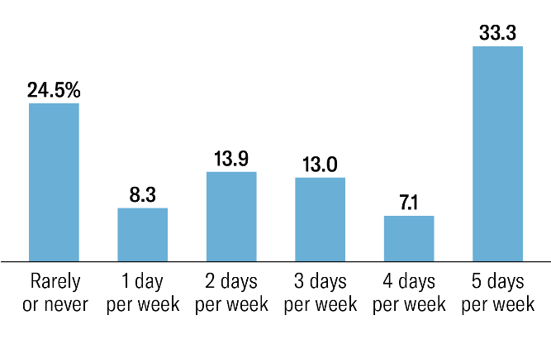
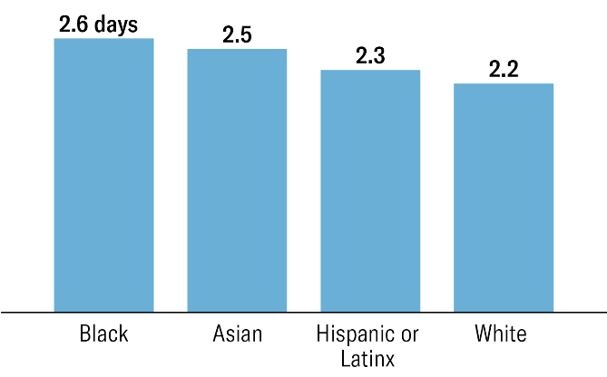
Work from home
Desires to work from home and cut commuting have strengthened as the pandemic has lingered, and many workers have become increasingly comfortable with remote human interactions.
Nearly 80% of U.S. Employees want to work from home at least one day a week
Most want to work 2.5 days a week on average.
Figures from Barrero et al 2021

Slide 25
COVID-19 Results in Wave of Early Retirement
The share of Americans not actively looking for work because of retirement increased by 7 percentage points between January and early April of 2020.
This increase is more than twice as large among women as among men.
This makes early retirement a major force in accounting for the decline in the labor-force participation.
Figures from Coibion et al 2021

Slide 26
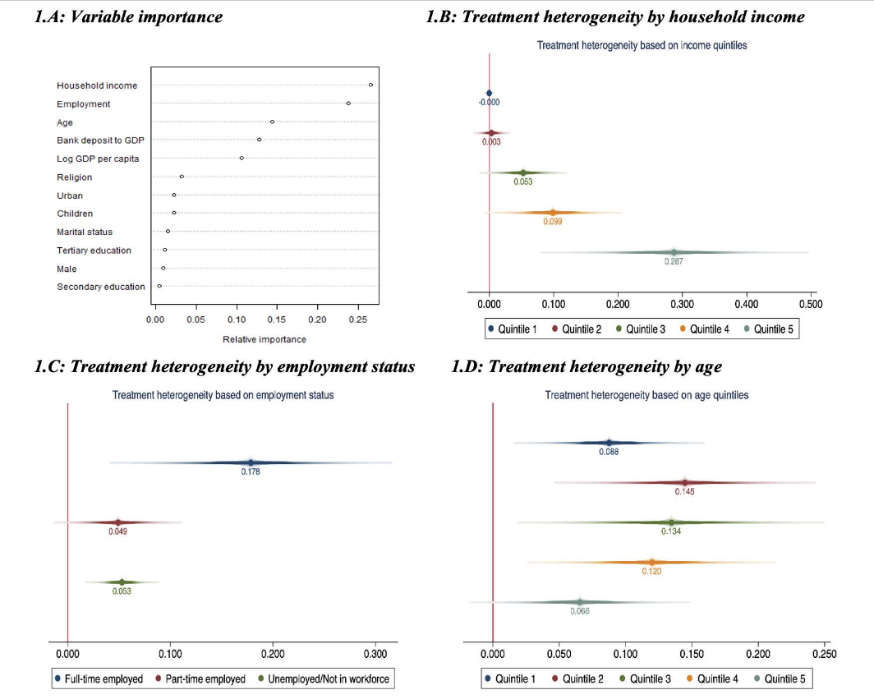
Covid as technological shock
Covid is accelerating the adoption of certain technologies
Epidemic exposure is associated with an increase in remote-access (online/mobile) banking and substitution from bank branch-based to ATM-based activity.
heterogeneity in this response centers on the age, income and employment of respondents. Young, high-income earners in full-time employment have the greatest propensity to shift to online/mobile transactions in response to epidemics.
Figures from Saka et al 2021
Notes:
The COVID-19 pandemic has generated significant uncertainty across all aspects of the global economy and society. Likewise, the pandemic’s long term impacts on science, technology and innovation are impossible to predict. In this context, it is instructive to explore some of the different (and sometimes contradictory) possible trends for how the pandemic could affect STI in terms of overall spending, digital infrastructure, openness, inclusiveness, and global collaboration.
Epidemic exposure is associated with an increase in remote-access (online/mobile) banking and substitution from bank branch-based to ATM-based activity.
We ask whether epidemic exposure leads to a shift in financial technology usage within and across countries and if so who participates in this shift. We exploit a dataset combining Gallup World Polls and Global Findex surveys for some 250,000 individuals in 140 countries, merging them with information on the incidence of epidemics and local 3G internet infrastructure. Epidemic exposure is associated with an increase in remote-access (online/mobile) banking and substitution from bank branch-based to ATM-based activity. Using a machine-learning algorithm, we show that heterogeneity in this response centers on the age, income and employment of respondents. Young, high-income earners in full-time employment have the greatest propensity to shift to online/mobile transactions in response to epidemics. These effects are larger for individuals in subnational regions with better ex ante 3G signal coverage, highlighting the role of the digital divide in adaption to new technologies necessitated by adverse external shocks.

Slide 27
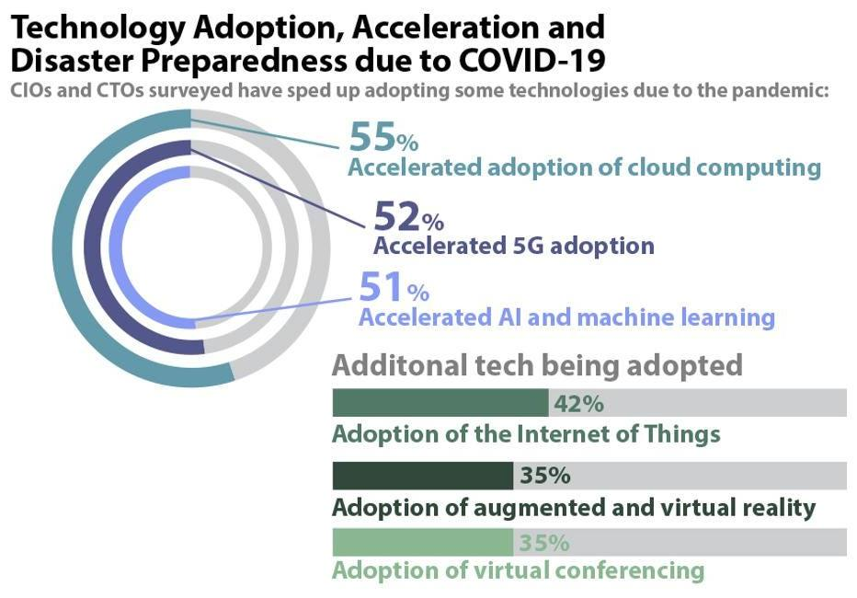
Covid as technological shock
Covid is accelerating the adoption of certain technologies by firms
Companies are also preparing themselves for potential large-scale issues like data breaches and natural disasters.
  increase their cybersecurity to help compensate for the existence of a mobile workforce, employees using personal devices, and to ensure that workplace data remains secure.
Figures from IEEE Survey
Notes:
The COVID-19 pandemic has generated significant uncertainty across all aspects of the global economy and society. Likewise, the pandemic’s long term impacts on science, technology and innovation are impossible to predict. In this context, it is instructive to explore some of the different (and sometimes contradictory) possible trends for how the pandemic could affect STI in terms of overall spending, digital infrastructure, openness, inclusiveness, and global collaboration.

Slide 28
Open Questions

Slide 29
Reallocation
As the recovery proceeds, a key question is whether demand will return to the same places where it fell, or whether some firms and sectors will lose demand and thus shed jobs permanently.
  reallocation may prove to be costly, as firms and workers rebuild human, physical and organizational capital.
How will the new economy look after the pandemic
  Supply chain issues
  Data protection
  Travel

Slide 30
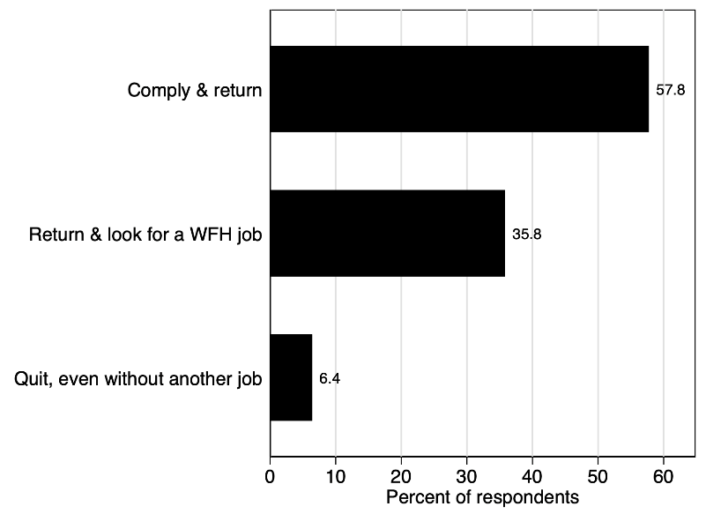
Work from home- Here to stay?
How would you respond if your employer announced that all employees must return to the worksite 5+ days a week starting on 1 August 2021?
Goldman Sachs and JPMorgan want bankers back in the office five days a week (Verlaine and Benoit 2021).
Other firms, like Apple and Google, want employees onsite only part of the week (Tilley 2021).
According to the Wall Street Journal, “Remote work is the new signing bonus” and “Workers have moved on” from restaurants and bars to jobs with higher pay and more flexible working arrangements (Cutter and Dill 2021, Haddon et al. 2021).
Figures from Barrero et al 2021
Notes:
Anecdotal evidence suggests that desires for remote work are contributing to high quit rates and labour shortages in leisure, hospitality, and other parts of the economy (Weber 2021, The Economist 2021).
To provide systematic evidence on these matters, we explore worker attitudes about returning to the office and the appeal of remote work in the June Survey of Working Arrangements and Attitudes (SWAA). We also draw on earlier waves of the SWAA – covering nearly 50,000 working-age Americans since May 2020 – to track the evolution of worker desires and employer plans for working from home in the post-pandemic economy (Barrero et al. 2021).
In June, we put the following question to respondents who currently work from home at least one day per week:
How would you respond if your employer announced that all employees must return to the worksite 5+ days a week starting on 1 August 2021?
- I would comply and return to the worksite
- I would start looking for a job that lets me work from home at least one or two days a week, but return to the worksite if I don't find one by August 1st.
- I would quit my job on or before August 1st, regardless of whether I got another job.

Slide 31
Work from Home – Accounting not Immune
PwC Announces 40,000 U.S. Employees Will Work From Home: How This Can Cause A Chain Reaction Of Companies Offering Competing Remote Options
  If an auditor or tax accountant decides to relocate from New York City, for example, and relocate to a lower cost location, the person will suffer a pay cut to match the current compensation levels where they now reside.
Australia’s largest accounting firms are open to allowing staff to continue working from home now that the extended COVID-19 lockdowns in NSW and Victoria have ended, but warn that serving clients and working with colleagues is still best done in person.
We are in the midst of the Great Resignation
Companies are battling the war for talent to attract and retain key personnel.
  A completely remote, working-outside-of-the-office approach is the big weapon.
Notes:
he remote-work decision made by PwC will turn out to be a highly effective recruiting, hiring and retention program. It will siphon off the best and brightest from competing companies. Rivals will have little other choice than to reconsider their work strategy. If they start losing key players, they’ll need to immediately institute a remote option to deter further defections. We can easily foresee a domino effect. One accounting firm after another may be forced to change their policies to curry favor with current employees and entice people to join their team.
It's likely that this will happen in sector after sector. As bellwether leaders pivot to a distributed workforce, competitors will be pressured to act accordingly. After nearly two years of remote work, it will be exceedingly difficult to lure people out of their homes into a 9 a.m. to 5 p.m. grind under the glare of a middle manager supervisor for five days a week.
To add insult to injury, they’ll revert back to a three-hour, door-to-door, round-trip commute, in heavily congested traffic or via overcrowded mass transit buses and trains with strangers breathing, sneezing and coughing in a tightly enclosed space with poor air circulation.

Slide 32
Accounting and Finance Not immune to other Changing Factors
Financial services firms are also accelerating their digital transformation and cloud enablement
  Investments in data protection
Retail banks find themselves juggling some big priorities
  Central banks, large universal banks, small to medium-sized regional banks, fintechs and challenger banks, are all facing unprecedented challenges and risks.
  Digital currency and Fintec to DeFi
Auditors are facing new and unique challenges performing audits.
  Tele audits and verifiability
  Risk assessments in a Covid world

Slide 33

Questions

Slide 34
PAC ANNUAL CONFERENCE
Professional Accounting Futures
October 28 & 29, 2021
Questions & Answers

Slide 35
PAC ANNUAL CONFERENCE
Professional Accounting Futures
Panel 3 October 29, 2021
Auditing challenges under extreme uncertainty during Covid-19
Pam Fowler, Partner EY
Maruf Raza, Partner, National Director Public Companies, MNP
Carol Paradine, CEO, CPAB
Karim Jamal, PhD, University of Alberta

Slide 36
PAC ANNUAL CONFERENCE
Professional Accounting Futures
October 29, 2021
Auditing under extreme uncertainty
Pam Fowler
Partner EY

Slide 37
Auditing under extreme uncertainty
Pam Fowler, Partner, National Accounting and Assurance
  29 October 2021

Slide 38
Auditing under extreme uncertainty
Pre-COVID environment
  Audit innovation and the role of technology
  Talent profile for audit of the future
Auditing in a virtual environment
  Accounting and auditing issues faced
    Asset impairment and going concern
    Auditing government assistance
    Observation of inventory
    Internal controls

Slide 39
Auditing under extreme uncertainty
Talent impact
  Application of professional skepticism and judgement
  Coaching, mentoring and on-the-job learning
  Work-life imbalance
Success in uncertainty
  Trust and compassion
  Creativity and curiosity
  Empathy

Slide 40
EY | Building a better working world
EY exists to build a better working world, helping to create long-term value for clients, people and society and build trust in the capital markets.
Enabled by data and technology, diverse EY teams in over 150 countries provide trust through assurance and help clients grow, transform and operate.
Working across assurance, consulting, law, strategy, tax and transactions, EY teams ask better questions to find new answers for the complex issues facing our world today.
EY refers to the global organization, and may refer to one or more, of the member firms of Ernst & Young Global Limited, each of which is a separate legal entity. Ernst & Young Global Limited, a UK company limited by guarantee, does not provide services to clients. Information about how EY collects and uses personal data and a description of the rights individuals have under data protection legislation are available via ey.com/privacy. EY member firms do not practice law where prohibited by local laws. For more information about our organization, please visit ey.com.
© 2021 Ernst & Young LLP. All Rights Reserved.
A member firm of Ernst & Young Global Limited.
This publication contains information in summary form, current as of the date of publication, and is intended for general guidance only. It should not be regarded as comprehensive or a substitute for professional advice. Before taking any particular course of action, contact Ernst & Young or another professional advisor to discuss these matters in the context of your particular circumstances. We accept no responsibility for any loss or damage occasioned by your reliance on information contained in this publication.
ey.com/ca

Slide 41
PAC ANNUAL CONFERENCE
Professional Accounting Futures
October 29, 2021
Auditing Challenges Under Extreme Uncertainty
Maruf Raza
Partner, National Director Public Companies, MNP

Slide 42

Auditing Challenges Under Extreme Uncertainty
Maruf Raza
October 2020

Slide 43
Digital Assets
Maruf Raza
Notes:
Cryptocurrencies, NFTs, ICOs auditing in the blockchain

Slide 44

The Premise
Auditing in the blockchain holds much promise – that the information is more reliable and potentially self-auditing

Slide 45
The Challenge
Is information obtained from the blockchain reliable?
Notes:
Consensus model (e.g., “proof of work” or “proof of stake”): The consensus reached by the
network represents the “truth” in a blockchain (from a probabilistic finality7 perspective). The
mechanism by which the consensus protocol resolves splits and forks that arise routinely as
part of the mining process is important.
a “consensus attack” (often called at 51% attack) on a blockchain may represent a business risk in that such an attack can result in the misappropriation of an entity’s crypto-assets by a third party.

Slide 46
Testing The Blockchain
Controls based approach required in almost all situations
Testing the possibility of a consensus attack
Notes:
Consensus model (e.g., “proof of work” or “proof of stake”): The consensus reached by the
network represents the “truth” in a blockchain (from a probabilistic finality7 perspective). The
mechanism by which the consensus protocol resolves splits and forks that arise routinely as
part of the mining process is important.
a “consensus attack” (often called at 51% attack) on a blockchain may represent a business risk in that such an attack can result in the misappropriation of an entity’s crypto-assets by a third party.

Slide 47
Custodianship & Ownership
How do you prove ownership?
How do you prove what is actually held?
Notes:
SOC reports
Non-traditional players

Slide 48
Valuation
Defining principal and active markets
NFTs, Digital currencies, Tokens, Coin offerings
Notes:
Defining exchanges

Slide 49
Ecommerce
Maruf Raza

Slide 50
ECommerce
As companies increase their online presence, the auditing challenges relating to these companies are different
Notes:
Where do companies turn to when there is no one available?
Impacts also on quality when resources are stretched so thin

Slide 51
Example
A company uses Amazon for its entire fulfilment function. The company may never take position of its inventory, may never bill its customers directly and may fully need to rely on Amazon for its information needs.
Notes:
Lets assume the company acts as the principal in the transaction – that is Amazon does not take on any risk.

Slide 52

Challenges
Inability to perform physical inventory counts at Amazon warehouses or obtain confirmation from Amazon of inventory balances.
Notes:
This requires auditors to perform other audit procedures, in accordance with CAS 501. Such other audit procedures may include obtaining a service auditor’s report on the adequacy of Amazon’s internal control for ensuring that inventory is properly counted and adequately safeguarded (see point 2 below) or inspecting documentation regarding inventory held by third parties, for example, warehouse receipts.

Slide 53
Challenges
Amazon is a service organization, but service auditor reports may be unavailable or will not be shared
Notes:
Under CAS 402, auditors may require a service auditors report (i.e. SOC Type 1 or 2 report) to provide audit evidence to support the user auditor's understanding about the design and implementation of controls at the service organization. This is required to provide an appropriate basis for the identification and assessment of the risks of material misstatement (RMM).

Slide 54
Challenges
Is sufficient appropriate audit evidence (“SAAE”) concerning the relevant financial statement assertions available from records held at the entity?
Notes:
In the case of an e-commerce service provide such as Amazon, SAAE is often times not available from the records held at the user entity and therefore further audit procedures are required through direct access to records maintained by the service organization. From this point on, there are additional challenges & complexities depending on whether those records and documents are held by the user entity or the service organization, whether the user entity maintains its own independent detailed records or documentation of specific transactions undertaken on its behalf, and contractual arrangements between the user entity and the service organization regarding access to the records of the service organization.
Auditors may then be faced with a situation where they have reports generated by Amazon that they wish to rely on – for example sales and inventory reports - but they are unable to test the completeness and accuracy of such reports that are intended to be used as audit evidence.

Slide 55
Other considerations
Integration of ERP systems into online IT process
Blockchain systems
Information from third party merchants
Notes:
Controls and specifically IT based controls
Mid sized companies (before the domain of the large)

Slide 56
Resource Capacity
Maruf Raza

Slide 57
Resource Capacity
Major factor affecting all audit firms today is a lack of capacity
Many firms are unable to take on new work and in fact are reducing their existing client loads
Notes:
Where do companies turn to when there is no one available?
Impacts also on quality when resources are stretched so thin

Slide 58
How did we get here?
Potential Factors
Slippage into industry for CPA designation
Growth
Pandemic issues
Generational issues
Notes:
Industry slippage: BC Forum 10-12%
Internal – hiring for today instead of tomorrow

Slide 59
Solutions
Potentially accept that the issues are endemic
CPA Profession needs to internalize and understand there is a problem
Adapt our onboarding and retention strategies
Immigration and governmental fast tracking of temporary workers
Notes:
German example

Slide 60
PAC ANNUAL CONFERENCE
Professional Accounting Futures
October 29, 2021
Auditing accounting estimates:
Strengthening audit quality
Carol Paradine
CEO, CPAB

Slide 61
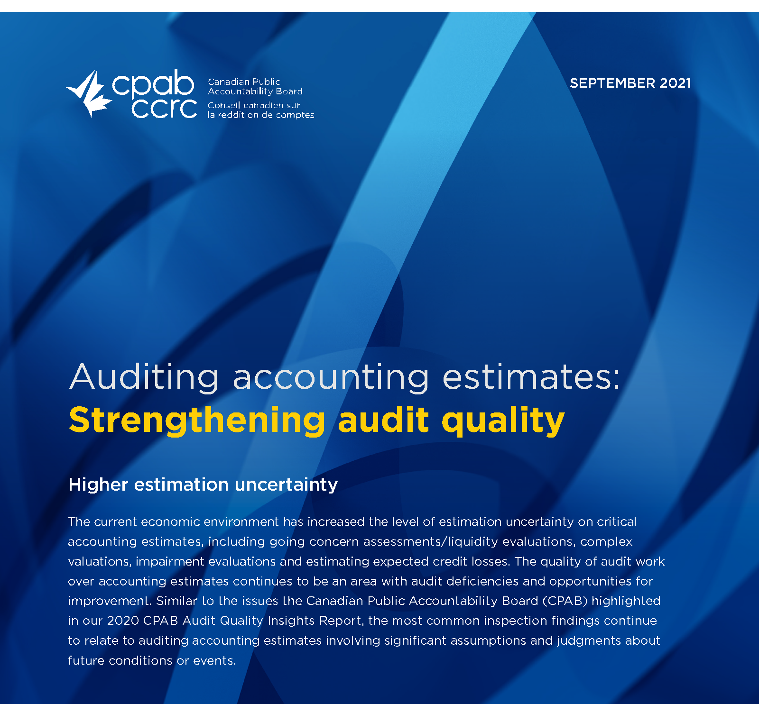

Slide 62

Auditing challenges
CPAB inspections results during
the pandemic
Auditing impact of volatility
and uncertainty
Higher-risk environments

Slide 63
PAC ANNUAL CONFERENCE
Professional Accounting Futures
October 29, 2021
History of Shocks That Changed Accounting
Karim Jamal, PhD
University of Alberta

Slide 64
History of Shocks That Changed Accounting
Karim Jamal

Slide 65
Fundamental Transformative Shocks To Accounting
1) Legal.
2) Wars.
4) Frauds.
5) De Professionalization of Auditing.
6) Rise and Fall of Arthur Andersen.

Slide 66
Shock 1: Legal Changes
1831 – New Bankruptcy Act in UK led to Rapidly Growing Accounting Firms with Strong Insolvency Practice (Quilter & Ball, Deloitte, Harding & Pullein, Turquand, Cooper Brothers).
1856 – Act of Parliament: Joint Stock Companies / 1862 – Limited Liability: Led to Private Demand for Audit (Price Waterhouse, Peat & Co).
By 1900 All The Current Big 4 Firms Were Large, Rapidly Growing and International firms [winners in a completely free market], ICAEW had Royal Charter (code of conduct and an exam), Mandatory Audit Law.

Slide 67
Why These Firms?
Marketing: Responded to the New Market Opportunity Quickly. Leaders were Good Rainmakers (William Welch Deloitte, Edwin Waterhouse were Upper Class People in a Lower Middle Class Profession).
Fraud Detection.
Helped Improve Accounting Disclosures-Written Accounting Standards.
Helped Improve Chart of Accounts and Recordkeeping.
Created Standardized [Written] Audit Methodologies.
Helped Improve Operational Performance of Clients – (Gave Good Business Advice…Deloitte a lot, Waterhouse less).

Slide 68
Shock 2: Wars
WW I led to “Temporary Income Tax” and Accountants Acted Fast to Seize a New Business Opportunity in Tax (Lawyers not so fast).
WW II led to More Taxation (welfare state), Admit Women into the Profession, and Managing at a Distance during the war (like COVID).
Showcased Business Skills of Accountants and Raised their Stature.

Slide 69
Shock 3: Frauds
Frauds helped Create Private Demand for Audit, and Mandatory Audit Legislation. Now Raise Questions About Current Auditor Responsibility- Expectation Gap.
Enron Created SOX, PCAOB, CPAB. Frauds Destabilize Auditing. Creation of PCAOB Reduces Professionalism of Auditing.
Courts Refuse to Accept GAAP / and Especially Auditing Standards as Absolute Standards – Demand Changes in Standards (e.g., Inventory Counts, A/R Confirmation).

Slide 70
Shock 4: De Professionalization of Auditing
Theories of “Regulatory Capture” and “Efficient Markets” Raise Questions About Role of Competition Vs Regulation in Professions.
In 1973 - Competition wins in Court: AICPA Starts to Water down Code of Conduct to Promote More Competition …Solicitation of Clients, Advertising, Low Balling of Fees…CICA Auditing Standards Board Follows. PCAOB also Wants More Competition = Downward Pressure on Audit Fees, Less Independence?
As Auditing Becomes More Commercial Over time, Slogans About Ethics, Skepticism, Professionalism Become More Shrill. Tomorrow =?

Slide 71
Rise and Fall of Arthur Andersen
AA Started in 1913 in Chicago (68 years after Deloitte). Grew Very Fast – Showed that a New Firm Could Compete With the Big Firms and Outgrow Them (like MNP in Canada now?).
AA Insisted on the “Right Accounting” not “ Generally Acceptable Accounting.” Infighting among Accountants over GAAP Led to Loss of Control Over Standard Setting (FASB 1973). Loss of Professionalism.
AA Indicted in 2002 – What happens when the Next Enron Occurs?

Slide 72
PAC ANNUAL CONFERENCE
Professional Accounting Futures
October 28 & 29, 2021
Questions & Answers

Slide 73
PAC ANNUAL CONFERENCE
Professional Accounting Futures
October 28 & 29, 2021
Break until 3:45 PM

Slide 74
PAC ANNUAL CONFERENCE
Professional Accounting Futures
Panel 4 October 29, 2021
Governance challenges under extreme uncertainty
Shan Atkins, Director, Aurora Cannabis
John Gordon, Audit Committee Member, Topaz Energy & Cardinal Energy
Carol Hansell, Senior Partner, Hansell McLaughlin Advisory Group
Peter Dent, Partner & President, Deloitte Forensic Inc.

Slide 75
PAC ANNUAL CONFERENCE
Professional Accounting Futures
October 29, 2021
Governance under uncertainty
Shan Atkins
Director, Aurora Cannabis

Slide 76

Governance under uncertainty
M. Shân Atkins, Director and Audit Chair
Aurora Cannabis (NASD/TSX: ACB), Darden (NYSE: DRI), SpartanNash (NASD: SPTN)
Professional Accounting Futures Conference
29 October 2021

Slide 77
Governance under uncertainty:
Lessons from the pandemic
Virtual meetings are here to stay:
  Board meetings: mix, frequency, duration, advance notice
  AGMs: virtual only or hybrid; in-person becoming anachronism
Boards leaning in: time, content (closer to ops?), compensation (or lack thereof)
Hiring in the new normal: have you ‘met’ your new CEO?
Incentive compensation: throwing away the playbook
Human resource challenges: onboarding (facts v. culture/values), inclusion, the ‘great resignation’
Seizing the moment: cyber attacks, ransomware
Back to the future: ESG - once more with feeling

Slide 78
PAC ANNUAL CONFERENCE
Professional Acc9unting Futures
October 29, 2021
Governance Challenges Under Extreme Uncertainty:
An Audit Committee Perspective
John Gordon
Audit Committee Member
Topaz Energy & Cardinal Energy

Slide 79
Governance Challenges
Under Extreme Uncertainty: an Audit Committee perspective
John Gordon, FCPA, FCA, ICD.D
Audit Committee Member, Topaz Energy & Cardinal Energy

Slide 80
Governance Challenges Under Extreme Uncertainty: An Audit Committee Perspective
Learn from the past, but focus on the future
Board/committee composition is critical
Succession plans and depth of talent are critical
Relationships among board members and senior management

Slide 81
Governance Challenges Under Extreme Uncertainty: An Audit Committee Perspective
Some possible future uncertainties worth considering:
Increasing influence of populism and short-term thinking on decision makers
Unprecedented level of informal transparency on operations, decision making and governance
Cyber related risk, on data and physical operations

Slide 82
Governance Challenges Under Extreme Uncertainty: An Audit Committee Perspective
Enhance considerations for Audit Committee roles
Oversight of controls
  Impact of changing work environment, training, monitoring
Accounting and Reporting matters
  Management are making judgements on matters that they haven’t encountered before
Oversight of external audit
  Impact of changing work dynamics on audit team, and effectiveness of their work
Oversight of internal audit
  Changing areas of focus, work protocols

Slide 83
PAC ANNUAL CONFERENCE
Professional Accounting Futures
October 29, 2021
On the Boardroom Table
Carol Hansell
Senior Partner, Hansell McLaughlin Advisory Group

Slide 84
2021 Professional
Accounting Centre
Futures Conference
Carol Hansell
ON THE BOARDROOM TABLE

Slide 85

Truth and Reconciliation
Heightened awareness is prompting greater investment in the reconciliation journey.
Continuing conflict highlights the need for consultation.
Supreme Court has re-affirmed the federal government’s fiduciary duty to indigenous people.

Slide 86

Diversity, Inclusion and Equity
Organizations are coming to terms with what diversity means for them.
Challenges in achieving diversity objectives are being recognized.
Collision between data gathering and disclosure on the one hand and privacy on the other are emerging.
Disclosure must be grounded in fact.

Slide 87

Environment, Social and Governance
Many organizations are just beginning their journey.
Acceptance of common frameworks (TCFD) and metrics (SASB) are improving the dialogue.
Important reporting implications.

Slide 88

Misinformation
Where the corporation and its employees are getting their information.
Dealing with information disseminated about the corporation.
Advancing digital literacy.

Slide 89

Carol Hansell
e: chansell@hanselladvisory.com
t: 416 649 8486

Slide 90
PAC ANNUAL CONFERENCE
Professional Accounting Futures
October 29, 2021
Impact of COVID-19 – Increasing Fraud Risks
Peter Dent
Partner & President, Deloitte Forensic Inc.

Slide 91


Impact of COVID-19 – Increasing Fraud Risks
Peter Dent, Partner and President of Deloitte Forensic Inc
October 29, 2021

Slide 92
Increase in Fraud Risk
The elements of the Fraud Risk Triangle
The methodology and circumstances which allow for a fraud to be committed
The underlying motivation or needs of an individual due to personal or professional circumstances
Opportunity
Pressure
Rationalization
The justification on the part of the individual to validate the fraudulent action

Slide 93
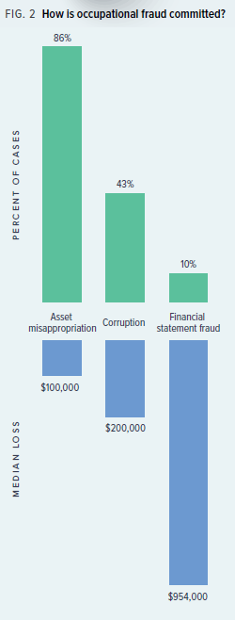
Impact on Financial Reporting
Areas of concern for an auditor
Two main categories of Occupational Fraud and examples that auditors are primarily concerned with in respect to auditing financial statements:
    Misappropriation of assets
        Theft of company assets
        Misuse of company assets
    Fraudulent financial report
        Fictitious revenue
        Fraudulent management estimates
        Improper timing of revenue
        Fraudulent federal relief program applications

Slide 94
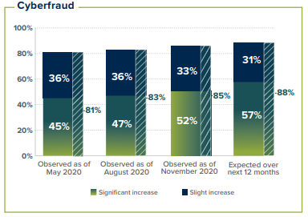
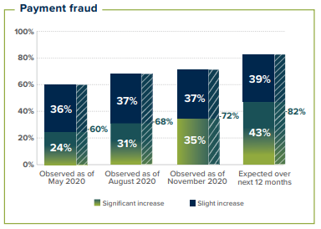
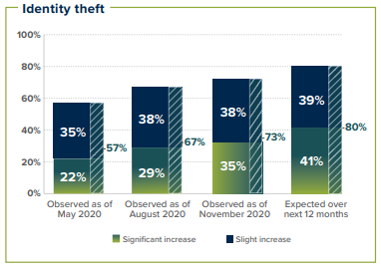
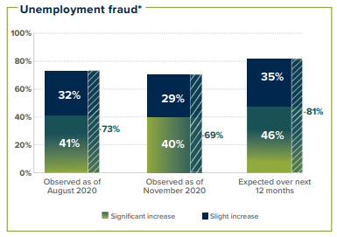
COVID Fraud Examples
How have fraud schemes changes?
Source: ACFE “Fraud in the Wake of COVID-19: Benchmarking Report – December 2020 Edition”

Slide 95
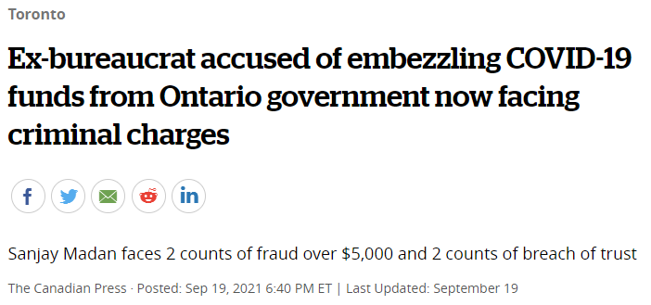
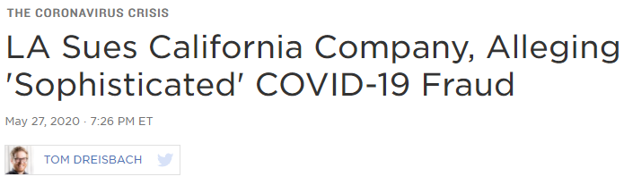
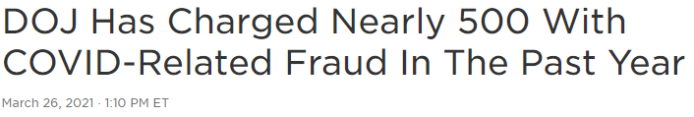
Fraud Scheme Examples
Fraud perpetrated during COVID

Slide 96

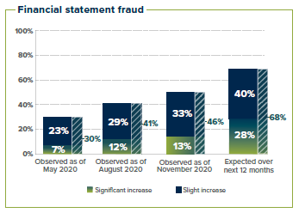
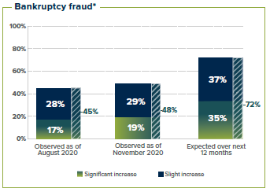
Fraud Scheme Examples
Fraud perpetrated during COVID

Slide 97
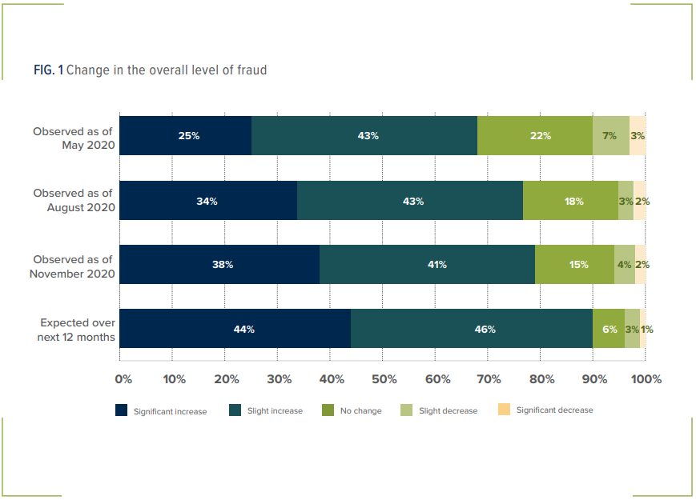
Expected changes in overall level of fraud risk
Source: ACFE “Fraud in the Wake of COVID-19: Benchmarking Report – December 2020 Edition”

Slide 98
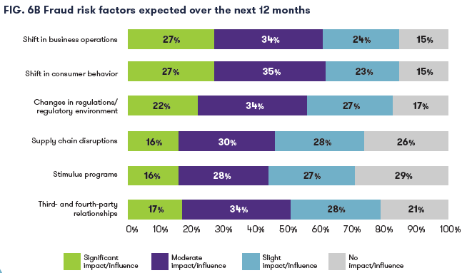
Impact on Business Operations
How COVID-19 is increasing fraud risks
Source: ACFE & Grant Thornton – “The Next Normal: Preparing for a Post-Pandemic Fraud Landscape”

Slide 99
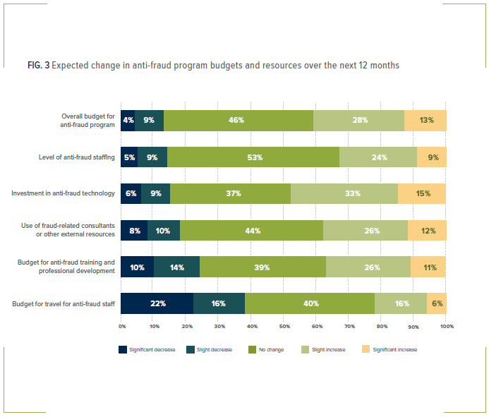
Impact on Anti-fraud programs
How COVID-19 is impacting organizations’ anti-fraud programs
Source: ACFE “Fraud in the Wake of COVID-19: Benchmarking Report – December 2020 Edition”

Slide 100
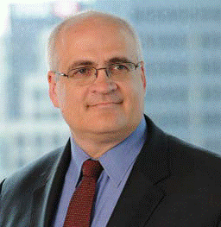
Contact Information
PETER DENT, CPA, CFF, CIA, CFE, ICD.D
Partner, Financial Advisory BC Region and President of Deloitte Forensic Inc
Deloitte LLP, Vancouver, Canada
+ 1 416 601 6692
+1 236 788 4528
pdent@deloitte.ca

Slide 101
About Deloitte
Deloitte provides audit and assurance, consulting, financial advisory, risk advisory, tax, and related services to public and private clients spanning multiple industries. Deloitte serves four out of five Fortune Global 500® companies through a globally connected network of member firms in more than 150 countries and territories bringing world-class capabilities, insights, and service to address clients' most complex business challenges. Deloitte LLP, an Ontario limited liability partnership, is the Canadian member firm of Deloitte Touche Tohmatsu Limited. Deloitte refers to one or more of Deloitte Touche Tohmatsu Limited, a UK private company limited by guarantee, and its network of member firms, each of which is a legally separate and independent entity. Please see www.deloitte.com/about for a detailed description of the legal structure of Deloitte Touche Tohmatsu Limited and its member firms.
Our global Purpose is making an impact that matters. At Deloitte Canada, that translates into building a better future by accelerating and expanding access to knowledge. We believe we can achieve this Purpose by living our shared values to lead the way, serve with integrity, take care of each other, foster inclusion, and collaborate for measurable impact.
To learn more about Deloitte's approximately 330,000 professionals, over 11,000 of whom are part of the Canadian firm, please connect with us on LinkedIn, Twitter, Instagram, or Facebook.

Slide 102
PAC ANNUAL CONFERENCE
Professional Accounting Futures
October 28 & 29, 2021
Questions & Answers

Slide 103
PAC ANNUAL CONFERENCE
Professional Accounting Futures
October 28 & 29, 2021
Thank you for attending
Visit our PAC website at
https://www.utm.utoronto.ca/pac/
Please join us next year

