Slide 1

PAC ANNUAL CONFERENCE
Professional Accounting Futures
October 29, 2021
Impact of COVID-19 – Increasing Fraud Risks
Peter Dent
Partner & President, Deloitte Forensic Inc.

Slide 2


Impact of COVID-19 – Increasing Fraud Risks
Peter Dent, Partner and President of Deloitte Forensic Inc
October 29, 2021

Slide 3
Increase in Fraud Risk
The elements of the Fraud Risk Triangle
The methodology and circumstances which allow for a fraud to be committed
The underlying motivation or needs of an individual due to personal or professional circumstances
Opportunity
Pressure
Rationalization
The justification on the part of the individual to validate the fraudulent action

Slide 4
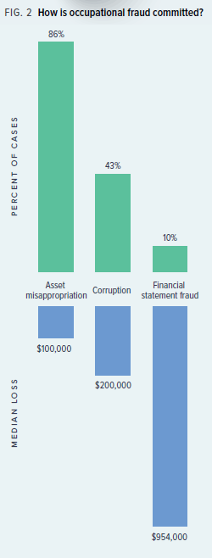
Impact on Financial Reporting
Areas of concern for an auditor
Two main categories of Occupational Fraud and examples that auditors are primarily concerned with in respect to auditing financial statements:
    Misappropriation of assets
        Theft of company assets
        Misuse of company assets
    Fraudulent financial report
        Fictitious revenue
        Fraudulent management estimates
        Improper timing of revenue
        Fraudulent federal relief program applications

Slide 5
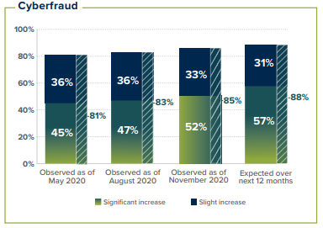
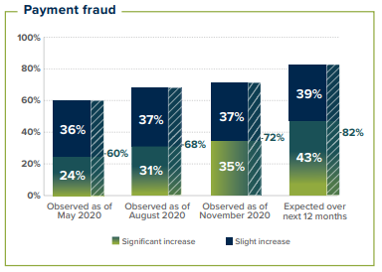
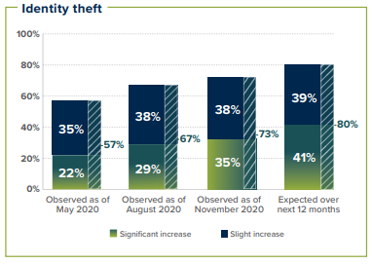
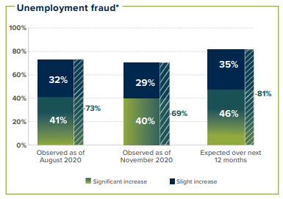
COVID Fraud Examples
How have fraud schemes changes?
Source: ACFE “Fraud in the Wake of COVID-19: Benchmarking Report – December 2020 Edition”

Slide 6
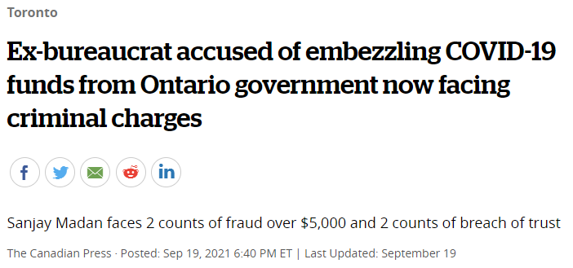
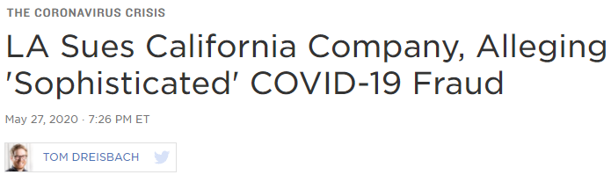
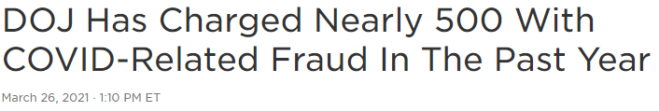
Fraud Scheme Examples
Fraud perpetrated during COVID

Slide 7

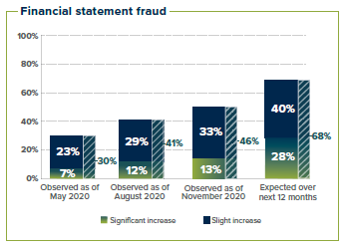
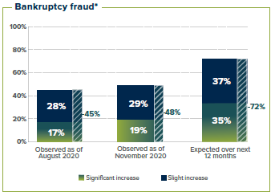
Fraud Scheme Examples
Fraud perpetrated during COVID

Slide 8
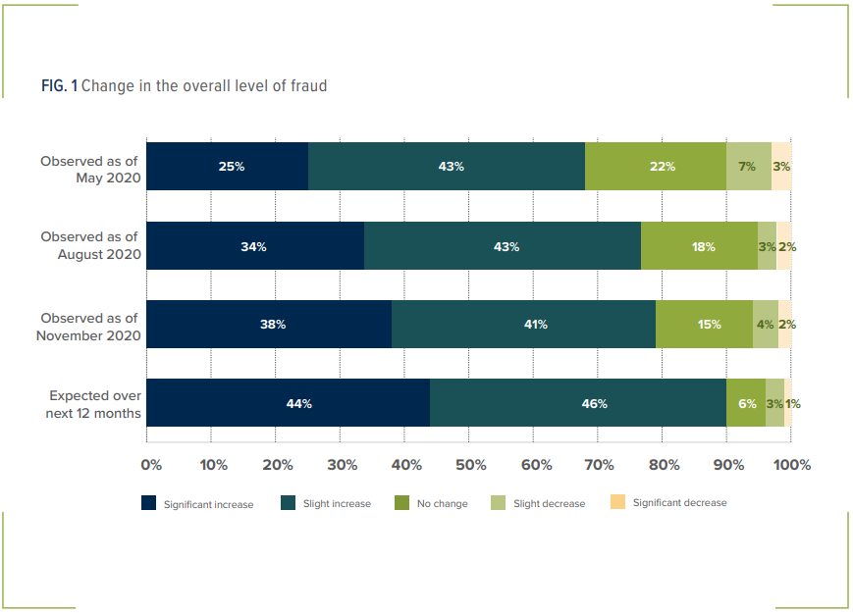
Expected changes in overall level of fraud risk
Source: ACFE “Fraud in the Wake of COVID-19: Benchmarking Report – December 2020 Edition”

Slide 9
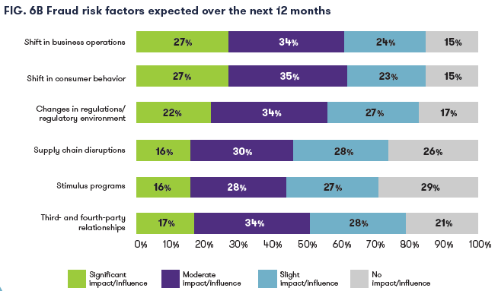
Impact on Business Operations
How COVID-19 is increasing fraud risks
Source: ACFE & Grant Thornton – “The Next Normal: Preparing for a Post-Pandemic Fraud Landscape”

Slide 10
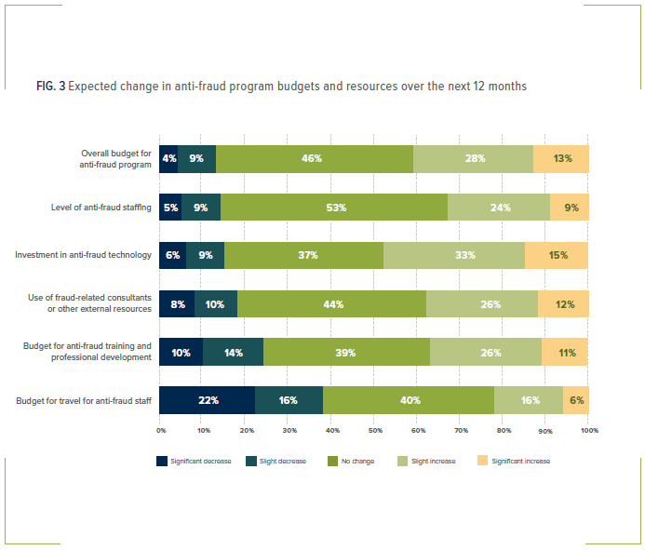
Impact on Anti-fraud programs
How COVID-19 is impacting organizations’ anti-fraud programs
Source: ACFE “Fraud in the Wake of COVID-19: Benchmarking Report – December 2020 Edition”

Slide 11
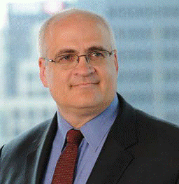
Contact Information
PETER DENT, CPA, CFF, CIA, CFE, ICD.D
Partner, Financial Advisory BC Region and President of Deloitte Forensic Inc
Deloitte LLP, Vancouver, Canada
+ 1 416 601 6692
+1 236 788 4528
pdent@deloitte.ca

Slide 12
About Deloitte
Deloitte provides audit and assurance, consulting, financial advisory, risk advisory, tax, and related services to public and private clients spanning multiple industries. Deloitte serves four out of five Fortune Global 500® companies through a globally connected network of member firms in more than 150 countries and territories bringing world-class capabilities, insights, and service to address clients' most complex business challenges. Deloitte LLP, an Ontario limited liability partnership, is the Canadian member firm of Deloitte Touche Tohmatsu Limited. Deloitte refers to one or more of Deloitte Touche Tohmatsu Limited, a UK private company limited by guarantee, and its network of member firms, each of which is a legally separate and independent entity. Please see www.deloitte.com/about for a detailed description of the legal structure of Deloitte Touche Tohmatsu Limited and its member firms.
Our global Purpose is making an impact that matters. At Deloitte Canada, that translates into building a better future by accelerating and expanding access to knowledge. We believe we can achieve this Purpose by living our shared values to lead the way, serve with integrity, take care of each other, foster inclusion, and collaborate for measurable impact.
To learn more about Deloitte's approximately 330,000 professionals, over 11,000 of whom are part of the Canadian firm, please connect with us on LinkedIn, Twitter, Instagram, or Facebook.

Slide 13
PAC ANNUAL CONFERENCE
Professional Accounting Futures
October 28 & 29, 2021
Thank you for attending
Visit our PAC website at
https://www.utm.utoronto.ca/pac/
Please join us next year

