Slide 1

PAC ANNUAL CONFERENCE
Professional Accounting Futures
October 29, 2021
Auditing accounting estimates:
Strengthening audit quality
Carol Paradine
CEO, CPAB

Slide 2
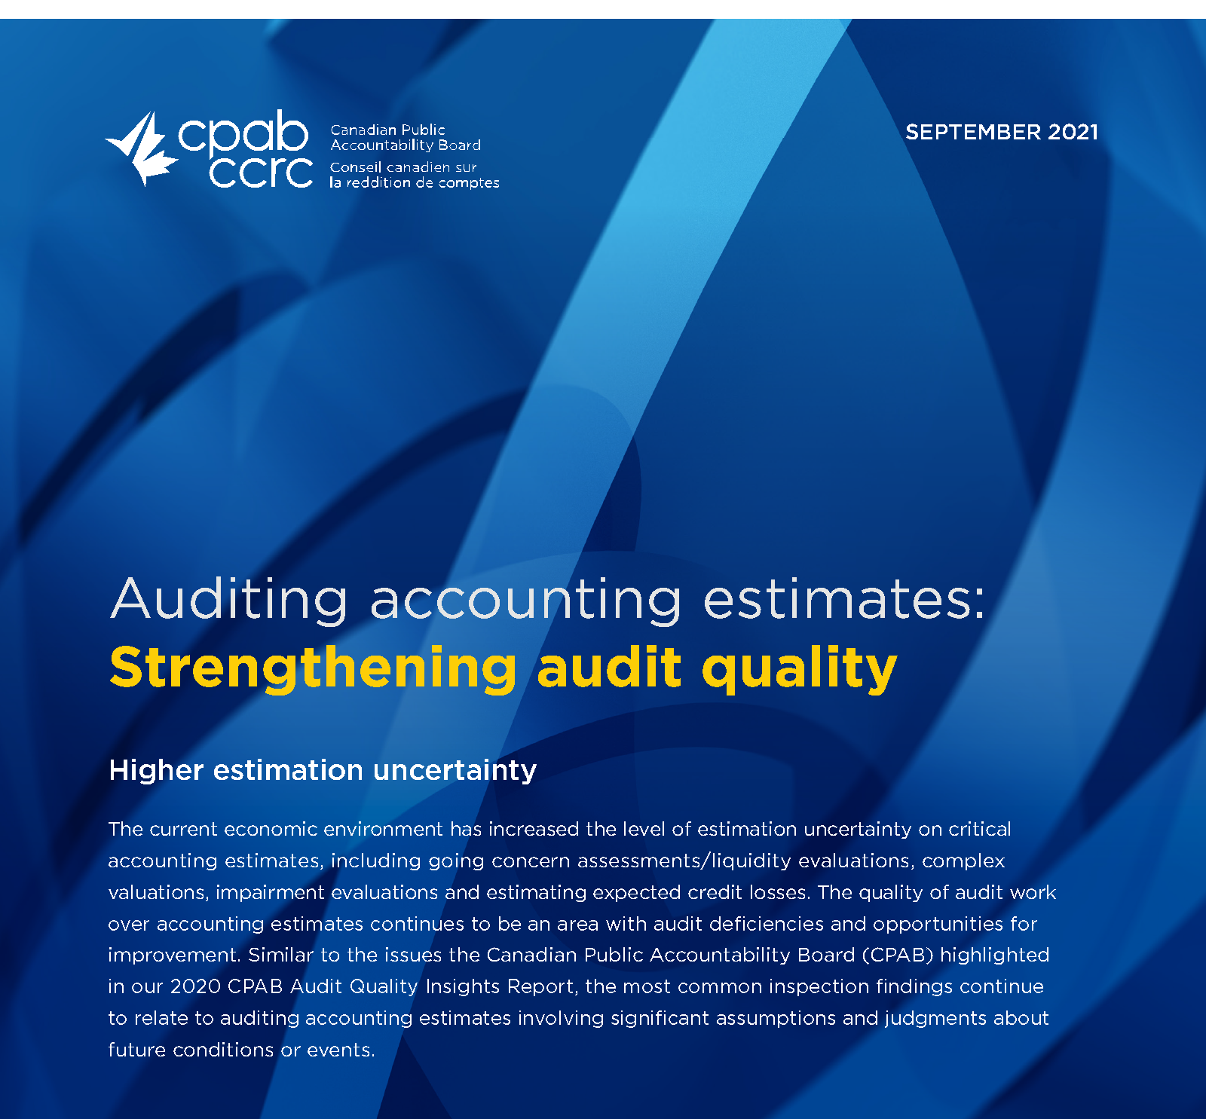

Slide 3

Auditing challenges
CPAB inspections results during
the pandemic
Auditing impact of volatility
and uncertainty
Higher-risk environments

Slide 4
PAC ANNUAL CONFERENCE
Professional Accounting Futures
October 28 & 29, 2021
Thank you for attending
Visit our PAC website at
https://www.utm.utoronto.ca/pac/
Please join us next year

