Slide 1

PAC ANNUAL CONFERENCE
Professional Accounting Futures
October 28, 2021
Investor Challenges
Sanjil Shah
Managing Partner,
Alignvest Student Housing

Slide 2

ALIGNVEST STUDENT HOUSING
PAC 2021 Professional Accounting Futures Conference

Slide 3
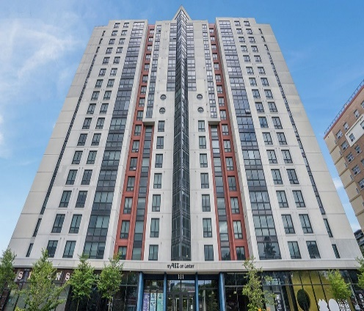

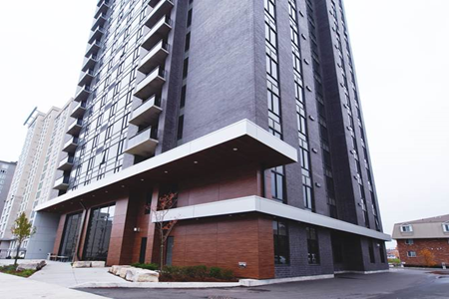
ALIGNVEST STUDENT HOUSING
ASH REIT is Canada’s Largest University PBSA Owner/Operator by Bed Count
Launched in June 2018 as an open-ended, private, Real Estate Investment Trust (“REIT”) focused on consolidating the fragmented, institutional-grade, student housing sector across Canada
  4,717 beds⁽¹⁾ owned and operated
  11 properties across five tier-one University markets
    Ottawa, Oshawa, Hamilton, Waterloo, Edmonton
  $670.1 million⁽¹⁾ appraised value with over $220 million of equity capital raised since inception
(1) As at September 30, 2021

Slide 4
COVID-19 - March 13, 2021
“U of T cancels in-person classes, switches to online and other means, due to COVID-19” – U of T
“COVID-19: Laurier is discontinuing in-person instructions in all courses” – Laurier University
“No more in-person classes and exams” – McMaster University
“University of Alberta is temporarily suspending on-campus classes effective immediately while we assess the recommendations of Alberta’s Chief Medical Offers related to COVID-19” – University of Alberta
“In-person course activity suspended” – University of Waterloo
“Ontario Tech classes are cancelled effective March 13 as we assess online delivery” – Ontario Tech University

Slide 5
CONCERNS AND REALIZATIONS FROM COVID-19 PANDEMIC
Management’s Immediate Concerns
What Transpired?
Is online learning going to disrupt the traditional learning model?
What will happen to our occupancy and collection rate?
How will we pay our operating expenses and service our debt obligations?
What will happen to our valuations?
Stable
Occupancy
Strong
Collection Rate
Enhanced Cleaning / Safety Protocols
Secure and Reliable Internet
Strategic Acquisitions
University Reliance on Private Sector
Proven and Resilient Asset Class

Slide 6
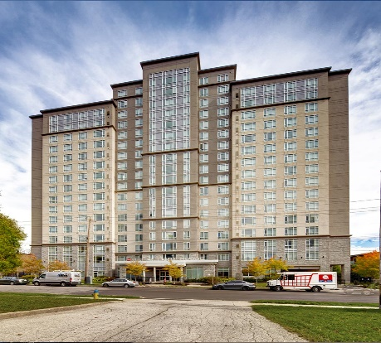



STRATEGIC ACQUISITIONS
Preston House & Bridgeport House
THEO
Core asset with 795 beds serving students from Laurier University and the University of Waterloo
Fully-furnished with private ensuite bathrooms in every bedroom
On-site laundry, lounges, study areas, fitness centre and games room
Expected operating efficiencies with ASH REIT’s three other Waterloo assets
528 high-quality beds serving students from the University of Ottawa
~18K sq. ft. of ground-floor retail (BMO, Dollarama, PiCo, KFC)
Movie lounge, café, basketball court, games room, music studio, study rooms
Expected operating efficiencies with ASH REIT’s two other Ottawa assets

Slide 7
WHERE ARE WE NOW?
ASH REIT
Market
September 2021/22 occupancy at 96%
Trailing-Twelve Month collection rate at ~97%
Gross Rent per Bed and Net Effective Rent per Bed increased by 13.0% and 7.7% in 2021 vs. 2020, respectively
Recently launched Campus Assets, a dedicated student housing development company
Seeking to expeditiously grow asset base by entering new markets across Canada
Asset values for Class A properties remained relatively static throughout COVID-19
Quality properties experienced strong leasing velocity for the 2021/22 academic year
  Private bedrooms with ensuite bathrooms
  Focus on cleanliness and hygiene
  High-quality internet that can facility online classes / exams
  Professional management

Slide 8

Alignvest Student Housing
First Canadian Place, 100 King Street West
70th Floor, Suite 7050
Toronto, Ontario M5X 1C7
www.alignveststudenthousing.com

Slide 9
PAC ANNUAL CONFERENCE
Professional Accounting Futures
October 28 & 29, 2021
Thank you for attending
Visit our PAC website at
https://www.utm.utoronto.ca/pac/
Please join us tomorrow

