Slide 1
Insights arising from applying measurement fundamentals to value creation solutions:
Implications for ESG reporting
Rob McLean
MatrixLinks International Inc. and
CPA Canada
October 23, 2020

Slide 2
Insights arising from applying measurement fundamentals to value creation solutions:
implications for ESG reporting
Outline
CPA Canada’s Foresight Initiative and Value Creation focus
Defining value creation
Focus on value creation decisions and solutions, and underlying measurement approaches
Measurement fundamentals
Applying measurement fundamentals to value creation solutions: emerging insights
Opportunities for collaboration to strengthen measurement in an ESG and other contexts

Slide 3

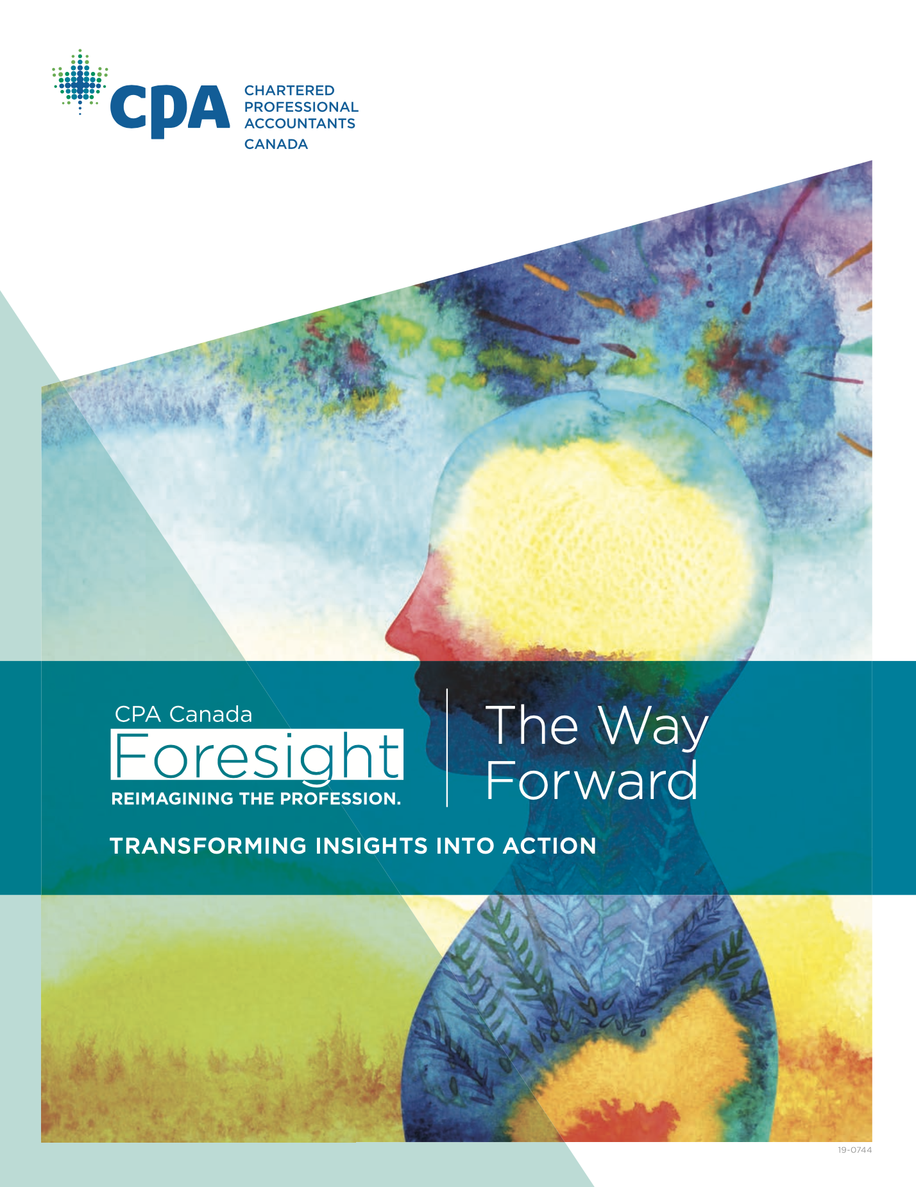
1. CPA Canada’s Foresight Initiative and Value Creation focus
Foresight: “Where to play”
Rethinking value creation, both in terms of the development of new and
evolving models of value creation and in reassessing how accountants add value.
Mastering and shaping a data-driven economy. Every CPA must ultimately
become comfortable in a world that will be data-rich, data-intense and data- driven. In concert with this, CPAs should play a role in the development of standards for data governance and data integrity.
https://www.cpacanada.ca/foresight-report/

Slide 4
2. Defining value creation
Traditional value realization
accounting and reporting
Measures previously-created value as it is realized through transactions with third parties
Value creation measurement
Measures future value creation potential (value streams) in advance of a third party transaction
Our provisional definition of value creation: “the process by which an organization creates the potential for:
a) revenue and net income that can be realized in the future, and/or
b) future benefits for the organization’s stakeholders”

Slide 5
Value Streams Thinking
Value Creation Life Cycle
Future Value
Streams
Value Streams
Focus
Realized Value
Financial and non-financial
Organization and stakeholders
Transactions
Traditional
accounting
Focus
“What is the value potential the enterprise can create in the future, and how well is it performing in making that potential realizable?”
“How well did the enterprise perform in the most recent fiscal period?”

Slide 6
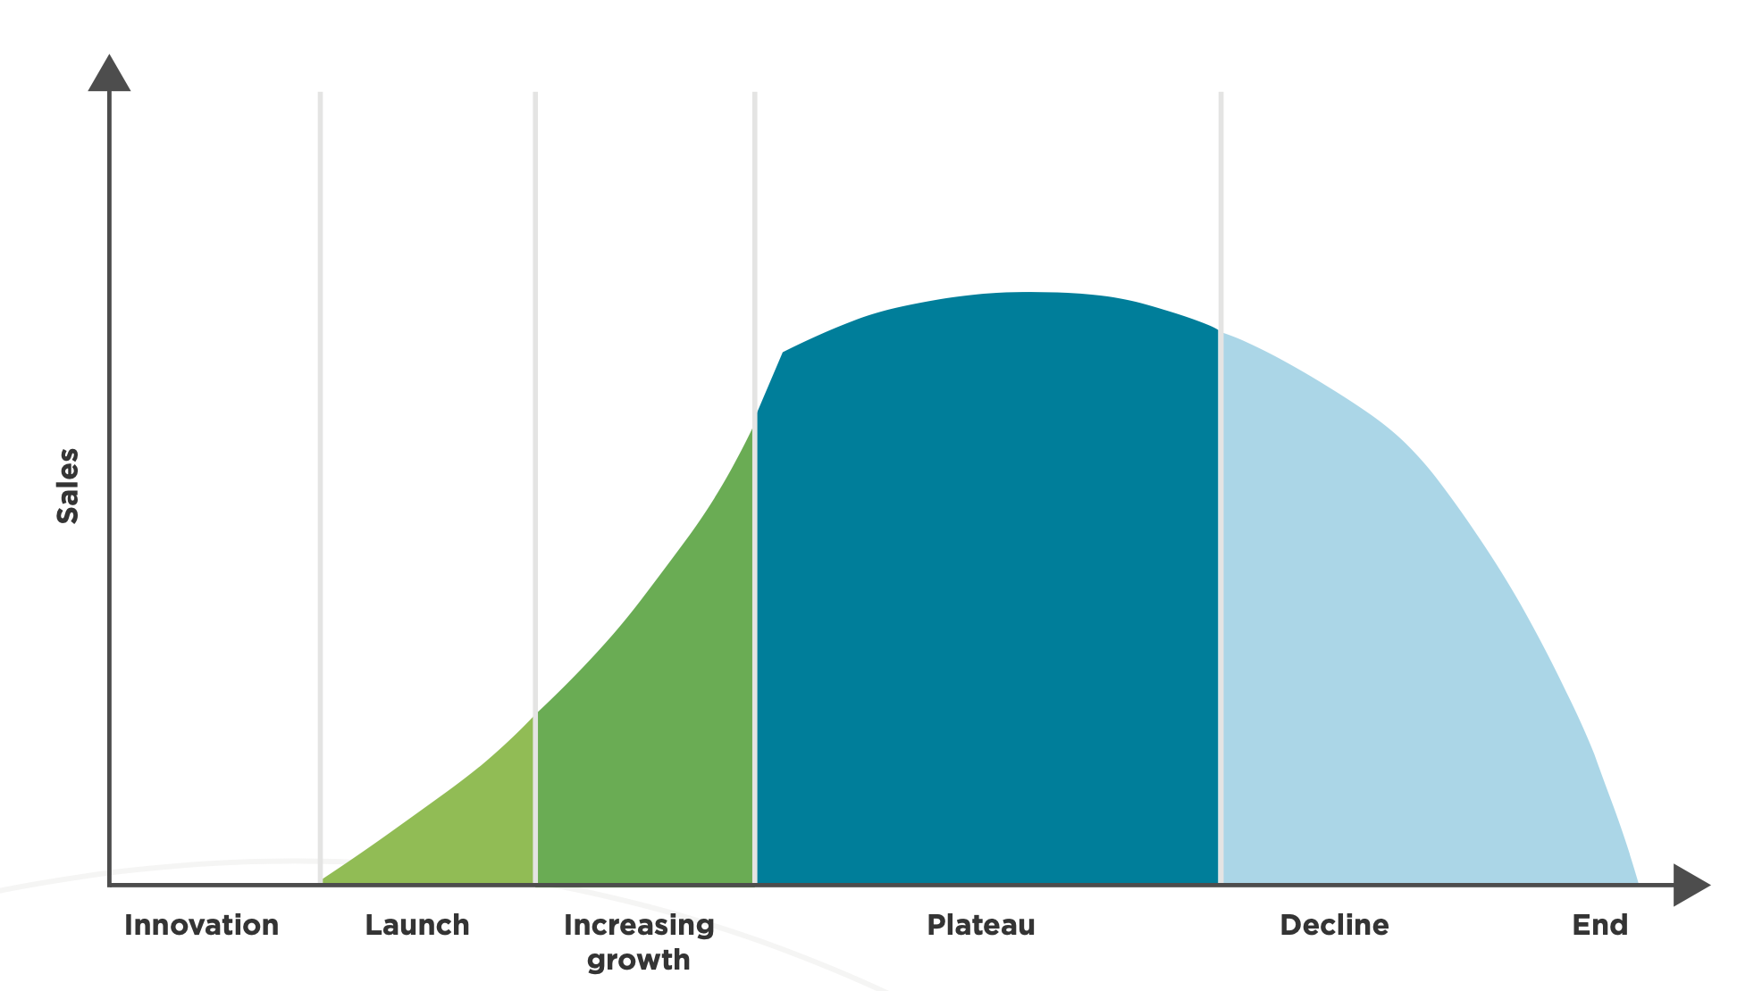
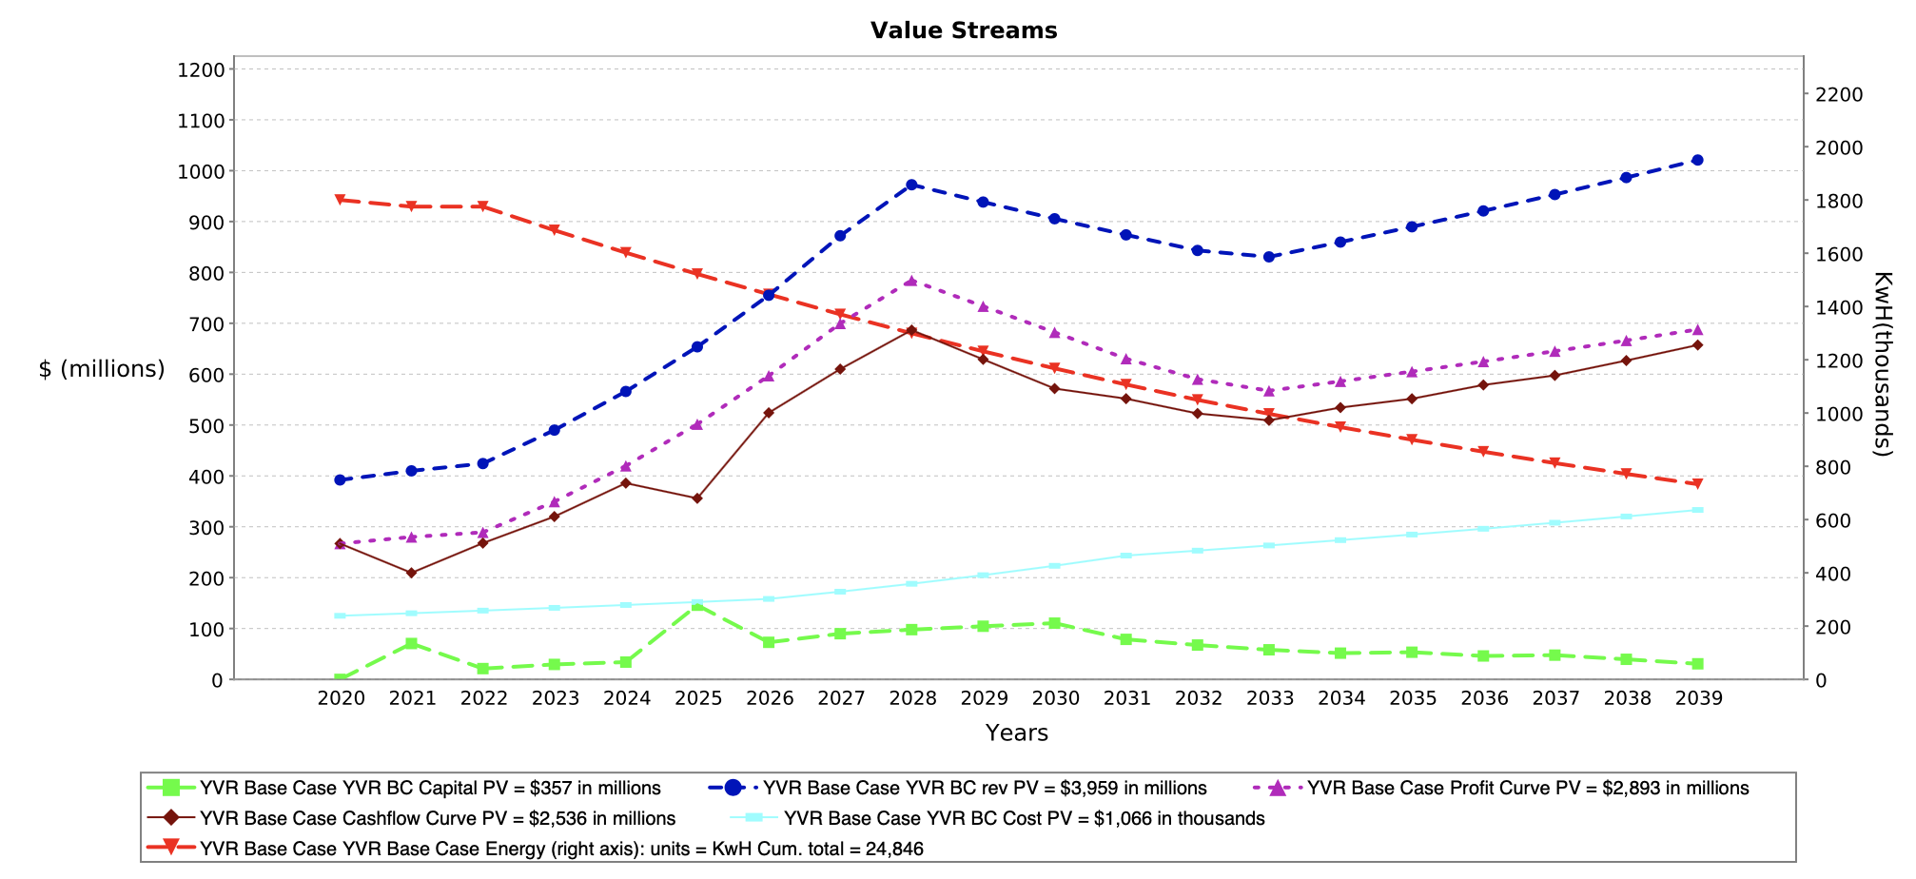
Modelling value streams

Slide 7
Value Creation Continuum
Narrower
Broader
From the perspective of the organization itself
From the perspective of all stakeholders. (This brings in sustainability and social impact)
From the perspective of investors and capital markets

Slide 8
3. Focus on value creation decisions and solutions (versus reporting / disclosure)

Slide 9
Focus on value creation decisions and solutions
CPA Canada initial value creation priority is helping CPAs play leadership roles in forward-looking value-creation-related decisions in the organizations they work with
All decisions involve choices among alternatives
Good decisions require good information
Decisions should be supported by measures that clarify the consequences of alternative decisions, at the highest level of precision that is practicable
CPAs are at core, measurement professionals
Our challenge and opportunity is to help CPAs expand their recognized skillset beyond measuring financial performance to include all aspects of measurement relevant to value creation decisions

Slide 10

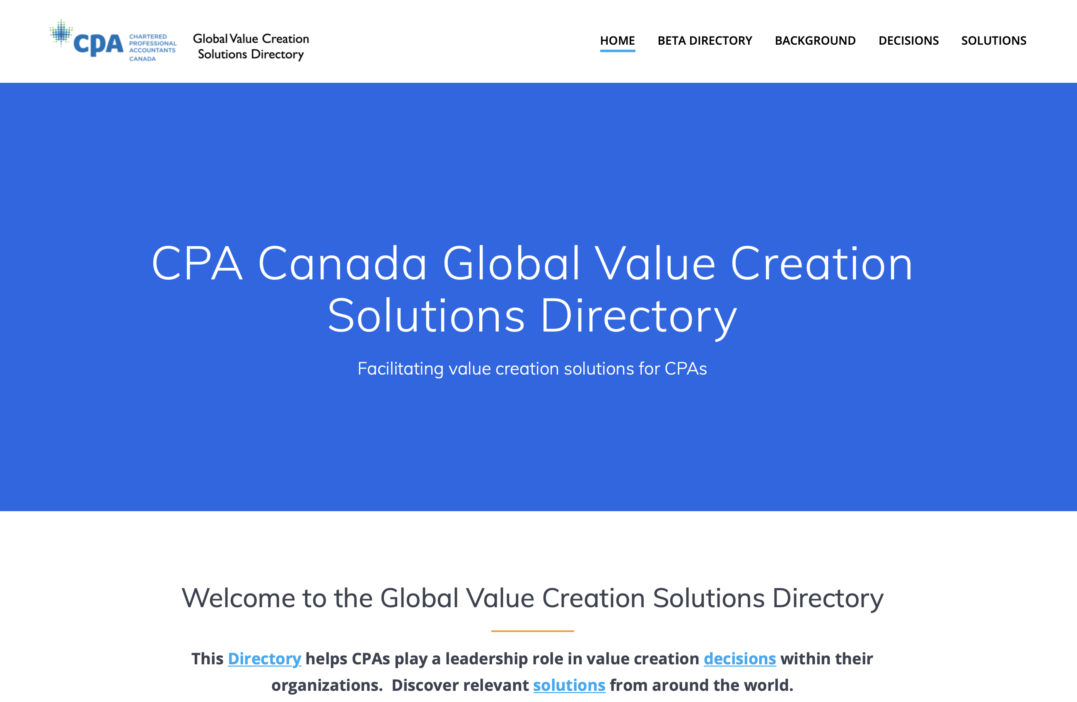
Focus on value creation decisions and solutions

Slide 11
Value Creation Solutions Measurement Analysis
Implementation requires quantitative measurement | 75%
Proponent provides guidance on what to measure | 68%
Proponent provides technical guidance on valid measurement | <10%

Slide 12
Value Creation Solutions Measurement Analysis
Principal measurement categories
1. Intangibles / Intellectual Capital / Data
2. The Capitals
3. Indicators / Metrics
4. Monetized impacts
5. Future value streams and events

Slide 13
4. Measurement fundamentals
“Measurement fundamentals” refers to the principles that underlie valid measures. Measurement approaches that violate these principles can be misleading, incomplete, inaccurate, and lead to conclusions and decisions that differ from those that would be reached based on valid and precise measures
• What are the key ingredients for valid measurement?
  Like objects of measurement (e.g. apples to apples)
  Like properties of measurement (e.g. quantity versus roundness versus cost, etc.)
  Like unit of measure (quantity, currency, etc.)
  Like precision based on the scale (e.g. nominal, ordinal, interval, ratio)
  Commensurability: when can I validly add or subtract one measure from another?
  Measurement fundamentals are “baked in” to the traditional transaction-centric accounting paradigm, but need to be specifically considered outside that paradigm

Slide 14
5. Applying measurement fundamentals to value creation solutions: emerging insights
The transaction-centric accounting paradigm
Many people assume that accounting measures assets and liabilities, but this is incorrect.
The principal object that traditional accounting measures is a transaction
The property measured is transaction value (which could be counted as revenue or cost)
The unit of measure is currency as of the date of the transaction
The scale and precision for currency is ratio
The fact that traditional accounting measures are based on third-party transactions is arguably one of its greatest strengths as well as its most important inherent limitation, if what we want to measure cannot be measured using a transaction (such as value creation in advance of its realization through a transaction)

Slide 15
Intangibles
Applying measurement fundamentals to value creation solutions: emerging insights
Intangibles that arise from a transaction, and self-generated intangibles that meet specific criteria may appear on balance sheets measured at cost (or less if value impaired)
For most intangibles the concept of market or fair value doesn’t apply for three main reasons:
  Many intangibles are non-tradeable (company culture, reputation, etc.)
  Even for tradeable intangibles (e.g. patents, data), comparable market values rarely exist
  For most intangibles, the value streams they can generate depends on context, and most have limited value outside a relevant context. To illustrate, the value Patent A can generate for Company B differs from that it could generate for Company C depending on each company’s “complementary business assets”. Patent A on its own has very limited value.
The value concept that does work for intangibles is “incremental value-in-use” based on the extent to which an intangible contributes to future value streams in the company context(s)
Advocacy efforts promoting better disclosure of intangibles should focus on supplementary information about intangibles, including cost and incremental value-in-use

Slide 16
The Capitals
Applying measurement fundamentals to value creation solutions: emerging insights
With the exception of financial capital (for which the underlying object is transactions), the other capitals (which depending on the specific framework may include manufactured, intellectual, human, social and relationship, and natural) are constructs, not objects that can be measured
If these constructs are disaggregated sufficiently to become measurable, the underlying objects, properties, and units of measure are diverse and not commensurable. So while thinking about the stocks of capitals works as a conceptual analogy and supports value creation from a process perspective, it is not technically possible to measure the value of stocks of non-financial capitals in a valid way
As a result, quantitative measures related to the capitals are usually expressed as metrics or indicators
From a value measurement perspective, it may be easier to quantify many of the underlying components of the capitals as flows (aka value streams) than stocks

Slide 17
Metrics and Indicators Frameworks (including ESG frameworks)
5. Applying measurement fundamentals to value creation solutions: emerging insights
There are two principal technical measurement challenges that arise related to any framework of metrics or indicators
  Given that a framework is necessarily selective and arbitrary based on the chosen metrics or indicators, how can we know that the framework “faithfully represents” the underlying reality?
  How does a user achieve a “holistic perspective” on value or performance from a framework of metrics or indicators? In accounting, comparing composite values such as net income, net assets, and net cash flow provides a holistic perspective on overall financial performance, and whether overall financial performance is getting better or worse over time. How does one achieve a similar overall understanding from a metrics or indicators framework?
There is a tension between these factors: more comprehensive and complex frameworks are more likely to better reflect the underlying reality, but the more comprehensive and complex the framework, the more difficult it is for a user to achieve a holistic overall perspective on that underlying reality

Slide 18
Monetizing impacts
Applying measurement fundamentals to value creation solutions: emerging insights
Monetizing impacts typically involves a string of measures, assumptions and conversions to represent ecosystem or social impacts in units of currency. For the end result to be valid in relation to measurement fundamentals, each step in the process must be valid.
How precise can monetized impacts be? For instance, if monetizing impacts were to involve a string of 5 calculations, a +/-10% error at each stage could result in a cumulative error of more than 100%.
In many cases, the resulting level of precision can be better expressed as a range estimate than a point estimate
Attempts to add or subtract transaction-based values and impact-based values creates a commensurability issue, since these are different measurement objects
Will the resulting values be sufficiently valid so as to be reliable for decision-making purposes? How do we ensure that users can have sufficient and justified confidence in the results so as to be able to use them for decision-making purposes?

Slide 19
Future value streams and events
5. Applying measurement fundamentals to value creation solutions: emerging insights
The concept of “event-based value streams” was developed as a methodology for measuring value creation, analogous to the way value realization is measured using transactions. Value streams can be financial and non-financial, and measured from the perspective of the organization and stakeholders
Modelling future value streams involves inherent uncertainty. (As the famous catcher Yogi Berra said, “It's tough to make predictions, especially about the future.”)
Methods to deal with this uncertainty include:
    Linking assumptions to events
    Full disclosure of assumptions and events
    Enabling users to view the results of substituting their own assumptions and events
    Sensitivity analysis
    Exploring alternative scenarios
    Tracking the ratio of past and future events influencing a model
    Attaching probability distributions to events and scenarios
  While financial value streams can be aggregated, developing a holistic perspective on multiple non-financial value streams remains a challenge, similar to that discussed above related to metrics and indicators frameworks

Slide 20
6. Opportunities for collaboration to strengthen measurement in ESG and other contexts
CPA Canada is eager to collaborate with proponents of value creation solutions and measurement approaches to enhance validity and precision to support decision-makers
ESG
Developing criteria for testing the degree to which ESG metrics or indicators frameworks are valid representations of underlying reality
Exploring ways to enhance users’ ability to obtain a holistic perspective from a ESG metrics or indicators framework
Developing methods for testing that monetized impacts are sufficiently valid and precise to support decisions
Other
Working toward generally-accepted methods for modelling incremental value-in-use for various types of intangibles
Exploring the potential to measure components of the capitals as flows / value streams
Working toward generally-accepted methods for modelling event-based value streams

Slide 21

Insights arising from applying measurement fundamentals to value creation solutions:
implications for ESG reporting
Thanks for listening, and we look forward to the ongoing discussion today, and in and the future
CPA Canada’s work on value creation is continuing, including forthcoming publications on measurement, data value, the Global Value Creation Solutions Directory, as well as additional future initiatives. Stay tuned!

