Slide 1

Low-carbon strategies and value creation
Professional Accounting Centre 2020 Conference
October 22-23, 2020

Slide 2
Evolution of ESG Financial Reporting
1934: Securities and Exchange Commission established in the United States.
1935: Registered companies must issue financial statements annually.
1950s: American Institute of CPAs, Generally Accepted Accounting Principles, Financial Accounting Standards Board develop and transform financial reporting.
  As recently as 2017, there are new accounting standards.
2001: International Accounting Standards Board formed to unify reporting across countries and adopt international reporting standards.

Slide 3
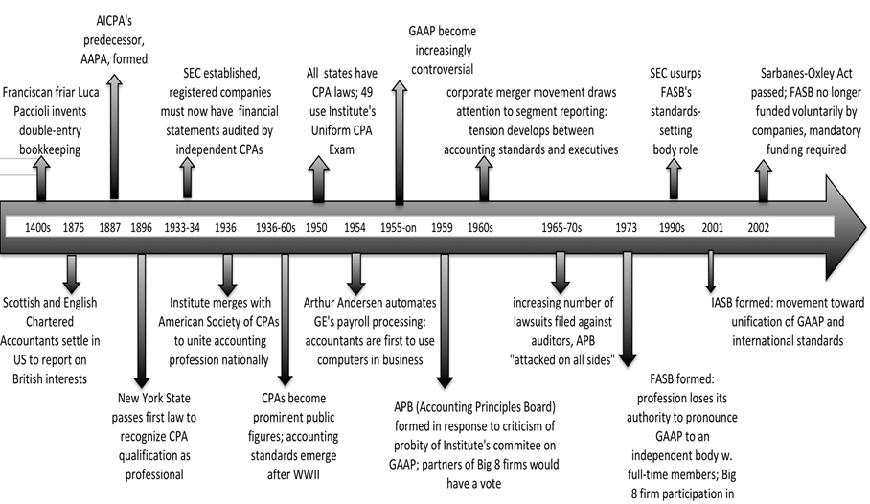
Evolution of ESG Financial Reporting
A Brief History of Financial Reporting: Major Developments

Slide 4
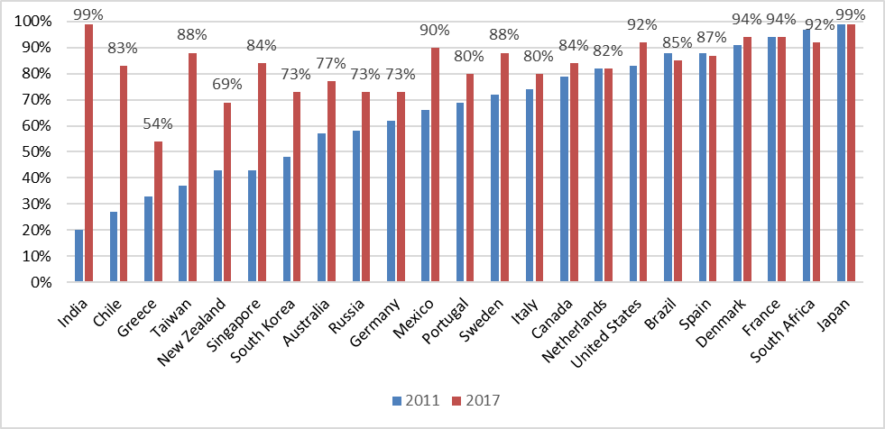
National Rates of ESG Reporting, % of Public Companies
Source: Data from ‘The KPMG Survey of Corporate Sustainability Reporting 2017’

Slide 5
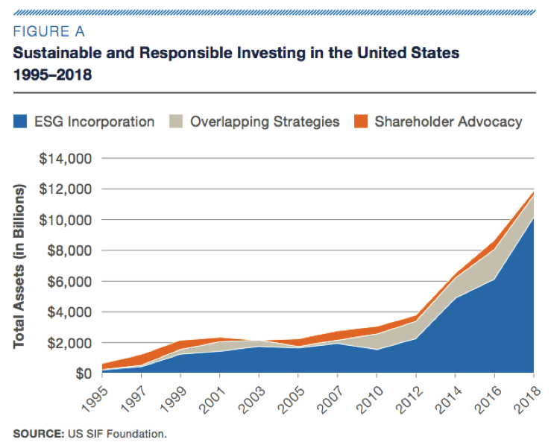
Investor Demand for ESG Reporting
In the U.S., 1 out of every 4 dollars invested under professional management is in sustainable, responsible and/or impact investments.

Slide 6
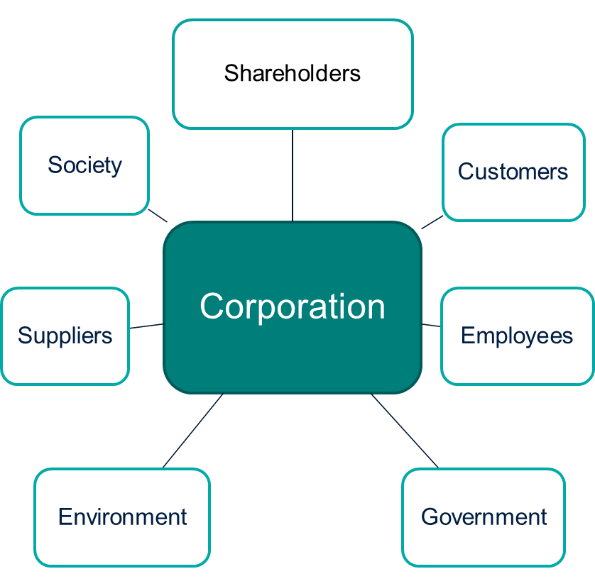
Drivers of ESG Reporting: Accountability

Slide 7
Drivers of ESG Reporting: Accountability
Accountability demands grow stronger as businesses become more powerful.
  Largest 500 corporations in the world represent around 50% of all sales and assets of the approx. 60,000 publicly-listed firms in the world.
  # of publicly traded firms more than doubled from 26K in 1990 to 60K in 2018; market capitalization increased >6x from $11T to $70T over same period.

Slide 8
Drivers of ESG Reporting: Value Relevance
Value relevance thesis of ESG information:
  Companies should supplement accounting information with other nonfinancial information that is of interest to shareholders.
  Financial information is incomplete because it is a lagging indicator of firm performance.
    Nonfinancial information (e.g., how companies are managing risks/opportunities relating to climate change) could provide insights into future financial performance.

Slide 9

Drivers of ESG Reporting: Value Relevance
2019 survey by Association of Chartered Certified Accountants:
  2/3 of 300 investors reported that they found corporate financial reports inadequate.
  45% did not see the value of financial reports.
    Insufficient information to understand value creation process within organizations.
  90% expressed interest in an integrated report incorporating financial and nonfinancial information that would provide a more holistic view of the likely direction of future corporate performance.

Slide 10
ESG Reporting Challenges
Survey of over 400 senior investment professionals:
  Impediments
    Lack of reporting standards
    Lack of comparable data across firms and time
Source: Why and How Investors Use ESG Information: Evidence from a Global Survey (2018). Amel-Zadeh, A. & Serafeim, G. Financial Analysts Journal 74(3):87-103.

Slide 11
Regulatory Forces Behind ESG Reporting
Mandatory ESG Disclosure Requirements & Voluntary ESG Reporting Guidelines
 | Government |  | Stock Exchange
 | Mandatory | Voluntary | Mandatory | Voluntary
UK | x | x |  | x
Japan | x | x
India | x | x |  | x
France | x
Denmark | x | x | x
South Africa | x | x | x | x
Mexico | x | x
Taiwan | x |  |  | x
Sweden | x | x
Spain | x | x
Brazil | x |  |  | x
Singapore | x | x | x | x
Canada | x | x | x
Chile | x | x
The Netherlands | x | x
Portugal | x | x
Italy | x | x
Australia | x | x | x | x
South Korea | x | x
Russia | x
Germany | x | x |  | x
Greece | x

Slide 12
How do investors react to mandated ESG disclosure?
We study investor reactions to Directive 2014/95/EU – the largest mandatory ESG disclosure regulation to date – which passed in 2014 and affected ~6,000 companies in the EU.
Three primary insights:
  Announcement of mandated ESG reporting was economically significant, generating a response from investors.
  Average market rxn is -0.79% of market value ($79m USD on average) across our sample events.
Source: Market Reaction to Mandatory Nonfinancial Disclosure (2018). Grewal, J., Riedl, E. & Serafeim, G. Management Science 65(7): 2947-3448.

Slide 13
How do investors react to mandated ESG disclosure?
Three primary insights:
  3. While investors expect costs > benefits, costs are concentrated in firms with weaker pre-regulation ESG performance and disclosure.
  Competitive dynamics: Investors expect firms with strong pre-reg. ESG performance to benefit because weak ESG firms incur higher costs to practice business as usual (for example, through penalties) or to improve ESG.
Source: Market Reaction to Mandatory Nonfinancial Disclosure (2018). Grewal, J., Riedl, E. & Serafeim, G. Management Science 65(7): 2947-3448.

Slide 14
How do companies respond to mandated ESG disclosure?
Regulators use mandated disclosure to change firm behavior; research shows that firms improve ESG performance following mandated reporting.
But how effective is this policy tool when firms are already voluntarily disclosing?
  2018: >8,000 firms reported ESG information absent regulation forcing them to do so.
  Research Question: Does mandated ESG reporting change the behaviors of already-disclosing firms?
Source: Real Effects of Disclosure Regulation: Evidence from Mandatory Carbon Reporting. (2020). Grewal, J. Working paper.

Slide 15
How do companies respond to mandated ESG disclosure?
Listed companies in the United Kingdom must report greenhouse gas emissions (GHG) in annual reports starting in 2013 → Mandatory Carbon Reporting (MCR)
~50% of 1,000 covered firms voluntarily-disclosed GHG prior to MCR
Estimate incremental effects of regulation over voluntary disclosure

Slide 16
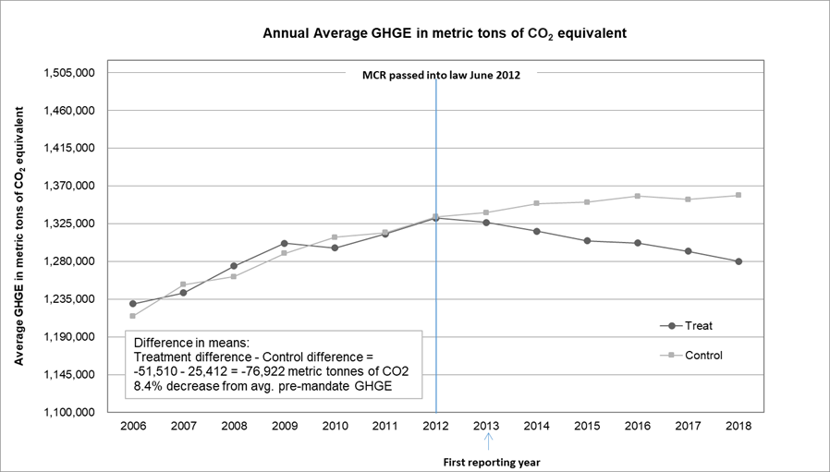
How do companies respond to mandated ESG disclosure?
Firms voluntarily disclosing GHG prior to regulation reduce their GHG levels (8.5%) and intensity (10.5%) following mandated reporting.

Slide 17
How do companies respond to mandated ESG disclosure?
Cross-sectional tests:
  GHG level-ranking change from before to after mandated reporting predicts subsequent GHG reductions.
    Effect is stronger for firms with higher climate change reputational risks → competitive benchmarking.
  Takeaway: Disclosure regulation can be an effective policy tool to affect ESG outcomes even among already-disclosing firms.

