Slide 1
Non-GAAP Reporting: What does it say about the relevance of GAAP income statements?
Ted Christensen
University of Georgia
University of Toronto PAC Conference
September 13, 2019

Slide 2
Complexity and Relevance
Complex
Business
Environment
Complex
Accounting Standards
Standardized Financial Statements
Technology
Rapid communication
Global competition
Evolving consumer demand
Various user groups
Different informational needs
Constantly changing environment
Does one size fit all?
Can different user groups benefit uniformly from standard financial reports?

Slide 3
Complexity and Relevance
Complex
Business
Environment
Complex
Accounting Standards
Standardized Financial Statements
Non-GAAP Performance Metrics

Slide 4
Non-GAAP Performance Metrics
GAAP
Standards
Regulatory Scrutiny
Analysts’ Focus
Non-GAAP
Reporting
Rival
Focus
Investor Demand
Industry Standards
Manager Preference

Slide 5
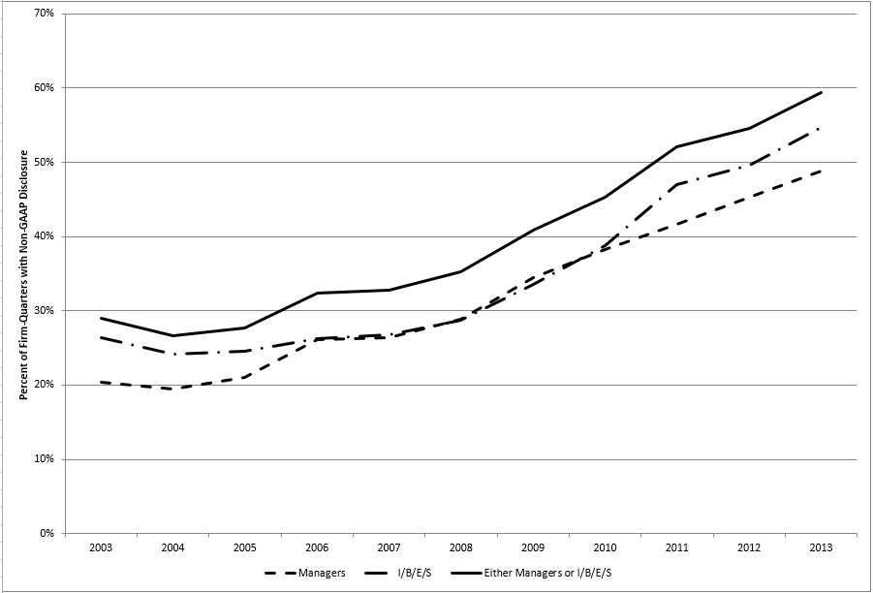
How does this paper fit into the Non-GAAP Reporting Literature?

Slide 6
My Soapbox:
SEC
Non-GAAP
Reporting
FASB
PCAOB

Slide 7
My Soapbox:
Maybe some of the C&DIs are too stringent?
Best kind of reconciliation is side-by-side income statements
Not all recurring exclusions are bad
Requiring consistency over time may not be the best policy.
SEC
Non-GAAP
Reporting
FASB
PCAOB

Slide 8
My Soapbox:
SEC
More disaggregation can:
Allow users to better understand manager-disclosed non-GAAP metrics
Calculate customized non-GAAP numbers that meet their needs.
Non-GAAP
Reporting
FASB
PCAOB

Slide 9
My Soapbox:
SEC
Has the time come for auditors to play a direct role?
Maybe a formal review?
Not attestation.
Non-GAAP
Reporting
FASB
PCAOB

Slide 10
Thank you!

