Slide 1
The Relevance of Non-Financial Key Performance Indicators (KPIs)
Bingxu Fang, Partha Mohanram and Dushyant Vyas
Professional Accounting Centre
University of Toronto
Sept 13, 2019

Slide 2
Motivation
Markets increasingly rely on KPIs outside the scope of traditional financial statements

Slide 3
Need for Nonfinancial KPIs?
KPIs are leading indicators of future financial performance: Traditional financial statement metrics (GAAP and non-GAAP) may not reflect underlying business developments on a timely basis
KPIs are customizable: Value drivers vary not only across, but within industries. Disclosure and use of nonfinancial KPIs can be contextualized
  For example, same-store sales growth for retailers, passenger load factor and cost per seat mile for airlines, the value of new orders and value of order backlog for homebuilders, and the number of restaurants opened/closed for restaurant chains

Slide 4
Our Objectives
To examine the value relevance of a large set of industry specific non-financial KPIs
To study the efficacy of a fundamental analysis strategy using KPIs to screen firms in multiple industries
To study cross-sectional and inter-temporal variation in (1) and (2) based on firm- and KPI characteristics

Slide 5
Measurement Approach
We assemble a dataset of industry-specific KPIs from S&P Capital IQ, which has a broad coverage over ten industries (airlines, retail, homebuilding, hotel, internet, oil and gas, restaurant, semiconductor, telecom, and pharmaceutical industries)
The resultant firm-year level sample focusses on U.S. firms from 2011 to 2016
Allocate all the KPIs into two broad categories:
  Efficiency: considering whether they are associated with cost or asset deployment efficiency
  Growth: Indicating growth in sales and/or assets
We then construct KPI scores for each firm and each category, denoted as K-Efficiency and K-Growth

Slide 6
Measurement Approach
Primary measurement challenge: Lack of standardization in measurement and disclosure of KPIs even within the same industry
Our approach:
  We select up to five KPIs with maximum available observations for each KPI category and industry, and then calculate the change in each variable relative to the prior year
  We next create a binary variable for each KPI that equals one (zero) if the corresponding KPI increases (decreases or remains constant) year-on-year
  Create the KPI scores as the average value of the indicators for each firm-year
  Tradeoff: Collapsing each KPI into a 0/1 binary variable forces standardization, but loss of relevant continuous information

Slide 7
Empirical Analyses

Slide 8
Association with Future Accounting Performance
K-efficiency is positively associated with future ROA
Table 3: One-Year-Ahead ROA and KPI Indices
 | (1) | (2) | (3) | (4)
VARIABLES | One-Year-Ahead ROA
Size | 0.007*** | 0.007*** | 0.004 | 0.007***
 | (4.24) | (4.34) | (1.47) | (4.15)
Loss | 0.007 | 0.007 | 0.008 | 0.007
 | (0.81) | (0.79) | (0.76) | (0.81)
ROA | 1.025*** | 1.027*** | 1.005*** | 1.024***
 | (25.48) | (25.45) | (12.25) | (25.36)
ROA*Loss | -0.456*** | -0.458*** | -0.739*** | -0.455***
 | (-6.45) | (-6.46) | (-6.39) | (-6.44)
K-Growth |  | -0.007
 |  | (-0.93)
K-Efficiency |  |  | 0.026***
 |  |  | (3.64)
K-Total |  |  |  | 0.006
 |  |  |  | (0.71)
Constant | -0.094*** | -0.092*** | -0.074*** | -0.096***
 | (-6.00) | (-5.63) | (-2.87) | (-5.91)
Observations | 1,933 | 1,908 | 823 | 1,933
Fixed Effects | Industry | Industry | Industry | Industry
Clustering | Firm | Firm | Firm | Firm
Adj. R-squared | 0.705 | 0.705 | 0.493 | 0.705
As K-Efficiency increases from 0 to 1, ROA increases by 2.6%

Slide 9
Association with Future Accounting Performance
K-efficiency is positively associated with sales growth
Table 4: Future Sales Growth and KPI Indices
 | (1) | (2) | (3) | (4)
VARIABLES | One-Year-Ahead Sales Growth
Size | 0.007 | 0.003 | -0.009 | 0.003
 | (0.92) | (0.40) | (-0.88) | (0.42)
Sales | -0.000*** | -0.000** | -0.000 | -0.000**
 | (-2.63) | (-1.99) | (-0.78) | (-2.06)
K-Growth |  | 0.089
 |  | (1.63)
K-Efficiency |  |  | 0.067***
 |  |  | (2.86)
K-Total |  |  |  | 0.091
 |  |  |  | (1.42)
Constant | 0.016 | -0.012 | 0.084 | -0.010
 | (0.27) | (-0.21) | (1.08) | (-0.19)
Observations | 1,933 | 1,908 | 823 | 1,933
Fixed Effects | Industry | Industry | Industry | Industry
Clustering | Firm | Firm | Firm | Firm
Adj. R-squared | -0.00143 | 0.000209 | 0.0383 | -0.000426
As K-Efficiency increases from 0 to 1, Sales Growth increases by 6.7%

Slide 10
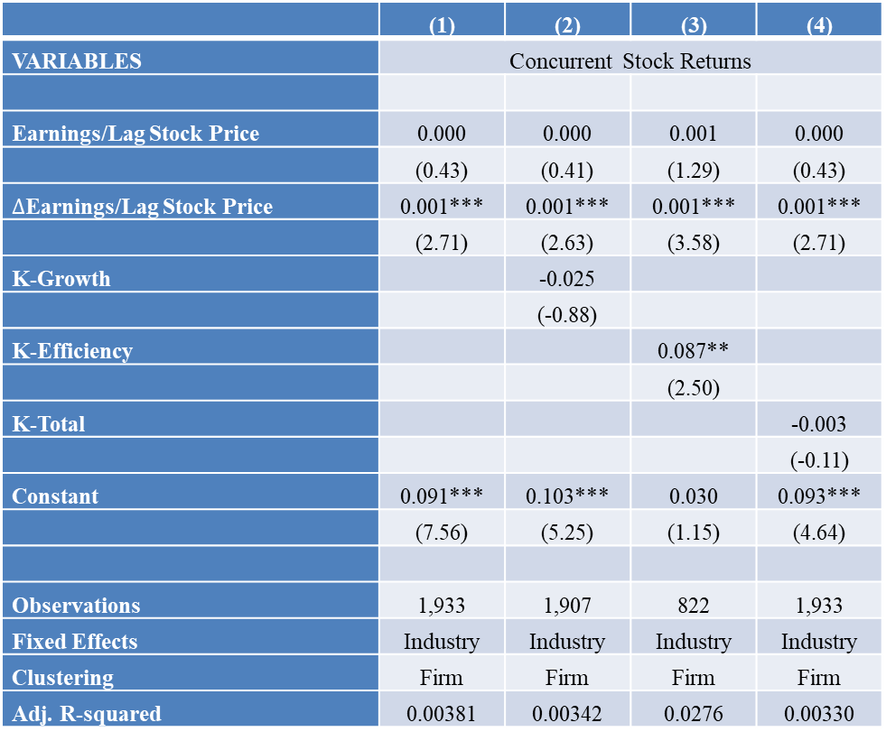
Association with Concurrent Stock Returns
K-efficiency is positively associated with concurrent stock returns
 | (1) | (2) | (3) | (4)
VARIABLES | Concurrent Stock Returns
Earnings/Lag Stock Price | 0.000 | 0.000 | 0.001 | 0.000
 | (0.43) | (0.41) | (1.29) | (0.43)
$∆$Earnings/Lag Stock Price | 0.001*** | 0.001*** | 0.001*** | 0.001***
 | (2.71) | (2.63) | (3.58) | (2.71)
K-Growth |  | -0.025
 |  | (-0.88)
K-Efficiency |  |  | 0.087**
 |  |  | (2.50)
K-Total |  |  |  | -0.003
 |  |  |  | (-0.11)
Constant | 0.091*** | 0.103*** | 0.030 | 0.093***
 | (7.56) | (5.25) | (1.15) | (4.64)
Observations | 1,933 | 1,907 | 822 | 1,933
Fixed Effects | Industry | Industry | Industry | Industry
Clustering | Firm | Firm | Firm | Firm
Adj. R-squared | 0.00381 | 0.00342 | 0.0276 | 0.00330
As K-Efficiency increases from 0 to 1, concurrent stock return increases by 8.7%
Value implications immediately impounded in current returns

Slide 11
Association with Future Stock Returns
On average, K-scores are not related to future stock returns
Table 6: One-Year-Ahead Returns and KPI Indices
 | (1) | (4) | (5)
VARIABLES | One-Year-Ahead Return
Size | -0.008* | -0.010 | -0.008*
 | (-1.70) | (-1.19) | (-1.76)
ROA | 0.114 | -0.351* | 0.114
 | (1.44) | (-1.93) | (1.45)
BTM | 0.044** | 0.029 | 0.045*
 | (1.97) | (0.85) | (1.96)
Momentum | 0.046 | 0.032 | 0.043
 | (1.56) | (0.89) | (1.48)
K-Growth | 0.043
 | (1.43)
K-Efficiency |  | 0.021
 |  | (0.60)
K-Total |  |  | 0.043
 |  |  | (1.26)
Constant | -0.017 | 0.008 | -0.013
 | (-0.44) | (0.10) | (-0.34)
Observations | 1,908 | 823 | 1,933
Fixed Effects | Industry | Industry | Industry
Clustering | Firm | Firm | Firm
Adj. R-squared | 0.0251 | 0.0563 | 0.0248
Robust t-statistics in parentheses
*** p<0.01, ** p<0.05, * p<0.1
Value implications immediately impounded in current returns

Slide 12
Association with Future Stock Returns: Cross-sectional Analyses
Potential mispricing for small firms
 | (1) | (2) | )
VARIABLES | One-Year-Ahead Abnormal Returns
 | Small Firms
Size | 0.043 | -0.095** | 0.041
 | (1.17) | (-2.23) | (1.15)
ROA | 0.139 | -0.359* | 0.136
 | (1.07) | (-1.94) | (1.05)
BTM | 0.048 | 0.071 | 0.048
 | (1.04) | (0.95) | (1.06)
Momentum | 0.054 | 0.053 | 0.051
 | (1.02) | (0.49) | (0.99)
K-Growth | 0.183*
 | (1.80)
K-Efficiency |  | 0.404**
 |  | (2.45)
K-Total |  |  | 0.220**
 |  |  | (2.20)
Constant | -0.225 | 0.102 | -0.232*
 | (-1.64) | (0.57) | (-1.71)
Observations | 468 | 73 | 475
Fixed Effects | Industry | Industry | Industry
Clustering | Firm | Firm | Firm
Adj. R-squared | 0.0137 | 0.0691 | 0.0168
Robust t-statistics in parentheses
*** p<0.01, ** p<0.05, * p<0.1
Value implications not immediately impounded in current returns for small firms → reflected in future returns
Increasing K-Total from 0 to 1 leads to 22% one-year ahead excess returns

Slide 13
Association with Future Stock Returns: Cross-sectional Analyses
Potential mispricing for firms with no analyst coverage
 | (1) | (2) | (3)
VARIABLES | One-Year-Ahead Abnormal Returns
 | No Coverage Firms
Size | -0.013 | -0.044 | -0.018
 | (-0.51) | (-1.41) | (-0.71)
ROA | -0.019 | -0.292 | -0.040
 | (-0.12) | (-1.43) | (-0.27)
BTM | 0.078* | 0.085 | 0.089**
 | (1.91) | (1.12) | (2.10)
Momentum | 0.015 | -0.049 | -0.001
 | (0.20) | (-0.44) | (-0.01)
K-Growth | 0.059
 | (0.86)
K-Efficiency |  | 0.309*
 |  | (1.92)
K-Total |  |  | 0.155*
 |  |  | (1.75)
Constant | -0.043 | 0.014 | -0.067
 | (-0.32) | (0.09) | (-0.51)
Observations | 162 | 54 | 162
Fixed Effects | Industry | Industry | Industry
Clustering | Firm | Firm | Firm
Adj. R-squared | 0.0244 | 0.0400 | 0.0417
Value implications not immediately impounded in current returns for no-coverage firms → reflected in future returns
Increasing K-Total from 0 to 1 leads to 15.5% one-year ahead excess returns

Slide 14
Association with Future Stock Returns: Cross-sectional Analyses
Potential mispricing for firms with low institutional ownership
 | (1) | (2) | (3)
VARIABLES | One-Year-AheadAbnormal Returns
 | Low IO Firms
Size | -0.035** | -0.057*** | -0.035**
 | (-2.28) | (-2.75) | (-2.36)
ROA | 0.159 | -0.258 | 0.162
 | (1.12) | (-1.28) | (1.15)
BTM | 0.073** | 0.025 | 0.079***
 | (2.51) | (0.60) | (2.68)
Momentum | 0.034 | -0.032 | 0.031
 | (0.83) | (-0.45) | (0.78)
K-Growth | 0.119**
 | (2.17)
K-Efficiency |  | 0.055
 |  | (0.84)
K-Total |  |  | 0.133**
 |  |  | (2.09)
Constant | -0.002 | 0.279 | -0.004
 | (-0.02) | (1.65) | (-0.05)
Observations | 519 | 229 | 533
Fixed Effects | Industry | Industry | Industry
Clustering | Firm | Firm | Firm
Adj. R-squared | 0.0415 | 0.0970 | 0.0452
Value implications not immediately impounded in current returns for no-coverage firms → reflected in future returns
Increasing K-Total from 0 to 1 leads to 13.3% one-year ahead excess returns

Slide 15
KPI-based Trading Strategy?
Positive abnormal returns on-average during 2011-2016; positive returns in 5 out of 6 years
Caveat: Results subject to sample size and time-period restrictions
Panel A: Returns to Hedge Strategy based on K-Total
 | Small Firms |  | No Coverage Firms |  | Low IO Firms
Portfolios | Mean | Obs | Mean | Obs | Mean | Obs
1 | -7.69% | 253 | -6.37% | 69 | -13.96% | 172
2 | 13.00% | 140 | -5.46% | 44 | -9.55% | 185
3 | 6.87% | 82 | 8.47% | 49 | -1.75% | 176
3-1 | 14.56% |  | 14.84% |  | 12.21%
t-stat | 1.77 |  | 1.72 |  | 2.34
p-value | 0.0768 |  | 0.0874 |  | 0.0195

Slide 16
Conclusion and Policy Implications
Evidence on large sample relevance of KPIs
  Leading indicators of future accounting performance
  On-average, relevant to equity investors
Market seems to understand the importance of KPIs, but less so for small firms with low analyst coverage
Policy question: Would standardization of KPIs help investors better understand the value implications of KPIs?
Ongoing/future research:
  Variation in standardization of existing KPIs
  Relevance in other settings (e.g., debt markets, M&A, compensation contracts)

Slide 17
Thank you

