Slide 1
Complexity & Relevance: Are they unresolvable Challenges to Accounting Standards?
PAC Annual Conference
September 13, 2019
The views expressed in this presentation are those of the presenter, not necessarily those of the AcSB.

Slide 2

Need for quality performance measures
Do you report:
  measures on how your organization creates and realizes value?
  operational measures besides GAAP information?
  measures transparently?

Slide 3
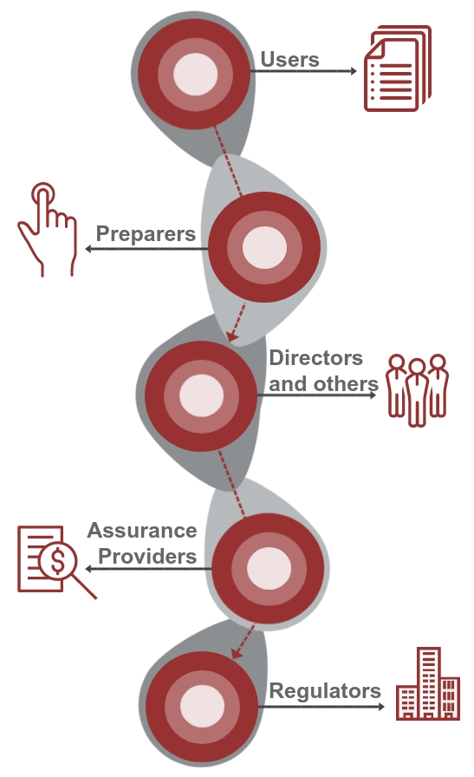
Reporting Performance Measures
For profit & not-for-profit entities
  Enhance the relevance of information users rely on to
  make resource allocation decisions
    From non-GAAP to operational measures
  We each have a role to play
Download the
Framework and other resources

Slide 4

Making non-GAAP measures more comparable?
IASB’s Primary Financial Statement Project
Proposing to require
  Use of additional subtotals
  Disclosure of management performance measures
To balance the needs of management and users

Slide 5
For more information, visit www.frascanada.ca
Contact
Nancy Anderson, AcSB member
Rebecca Villmann
Director, Reporting Initiatives and Research
rvillmann@frascanada.ca

