Slide 1
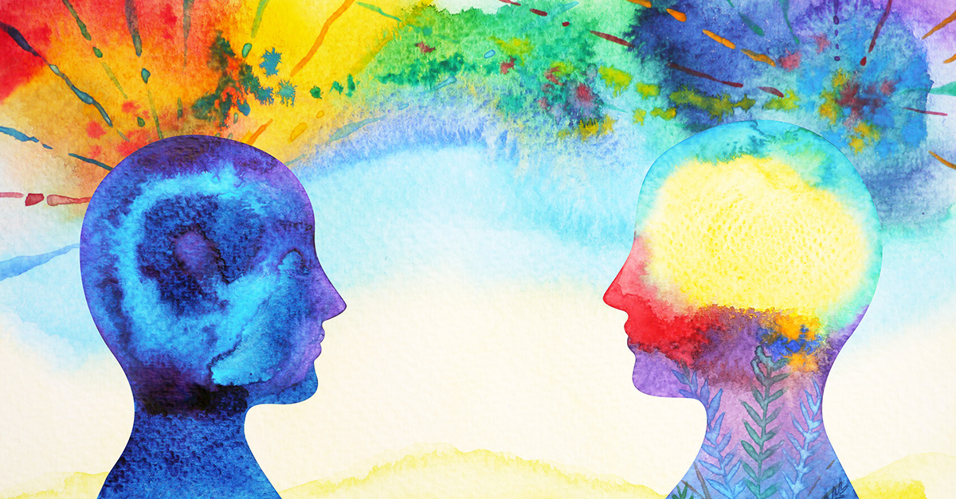
CPA Canada Foresight: Reimagining Accounting
for the Information Age
Board of directors
March 6, 2018
Private and confidential
Notes:
Good day and thank you for giving me an opportunity to speak with you today about a new significant project we have started at CPA Canada. Its called Foresight and its focus is on reimagining the accounting profession both within Canada and hopefully globally as well.

Slide 2
Project Timeline
Phase 2
July - September
Phase 4
January – March 2019
Engage stakeholders into building case for change, sense of urgency, highlight potential impact of key drivers of change
Develop strategy to address identified themes and scenarios
1
2
3
4
5
Phase 1
April - August
Phase 3
October - December
Phase 5
Post March 2019
Initial framing of mandate and identification of key participants
Scenario planning and scenario building
Implementation and Ongoing Monitoring
Notes:
As you can see from this slide this is a very ambitious process with a very aggressive timeline.

Slide 3
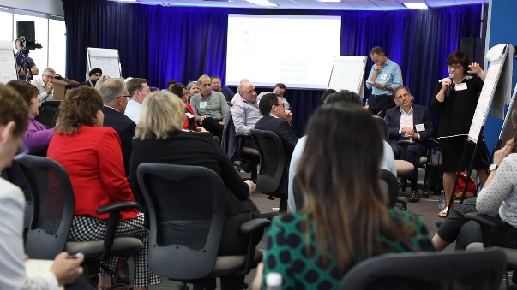
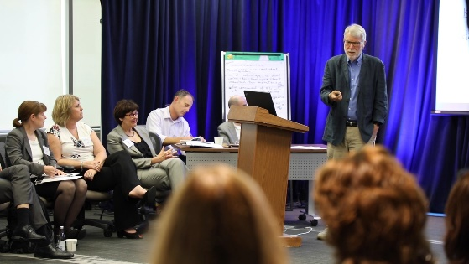
Framing the Issues
We are operating in the white water world
Data is the most significant global flow and subject to the least amount of governance and regulation
Investors and financial institutions are relying
less on historical financial statements
Enhanced technologies, processing results in real time and the proliferation of data are disrupting the accounting profession
Sustainability is good business
We are not alone in struggling with these issues
Notes:
We had some very interesting insights from our speakers:
Our first speaker talked about the world in which we operate – once upon a time business was like a steamship – you set a course and steamed to that beacon. Then business moved to more of a sailboat – needing to jibe and tack along the way but the world today is more like a white water – to successfully navigate you need to look beneath the surface and read the currents.
We also talked about data – and the challenges to the global flows. We heard about Moore’s law and the power of exponentials in the acceleration of change.
We had presenters from the medical profession discussing how change is affecting their work.
We learned a lot about sustainable business and how building in climate resiliency is good for business.
Finally, we talked a lot about technological change and in particular the impact on business of real time financial data.

Slide 4

What are scenarios?
  “Scenarios are stories about the ways that the world might turn out tomorrow…
  …that can help us recognize and adapt to changing aspects of our current environment”
  Peter Schwartz

Slide 5
Looking out to 2030: Critical Certainties
Ongoing developments in technology will continue
Investors are looking beyond financial information when assessing corporate value
Real-time business information and decision making
Exponential growth of data
Real concerns over climate change and sustainability
What factors will shape the world – and hence the profession?
Notes:
Strategic foresight is based on identifying critical certainties and critical uncertainties. The critical certainties are the things we know are going to happen … here are some things we are pretty certain are going to cut across all plausible futures…
Looking out to 2030, one of the questions the roundtable asked was “What factors might shape the world – and hence the profession.” Everyone agreed that clearly the ongoing developments in technology, including artificial intelligence and blockchain would impact the profession. But, so would digitization of information, as more and more data was being generated and used to make lending and investment decisions. It was also clear that data governance and standards were necessary to ensure the integrity of data being transferred from one party to the next.

Slide 6
Looking out to 2030: Critical Certainties
“We have actually had to slow our model down so customers don’t find it to be too fast.”
On Deck Lending
“I think where accounting can be very valuable is standards….Every company will define churn differently, will define metric X differently, but there are ways to hold these companies to a higher standard”
CPP Investment Board
Real time data impacting decision making
Notes:
Looking out to 2030, one of the questions the roundtable asked was “What factors might shape the world – and hence the profession.” Everyone agreed that clearly the ongoing developments in technology, including artificial intelligence and blockchain would impact the profession. But, so would digitization of information, as more and more data was being generated and used to make lending and investment decisions. It was also clear that data governance and standards were necessary to ensure the integrity of data being transferred from one party to the next.

Slide 7
Looking out to 2030: Critical Certainties
“Intangible assets now make up 84% of the market value of the S&P 500. That's up from just 17% in 1975. The generations of accountants before you could account for the vast majority of things that investors valued. Traditional accounting now accounts for a very small minority [of that]. “
–Jon Lukomnik,Executive Director of IIRC Institute and Managing Partner of Sinclair Capital
“Accountants count things. But that mindset of counting money needs to expand to looking at other sources of value—things like employee engagement, innovation, customer satisfaction, brand”
- Round Table Participant
New ways of measuring and reporting value
Notes:
Looking out to 2030, one of the questions the roundtable asked was “What factors might shape the world – and hence the profession.” Everyone agreed that clearly the ongoing developments in technology, including artificial intelligence and blockchain would impact the profession. But, so would digitization of information, as more and more data was being generated and used to make lending and investment decisions. It was also clear that data governance and standards were necessary to ensure the integrity of data being transferred from one party to the next.

Slide 8
Looking out to 2030: Critical Certainties
Climate change and sustainability
“Failure to value natural capital (air, water, land) has led to over consumption now (and bad public policy) to detriment of future generations (similar to government debt). Current consumption needs to be less than value created (inclusive of consumed natural capital) for a better future.”
-Digital Round Table Participant
“Failing to measure natural capital will continue to skew incentives and give an incomplete picture of true cost of economic activity. This could imperil nature and future generations. The earth’s natural capital is a finite resource that is not solely for the benefit of earth's current inhabitants.”
- Digital Round Table Participant
Notes:
Many participants, both digital and in the Roundtable recognized that the failure to measure natural capital continues to skew incentives and give an incomplete picture of the true cost of economic activity. Sustainability of economic prosperity and indeed of the planet will require us to measure the impact or consumption of natural capital in the creation of long term value. However, despite sustained efforts the profession has made little headway on environmental disclosure.
This

Slide 9
Looking out to 2030: Critical Uncertainties
Extent of global coordination or fragmentation?
How user needs might change?
Speed of adoption of new technology?
Extent and impact of inequality in society?
The nature of trust – in information, institutions, each other?
What factors might shape the world – and hence the profession?
Notes:
Many participants, both digital and in the Roundtable recognized that the failure to measure natural capital continues to skew incentives and give an incomplete picture of the true cost of economic activity. Sustainability of economic prosperity and indeed of the planet will require us to measure the impact or consumption of natural capital in the creation of long term value. However, despite sustained efforts the profession has made little headway on environmental disclosure.
This

Slide 10
Looking out to 2030: Critical Uncertainties
“Resist”
Low willingness / ability to adapt
“Embrace”
High willingness / ability to adapt
What is our reaction to transformative change? (technology advances, climate)

Slide 11
Looking out to 2030: Critical Uncertainties
Fragmented
Cohesive
What happens to ‘social capital’ by 2030?

Slide 12
Scenario Framework
Cohesive
Slow & Steady
Phoenix Rising
Resist
Embrace
My Way
Tech Titans
Fragmented

Slide 13
High
(priority is common good)
2. Phoenix Rising
A world where calamity inspires global cooperation and technology is harnessed for the common good: equitable, integrated, regulated, redistributive
1. Slow and Steady
A world where strong institutions guide decisions based on careful analysis: conservative, prudent, consensus-driven, standards-based
Low
Willingness to embrace Social/technological change
High
Cooperation, cohesion, social capital
4. My Way
A world where communities turn inward to protect local interests: protectionist, fragmented, community-focused
3. Tech Titans
A world where “wild west” innovation thrives with few regulatory impediments: dynamic, competitive, un-equal
Low
(priority is individual advantage)

Slide 14
CPAs must consider new ways of unlocking value
Value
Identify
Measure
Report
Create
Notes:
To assess if value, of any kind, has been created, we must be able to identify, measure and report it
Value” is rooted in the concept of relative worth. When value increases (or when there is strong performance), we are better off. Traditionally, ‘value’ has been understood in financial terms. Increasingly, our understanding of performance and identification of how an organization unlocks or creates value is expanding to include non financial dimensions such as environmental, social, reputational and community impact..

Slide 15
Data is the new currency – CPAs have a role to play in how data is protected, trusted, governed and used in decision making
Data transparency
Data ownership
Data integrity and relationships
Turning information into insight to facilitate better decision making
Assurance regarding the integrity of the model and the process and managing bias in the design process
Notes:
Technological change is a critical certainty – the pace of regulation and adoption may vary but the integration of technologies such as blockchain, AI and Robotics is inevitable. And this will irrevocably change our profession. But that change – if we are prepared offers numerous possibilities for professional accountants. While the transactional part of our business may diminish our core skills around analyzing information, applying professional judgement and skepticism, communicating effectively and evidenced based decision making will allow us to add value in entirely new ways.
Businesses will need help in developing data governance systems including privacy and ownership issues, understanding data integrity and determining the appropriate data sets to flow into the “black” box that is AI.
While AI driven systems may process the data but someone will need to audit the effectiveness and the accuracy of the models
Finally – with all the information that will now be available – professional accountants will be needed to turn that information into insights to drive better decision making.
It will be a shift and we will need to change to move there.

Slide 16

Role of Trust and Ethics
Even though a new world of AI powered applications is being forged, the fundamental ethical issues around integrity, professionalism, duty of care, confidentiality and competence remain the same…
Excerpt from: Machines can learn but what will we teach them… Ethical considerations around artificial intelligence and machine learning.
CAANZ July 2018
Notes:
What we have learned, thus far, is the fundamentals of our profession remain. Integrity, professionalism, duty of care, confidentiality and competence remain the same. These are core competencies of who we are as professional accountants and they remain relevant regardless of whatever future transpires.

Slide 17
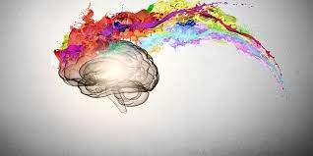
Learn, Unlearn and Relearn
Resiliency
Adaptability
Creativity
Digital
judgement
leadership
Notes:
Part of this change will be what and how we learn.
In this new world CPAs will have to learn, unlearn and relearn. Learning will be more experiential, adaptive and personal.
Technical skills need to be updated every 3 years
Development of digital skills and digital navigation skills
Core skills such as resiliency, creativity, application of judgement, leadership will be increasingly essential
Need to consider new and innovative learning solutions

Slide 18

CPA Canada Foresight:
Reimagining the Accounting Profession
Communicate Phase 1 outcomes
Broad engagement to build a compelling case for change
Develop project plans to support workstreams
Identify appropriate governance and funding models

