Slide 1
The future of the profession:
UK perspective
PAC 2019 conference
Martin martinoff, icaew

Slide 2

A watershed moment?

Slide 3
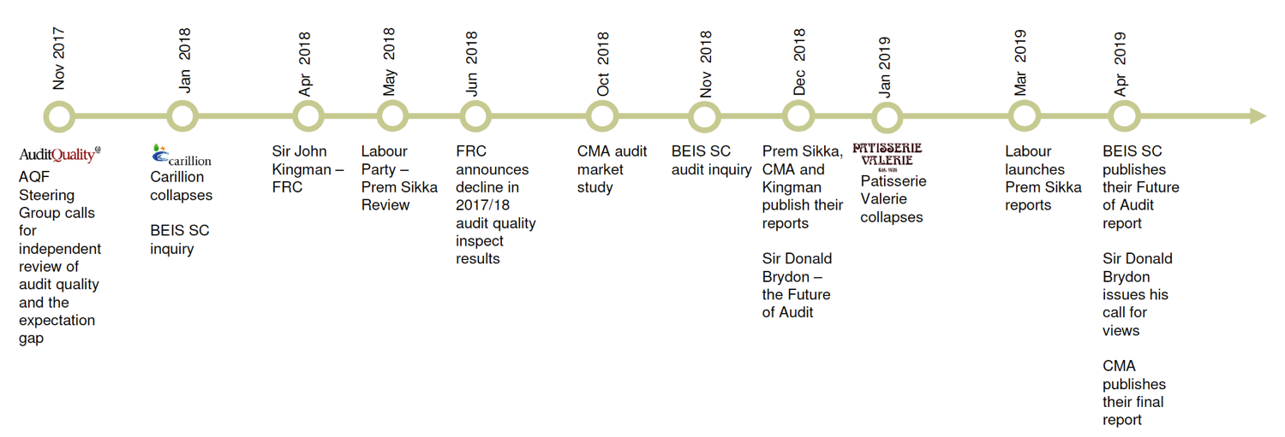
Multiple UK inquiries

Slide 4
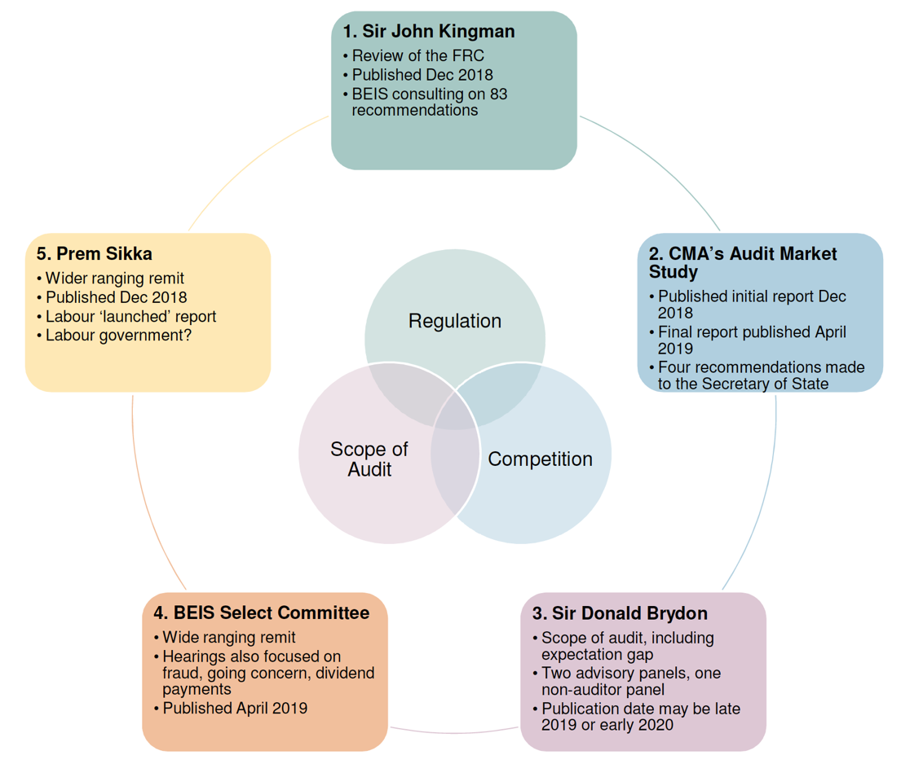

Slide 5
Regulation: new, stronger regulator
Structural changes to increase powers and independence
Proactive, forward looking market analysis
Publication of Audit Quality Reviews
Ability to direct reporting changes without court intervention
Powers to hold directors to account

Slide 6
Competition: intervention to increase market choice
Audit committee scrutiny
Increasing choice and resilience through
  Mandatory joint audit for most large companies
  Peer reviews for largest companies
  Mitigate against Big Four failure
Big Four operational splits
Five-year review of progress by the regulator

Slide 7
Scope of audit: expanding the scope to decrease the gap
Increasingly forward looking - duty of alert, going concern and viability statement reforms
Graduated audit findings
Potential UK Sarbanes-Oxley equivalent
Subject to the Brydon Review

Slide 8
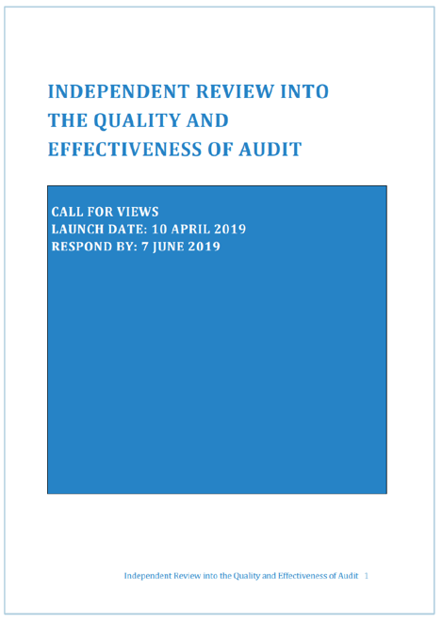
Brydon Review
Call for views issued 10 April
60 questions on: Purpose, Scope, Quality
Aims to clarify:
  Needs and expectations of users
  Improvements to process/product
  Legal/regulatory changes required
  Other forward looking forms of business assurance
‘… the gap between the role expected of auditors and that performed by them today.’
‘The voice of the ultimate user has been curiously muted; yet in the rest of the world the consumer drives the evolution of product features.’

Slide 9
ICAEW response
ICAEW Representation 64/19
  50 pages and 25,000 words.
Major points
  A new vision for User-Driven Assurance
    Pillar 1: A better statutory audit, with a renewed focus on avoiding disorderly failure and protecting against fraud
    Pillar 2: Enhanced use of other assurance engagements by regulators and other sector-focused bodies
    Pillar 3: Significant empowerment of shareholders enabling them to require the commissioning of other assurance engagements.
  Better regulation principles
  Our role as a professional body
  UK global leadership.

Slide 10
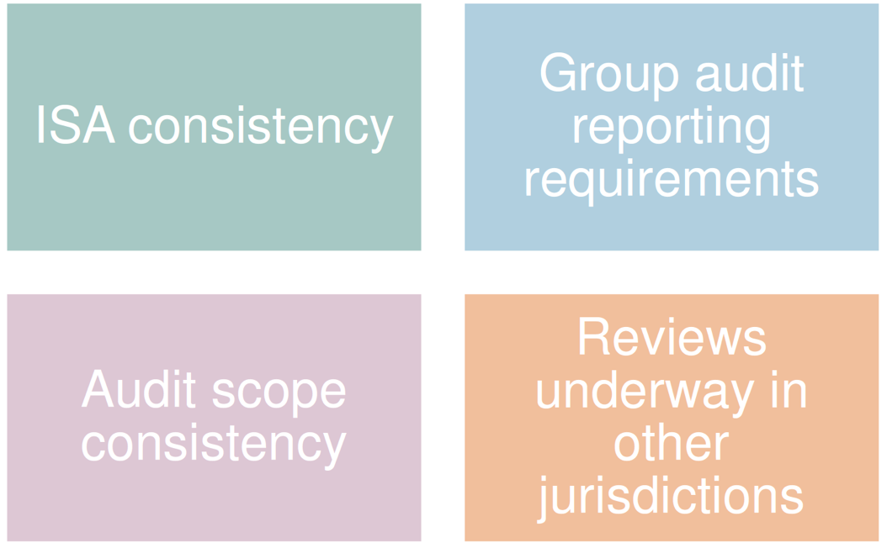
International impacts?

Slide 11
Other challenges
Could increased regulator powers undermine efforts to reduce barriers to entry?
How might increased competition affect audit quality?
Could changes to what auditors/regulators do potentially increase the expectations gap?
Impact on non-PIE audits and the attractiveness of the profession?
Need for reform of auditor liability?

Slide 12
Thought leadership essays
Available to all at icaew.com/futureofaudit.
Background essays
  Who does what?
  The scope of audit.
Thought leadership essays include
  Internal controls
  Shared and joint audits
  User-Driven Assurance
  Going concern and viability
  Fraud
  Standard setting.

Slide 13
Thank you!
Let’s connect!
Martin.Martinoff@icaew.com
@AuditFutures
www.AuditFutures.net

