Slide 2
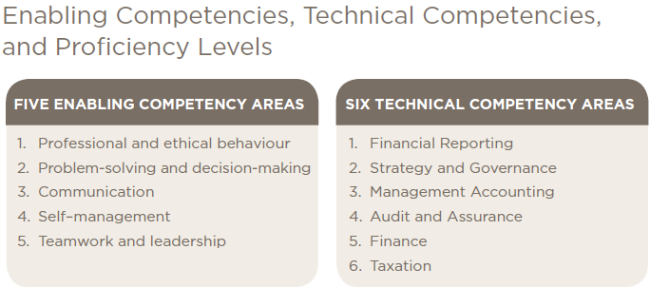
Notes:
This is the current competency map – the map that drives and defines what we teach and assess.

Slide 3
What are we missing?
Do we need to “rebalance” the portfolio?
What do we have too much of?

Slide 4
What are we missing?
Adaptability & Resilience
Initiative
Accountability
Creativity & Innovation
Implementation & Change management
IT/Technology/Data analytics
Broad business context
Sustainability
Project management

Slide 5
Do we need to “rebalance” the portfolio?

Slide 6
What do we have too much of?

Slide 7
Acting Ethically and Demonstrating Professional Values
Adding Value
Solving Problems and Making Decisions
Managing Self and Others
Building Relationships
Communicating
Leading
Information Systems/
Technology
Broad Business Knowledge

