Slide 1

Future of Professional Accounting & the Role of External Auditors
PAC Conference – Professional Accounting Futures 2018
September 14, 2018

Slide 2
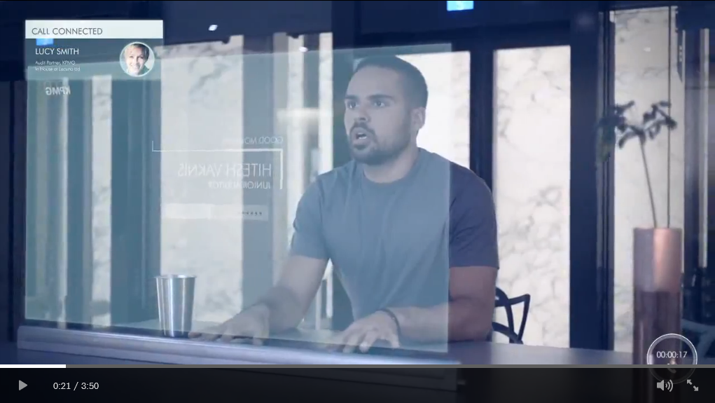
Audit 2023: Audit technology fit for the future
Notes:
Video: Audit 2023 Audit technology fit for the future

Slide 3
The future of professional accounting
1
The explosion of data
2
Innovating to improve audit quality
3
Adding trust in a digital world
4
The next generation auditor

Slide 4
Explosion of data is a fundamental challenge
messages processed on WhatsApp
The answer
44,000,000
More than
messages sent
More than
Tweets sent on Twitter
More than
hours of video are uploaded
More than
video views and
hours of video watched on YouTube
21,000,000
430,000
300
2,700,000
new reviews posted on Yelp
photos on WhatsApp
More than
minutes of audio chatting on WeChat
songs added on Spotify
139,000
26
486,000
195,000
More than
hours of music listened
14 New
39,300
Digital tools
New accounts opened on LinkedIn
video messages shared on WhatsApp
120
70,000
More than
hours of video watched on Netflix
More than
new domains registered
More than
emails are sent
69,500
Almost
Snaps sent on Snapchat
100
150,000,000
300,000
aArticles pinned on Pinterest
More than
searches on Google
Automation
More than
matches made
More than
apps downloaded on Android
More than
apps downloaded on iPhone
9,800
2,315,000
18,000
95,000
48,000
Around
photos uploaded on Instagram
56,000
daily swipes on Tinder
More than
items are shared on Facebook
Robotics
972,000
More than
submissions on Reddit
3,000,000
140
3,125,000
243,055
This all happens every 60 seconds.
60
Data analytics
In
seconds
* Source: Go-Global
Cognitive computing

Slide 5
Innovation to improve audit quality
Quickly collects and analyzes various data sources
Greater visibility into trends and anomalies across all geographies and businesses
A higher level of precision so we can better focus our audit procedures on specific risks

Slide 6
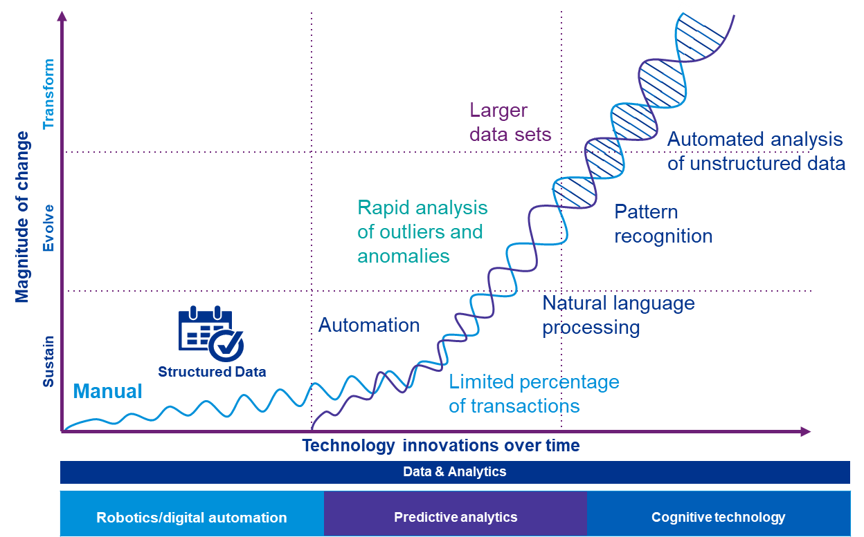
The innovation journey

Slide 7

Our investment in technology
Predictive analytics
Smart Audit Platform
Robotics/Digital
automation
Cognitive technology

Slide 8
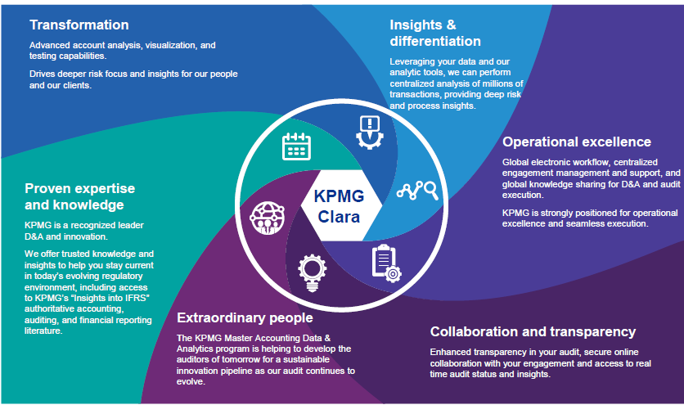
Enhancing audit quality
Proven expertise and knowledge
Ability to offer trusted knowledge and insights to help a client stay current in today’s evolving regulatory environment, including access to authoritative accounting, auditing and financial reporting literature.
Transformation
Advanced account analysis, visualization, and testing capabilities.
Drives deeper risk focus and insights for auditors and clients.
Extraordinary people
The need to develop the auditors of tomorrow for a sustainable innovation pipeline as our audit continues to evolve.
Insights and differentiation
By leveraging client data and analytics tools, auditors can perform centralized analysis of millions of transactions, providing deep risk and process insights.
Smart Audit Platform
Collaboration and transparency
Enhanced transparency in an audit, secure online collaboration with an engagement and access to real-time audit status and insights.
Operational excellence
Global consistency in execution, centralized engagement management and support, and global knowledge sharing for D&A and audit execution.

Slide 9
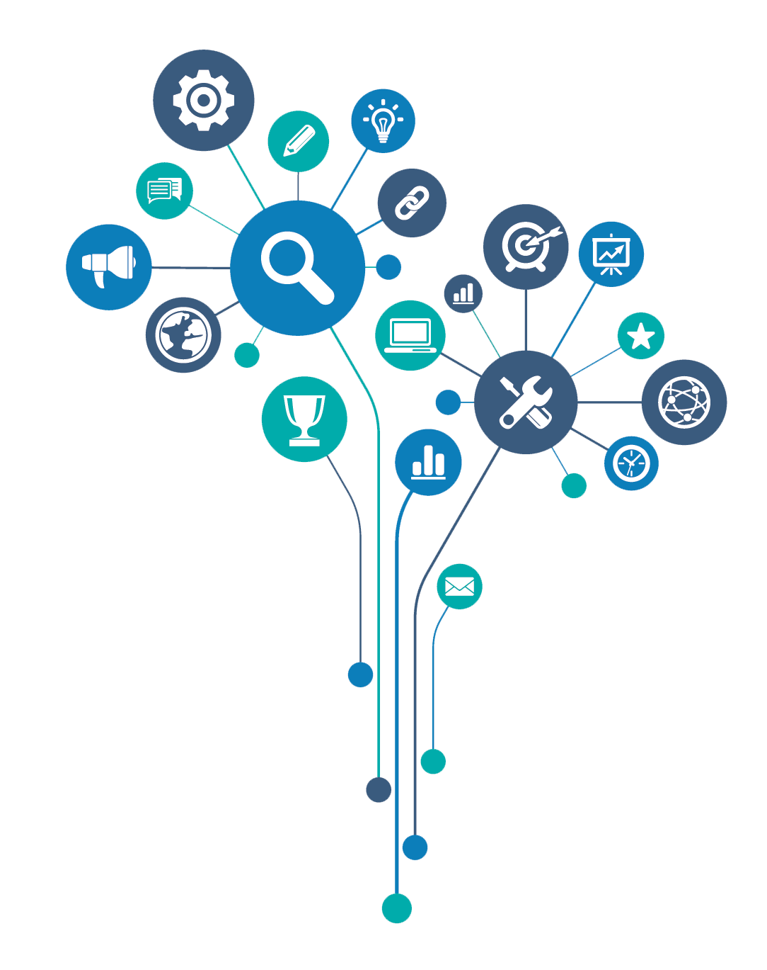
Adding trust in a digital world
The data explosion is causing investors to look beyond the historical audit to other types of assurance
Blockchain
Digital Assurance
Sustainability
Non-GAAP measures
Value of data

Slide 10

The next generation auditor
Maintains a firm foundation in accounting, auditing, and financial reporting
Is empowered with data and analytics skillsets
Applies advanced technologies with ease
Collaborates and innovates with diverse teams
Has deep risk assessment and internal controls capability
Embraces change
How do we get there?

Slide 11
Thank you

Slide 12
The information contained herein is of a general nature and is not intended to address the circumstances of any particular individual or entity. Although we endeavour to provide accurate and timely information, there can be no guarantee that such information is accurate as of the date it is received or that it will continue to be accurate in the future. No one should act on such information without appropriate professional advice after a thorough examination of the particular situation.
© 2018 KPMG LLP, a Canadian limited liability partnership and a member firm of the KPMG network of independent member firms affiliated with KPMG International Cooperative (“KPMG International”), a Swiss entity. XXXXX
All rights reserved. The KPMG name and logo are registered trademarks or trademarks of KPMG International.

