Slide 1

Innovative Financial and Non-financial Reporting
2017 Professional Accounting Centre Conference
Stacey Nagle
Partner, Audit & Assurance, Deloitte

Slide 2

Our research
We heard from board members, preparers, regulators, standard setters, and accounting professionals across Canada and asked them what improvements can be made within the current model, and how to influence change for tomorrow’s.

Slide 3




Deloitte’s series on corporate reporting
Part 1: Defining the problem
We established that corporate reporting has become, though for various valid reasons, overwhelmingly complex and lengthy
Part 2: Quick fixes
We proposed that the existing model can be improved by using some quick fixes such as using plain language, prioritizing information better, and better using technology
Part 3: Looking to the future
We proposed more fundamental changes to the way companies measure and communicate how they are creating value in this era of rapid business change
Part 4: Raising the game
We look to the accounting and audit profession to see how their role can be elevated to become an agent for change to help move the needle to a reimagined and modernized model

Slide 4
Measuring and reporting value-creation metrics and indicators as well as value-realization metrics would give stakeholders a more comprehensive picture.

Slide 5
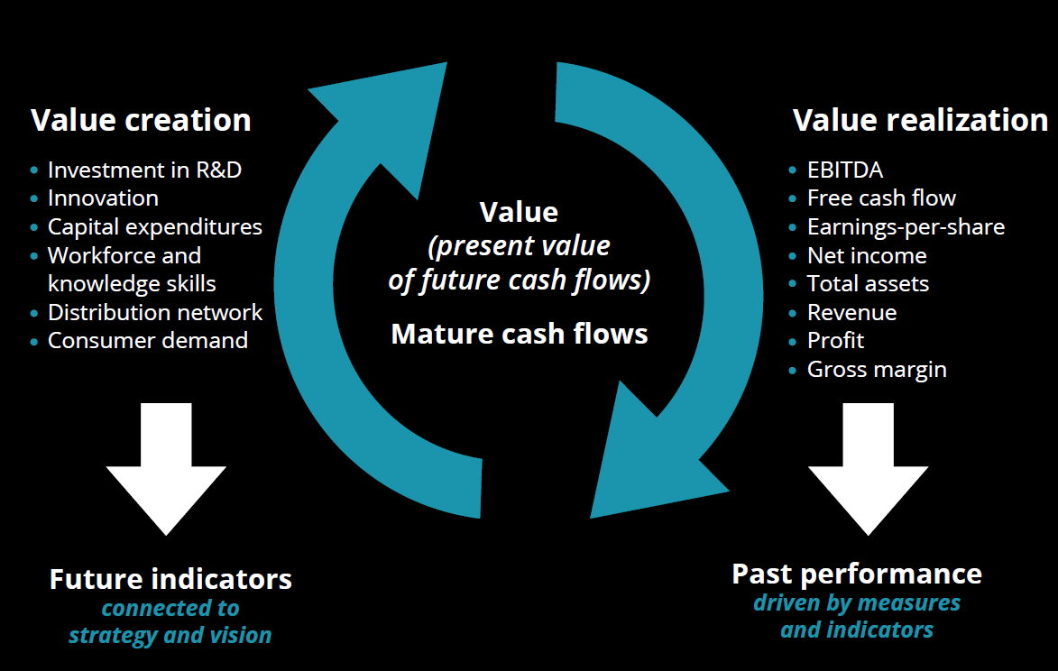
Value realization vs. value creation: a balanced approach

Slide 6
Tomorrow’s ideal model: Communicate a clear, succinct story about how an organization is managing its resources to create value over time.

Slide 7
Corporate reporting model, re-imagined
Key strategies & goals
Management performance & compensation
Current year & longer term performance
Long term measures of performance

Slide 8
The future in action
Vodafone case study

Slide 9
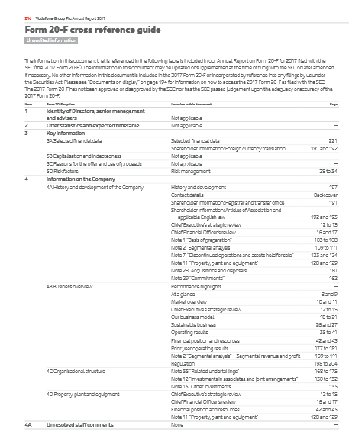
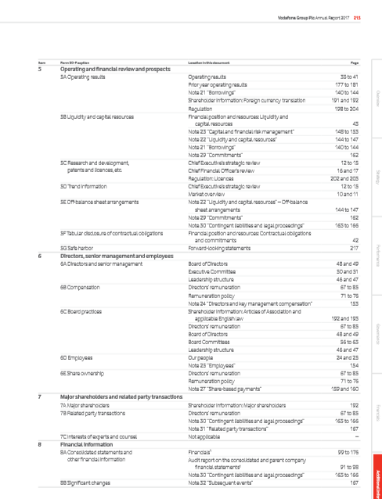
The future in action – Vodafone

Slide 10
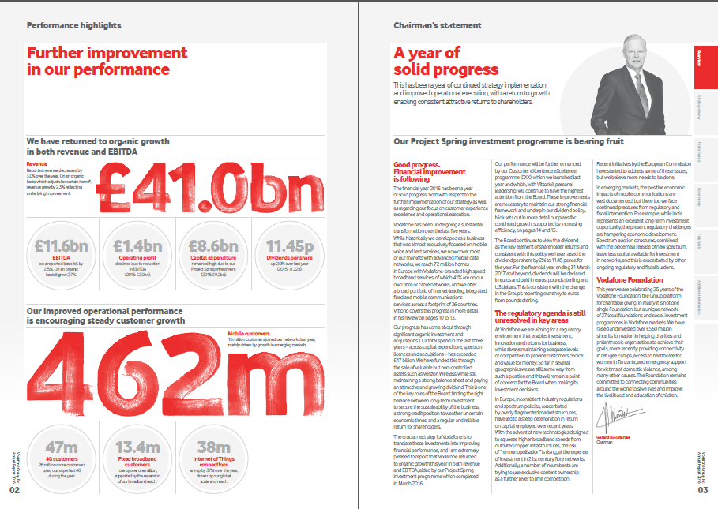
The future in action – Vodafone
Introduction included in Form 20-F, as required to be filed with the SEC – their story is told with all the elements we describe AND is compliant with SEC requirements!

Slide 11
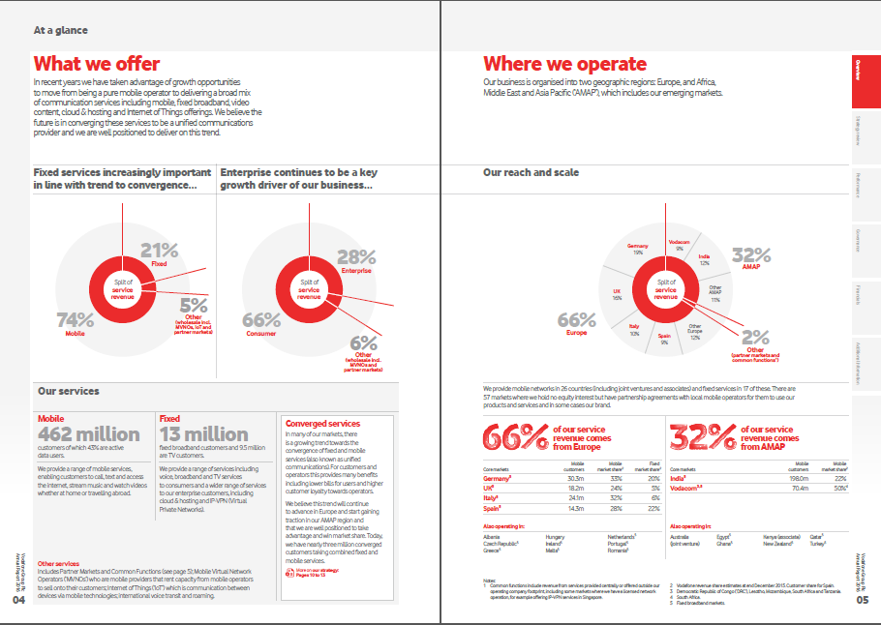
The future in action – Vodafone business model

Slide 12
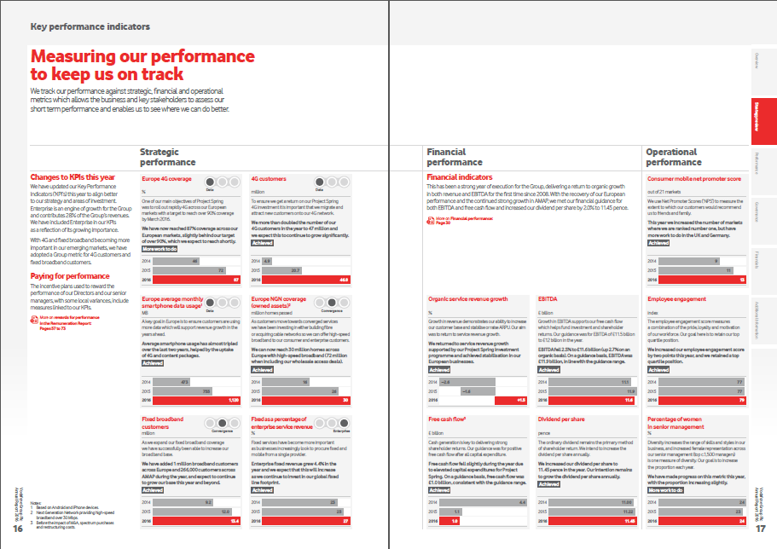
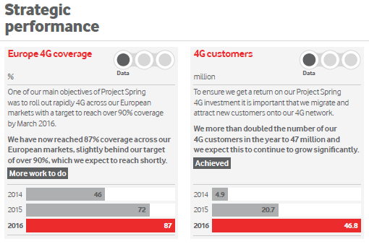
The future in action – Vodafone KPIs
Performance measurements conveyed by charts/graphs and easy to an easy to digest scorecard system.

Slide 13
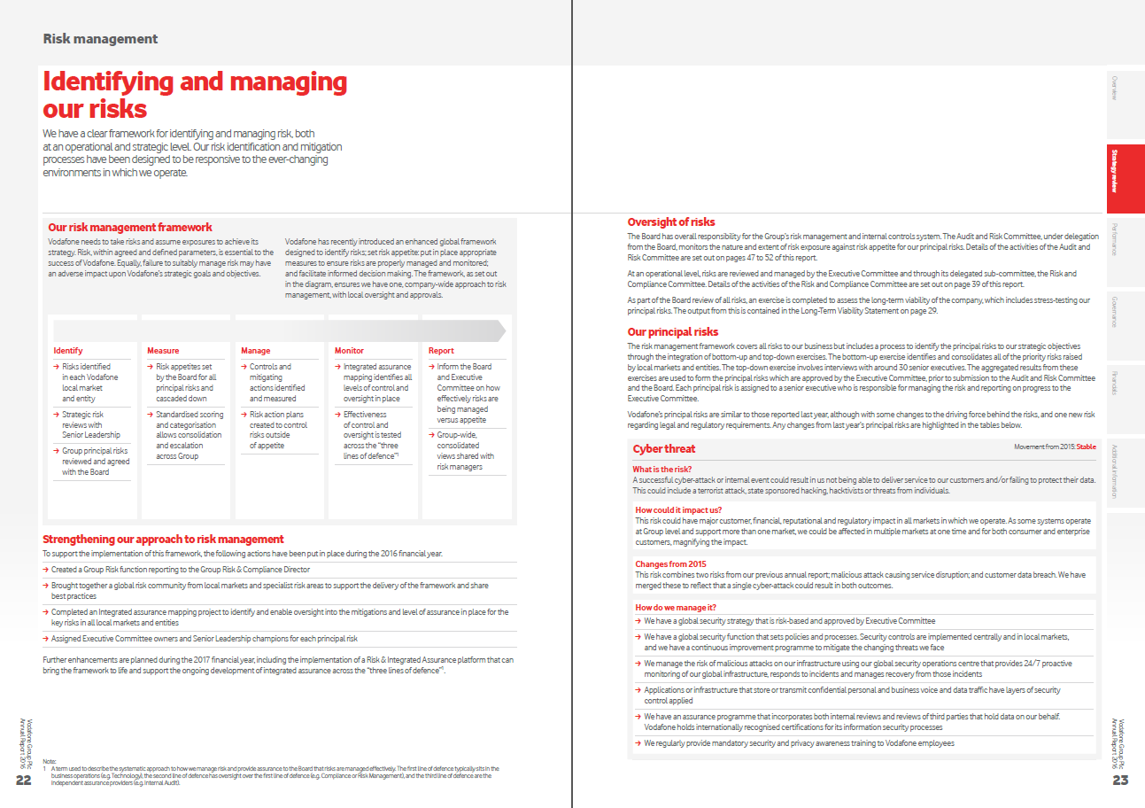
The future in action – Vodafone risk identification
A clear framework for measuring risk
Standard format for risk analysis
  What is the risk?
  Impact?
  Changes?
  How is it managed?

Slide 14
Questions?

Slide 15

Stacey Nagle
Partner, Audit & Assurance
Deloitte
e. stanagle@deloitte.ca
t. 416-643-8487
Deloitte, one of Canada's leading professional services firms, provides audit, tax, consulting, and financial advisory services. Deloitte LLP, an Ontario limited liability partnership, is the Canadian member firm of Deloitte Touche Tohmatsu Limited.
Deloitte refers to one or more of Deloitte Touche Tohmatsu Limited, a UK private company limited by guarantee, and its network of member firms, each of which is a legally separate and independent entity. Please see www.deloitte.com/about for a detailed description of the legal structure of Deloitte Touche Tohmatsu Limited and its member firms.
The information contained herein is not intended to substitute for competent professional advice.
© Deloitte LLP and affiliated entities.

