Slide 1

Consequences of adopting an expanded auditor's report in the United Kingdom
Elizabeth Gutierrez, Universidad de Chile
Miguel Minutti-Meza and Kay W. Tatum, University of Miami
Maria Vulcheva, Florida International University
Sep 15, 2017

Slide 2
If you remember only one thing as you leave today…
The expanded auditor’s report in the UK provides additional information about auditor’s judgments
However, it is unclear whether the report significantly changed the audit and its consequences in the relatively short term (+2 years) for the large companies that adopted the new rules

Slide 3
Worldwide move towards expanded auditor’s reports
Investors and regulators worldwide have expressed growing concerns about the content of the (public) auditor’s report
Diverse stakeholders seem interested on getting more information about the auditor’s judgments
The proposed and adopted changes follow previous requirement in the U.K. and other countries to disclose audit partners’ names

Slide 4
Adopters of the expanded report:
London Stock Exchange, main market, premium listing
Main market is the LSE primary market for listed companies
Three types: premium, standard and high growth (AIM)
Premium listed companies must comply with the U.K.’s highest standards of regulation and corporate governance
Less than 800 companies have PREMIUM STATUS, about a third are investment entities (funds) ,and we focus only on non-financial entities

Slide 5
The UK expanded auditor’s report
Increased by two pages approx. 2,400 words, compared to 760 words in the old reports
Typically four risks and 660 words, approximately 1/3 of the additional words
Revenue recognition is the predominant risk, in over 60% of the reports
Average materiality is 0.6% and median is 0.5% of total assets. We standardized as a % of assets to make this number comparable across all companies, however there is variation in the actual basis used by auditors

Slide 6
Example of risk disclosures in the first year
2013 Hilton Food Group plc
Fraud in revenue recognition
ISAs presume there is a risk of fraud in revenue recognition because of the pressure management may feel to achieve the planned results. We focused on the amount and timing of the recognition of revenue, particularly where the contractual customer terms provide for cost plus pricing or discounts, which are calculated by management. We tested revenue by agreeing it to supporting documentation, including customer contracts, discounts and incentives, and to cash receipts. We also tested journal entries posted to revenue accounts by identifying and challenging unusual or irregular items

Slide 7
Research question #1
Did investors’ react to additional disclosures?
Auditor’s disclosures were not strictly directly available to investors before the new rules. Non-standard reports (GCO and other) are associated with price and trading volume reactions in previous research
However:
  The new disclosures are somewhat generic
  Disclosures can be implied by other publicly available information
  Investors may be unable to fully understand the new disclosures or possible “disclosure overload”

Slide 8
Research question #2
Did the cost of audits change?
Additional effort and risk may make audits more expensive. Firms may have incurred both one-time and recurring costs
However:
  FRC expected only a small fee increase
  Information on risk, materiality, and scope was already discussed with the audit committee
  Audit fees reflect only part of the cost of audits if workload and fees are negotiated between clients and auditors

Slide 9
Research question #3
Did audit quality change?
Auditors may be under more scrutiny, especially when it comes to risks, and thus increase audit quality. Carcello and Li (2013) find that after the partner is required to sign in the UK, the perceived increase in responsibility leads to higher audit quality
However:
  Unclear whether auditors significantly changed their methodology
  Additional disclosure might serve as a disclaimer for responsibility
  It might be too early to detect changes in audit quality

Slide 10
Difference-in-differences or incremental change
PREMIUM (adopters) versus AIM UK companies
AIM Non-adopters
2 years
After Sept 2013
PREMIUM Adopters
First 2 years new report
After Sept 2013
AIM Non-adopters
2 years
Before Sept 2013
PREMIUM Adopters
2 years
Before Sept 2013

Slide 11
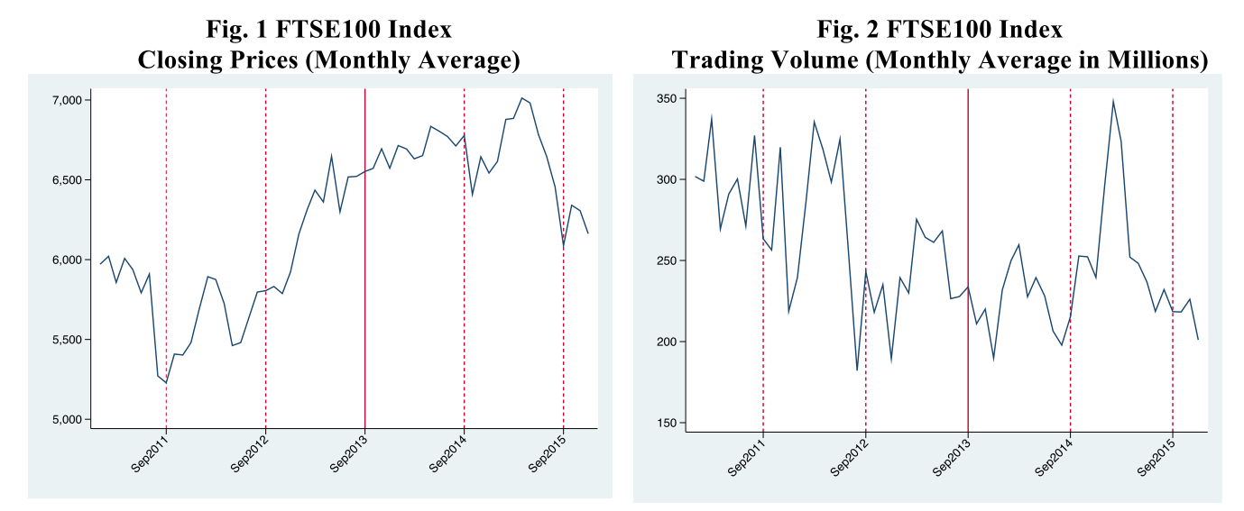
Why do we need a “control” group of other UK companies?
Significant market run upwards around 2013

Slide 12
The four main outcome variables in our study
Abnormal (market-adjusted) 3-day returns
  Auditor’s report public date, released together with the full annual report
Abnormal 3-day trading volume
  Daily trading volume, adjusted for a “normal period” of daily volume before the report’s public date
Audit fees
  Sum of audit fees for parent-company and statutory audits
Absolute discretionary (unexpected) accruals
  Rough measure of quality, possibly only diagnostic indicator of “something” changing in total accounting estimates
  (NI-CFO)/Assets “adjusted for normal %” using a model

Slide 13
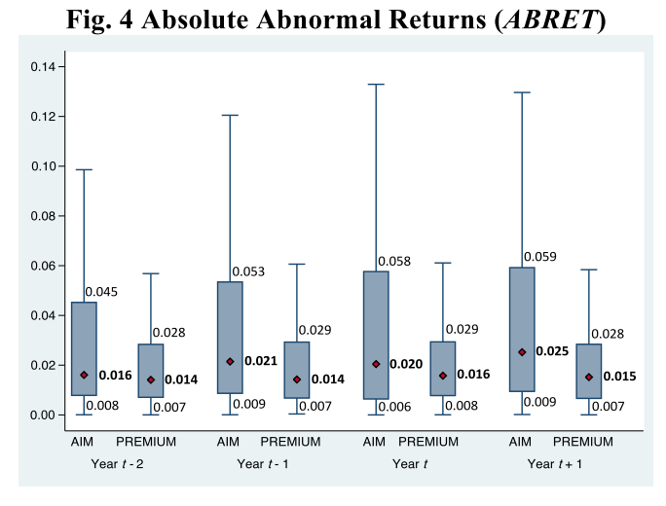
No evidence of a substantial incremental change in investors’ reaction to the public release of the report
Median
returns for PREMIUM companies
0.014
0.014
0.016
0.015
and for AIM companies
0.016
0.021
0.020
0.025
Change is too small to conclude

Slide 14
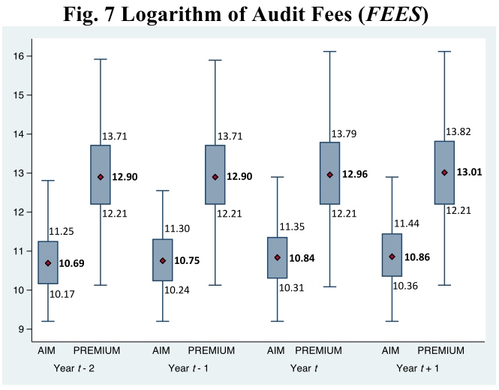
No evidence of a substantial incremental change in audit fees
Median
Log fees for PREMIUM companies
12.90
12.90
12.96
13.01
and for AIM companies
10.69
10.75
10.84
10.86
Change is too small to conclude

Slide 15
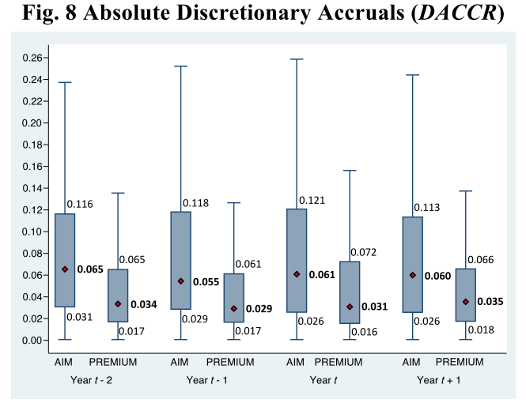
No evidence of a substantial incremental change in accounting estimates (NI-CFO)/Assets, adjusted for normal %
Median
Abn Accr for PREMIUM companies
0.034
0.029
0.031
0.035
and for AIM companies
0.065
0.055
0.061
0.060
Change is too small to conclude

Slide 16
#1 Issue in determining investors’ reaction
Low overall reaction to annual report’s filing
The auditor’s report is included in the release of the full annual report
The release of the full annual report follows an earlier earnings announcement disclosure. For the companies in our sample the earnings announcement is a very complete form of disclosure, containing full financial statements and mentioning whether the auditor’s opinion was unqualified.
It is difficult for an audit report to add to an already rich disclosure environment

Slide 17
#2 Issue in determining investors’ reaction
Other information in the annual report
There were other changes to corporate reporting in the UK around the same time, in particular the Corporate Governance Code in October 2012. These changes require additional audit committee disclosures
These disclosures can affect our analyses. We also consider the overlap between the auditor’s and audit committee’s disclosures and reach similar conclusions
There is always a chance that our measures are “too coarse” to capture an effect, however they are standard in accounting and audit research

Slide 18
However audit fees and risks in the report are linked (+)
There is an association between auditor effort (fees) and the auditor’s assessment and disclosure of audit issues. If the risk disclosures were entirely boilerplate or “empty” we would not find this association

Slide 19
Also, abnormal accruals and materiality are associated (+)
However, there is also association between auditor effort (small materiality) and the magnitude of abnormal accruals (small abnormal accruals)

Slide 20
Finally, auditors are responsive to feedback!
See the changes between first and second year

Slide 21
Summary and final thoughts
We document a statistically undetectable change on investors’ reaction around the public release date of the report, audit fees, and audit quality. The expanded report does not seem to disrupt the way audits are conducted or the market for audits in the UK
However, risk and materiality are predictably related to audit fees and quality. Arguably, if risks and materiality disclosures were strictly “empty” or boilerplate, they would not be associated with these outcomes
Perhaps there will be a long-term impact (change in behavior) that we cannot yet determine, or the report may be more informative for smaller companies with comparatively less oversight than the UK Premium companies

