Slide 1
The Rise Of Non-GAAP Metrics
Professional Accounting Futures (PAC)
September 15, 2017
Dimitry Khmelnitsky, CPA, CA
Vice President
Head of Accounting & Special Situations Group
Notes:
Talk to you about the rise of non-GAAP metrics and how they are replacing traditional Financial Statements in and Stock Market Valuations

Slide 2
Outline
  Why Veritas
  The State of Non-GAAP
  Why Non-GAAP Is Important
  Uses/Usefulness of Non-GAAP
  Common Non-GAAP Adjustments
  Recommendations
Notes:
Temporary differences may become permanent in practice:
Cost capitalization with low amortization rate
Deferred income taxes

Slide 3
Veritas
Independent
Employee owned
In-depth
Experienced
We tell the truth,
not what management or
the market wants to hear
Notes:
YouTube commercial

Slide 4
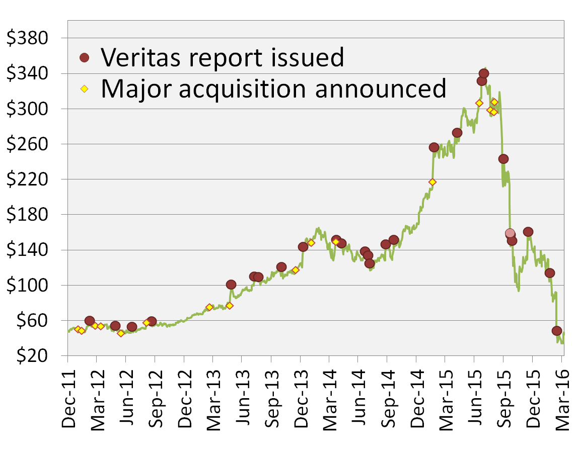
Valeant Pharmaceuticals Inc.
Negative Implications of Senate testimony
Business Model Built on Price Hikes
SELL: Desperately Seeking Allergan
No More Secret Sauce
Bausch & Lomb deal
Veritas uncovers Philidor-Isolani link
Added to
Veritas Watchlist
Citron ‘smoking gun’ same morning
Why we should be worried US$72 target
‘Uninvestable’ US$29 target
Notes:
when you understand the accounting and disclosures you are two steps ahead when shit hits the fan. We were two steps ahead.
we never let up on our view
If entered somewhere in 2013-2015 would have lost clients

Slide 5
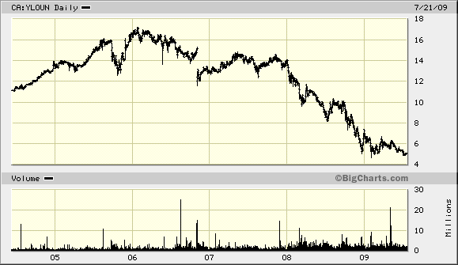
Yellow Pages – Caught by Competitive Threat
Sell: 07/05
We firmly believe that those investors that sell their YPG units now will reap the rewards of their decision at leisure, while others that hang on for more gains might find the exit door shut in the face of a stampede a year or two down the road
“I mean, 11 out of 12 analysts that cover us have ‘buy’ recommendations.”
Marc Tellier
CEO, Yellow Pages Income Fund- September 2005

Slide 6
Buy and Sell Only
Veritas Performance: March 25, 1999 to August 31, 2017

Slide 7
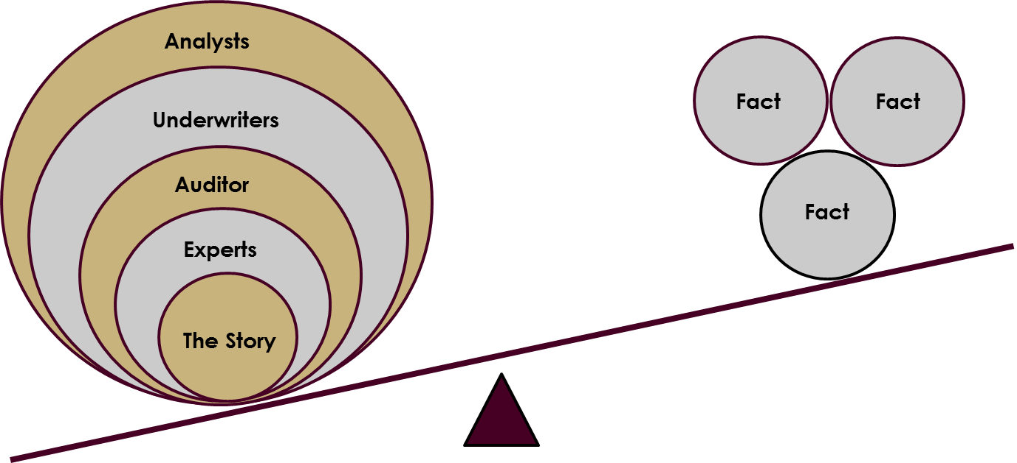
Out-Performance: Don’t Get Caught In The Noise

Slide 8

Out-Performance: Infamous Blow-Ups

Slide 9
Capital Preservation
Loss avoided by Veritas Sell ratings
10 Worst S&P/TSX 60 Stocks

Slide 10
Recent Study: Is the Audit Losing Relevance?
CFA Society Toronto, AASB, AcSB and CPAB partnered together to solicit input from investors and financial analysts
Surveyed institutional investors representing $3+ trillion &
Major sell-side research firms and credit rating agencies
Notes:
As a lead up into non-GAAP let’s look at the perception of audit and what information is used for investors decision making

Slide 11
Key Messages
The Audit is Highly Relevant (unanimous agreement)
But, detailed knowledge about the Audit scope, Audit process, and Accountabilities is low
Investors use a wide variety of information to make their decisions (including a variety of data aggregators)
While audited GAAP financials are fundamental, investment decisions are increasingly based on unaudited information

Slide 12
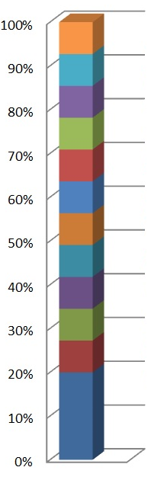
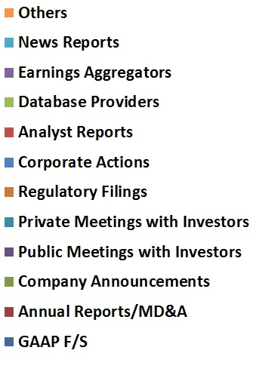
Sources of Information
Notes:
Upcoming events

Slide 13
Understanding The GAAPs
Information | Examples | Standard/ Policy Set by | Verification
GAAP Financial KPI | EPS | GAAP [NI 52-109] | External Audit
Non-GAAP Financial KPI | Pro-Forma EPS, Adj. EBITDA, Free Cash Flow | Securities Regulators [Staff Notice 52-306] | Audit Committee; Auditor Review - "not inconsistent" with GAAP F/S
Other Financial KPI | ARPU, SSS, Sales/sqft | Management | As above
Operating KPI | Churn, Barrels, Subscribers, Customer Sat | Management | As above
Notes:
What are the key non-GAAP metrics and how they compare to GAAP KPIs
Aggressive non-GAAP metrics are a symptom of underlying operating issues

Slide 14
Users Value (CFA/CPAB Study)
Dialogue with the standard setters
Reliability of key non-GAAP financial information & KPIs
Consistent use & calculation of KPIs
Comparable definitions of KPIs within a sector
Greater Transparency:
  Disclose which KPIs are most relevant (incl. mgmt compensation)
  Disclose definition & calculation of KPIs
  Identify any changes in KPI definitions
Accuracy trumps Timeliness
Users believe the enhancements in these areas would outweigh any incremental cost
Notes:
Commend CPA Canada team by name

Slide 15
2013 Buy-Side Study: Veritas/PWC
Most Used Financial Metrics for Investment Decisions:
EBITDA
Free Cash Flow
EPS (adjusted)
Consistent with Veritas 2015 Study

Slide 16
A Common Perception
Accountant
Investor
Notes:
Why investors like non-GAAP metrics because bridges the gap b/w past and future

Slide 17
Non-GAAP – Key Question
How much is a company earning on a sustainable basis?
Notes:
And helps user the key investor question The other usefulness of non-GAAP is to answer the?

Slide 18
The Analyst’s Job - Evaluate Performance
Business Innovation (Organic/Acquisition)
Or
Accounting Innovation
Notes:
Analyst and investor’s job is to evaluate performance and distinguish between business and accounting innovation

Slide 19
The Cause and Effect
Business Innovation = Earnings & Multiple Expansion
Accounting Innovation = Not Sustainable
Notes:
The problem with non-GAAP metrics is that they tend to substitute business innovation with accounting innovation and also tend to ignore recurring costs integral to sustainable earnings

Slide 20
VRX: Metrics Change to Support the Story
Notes:
30 days to 90 days, discontinuations, genericization, sale of old drugs through newly acquired channels deemed organic, unsupported FX adjustments
Philidor 55% (incl price hikes) and price hikes another 25%

Slide 21
HMHC: Accounting Innovation - Cash EBITDA
Change in non-GAAP metric in 2014
Deferred revenue included in Adj. Cash EBITDA
Deferred revenue may stretch for > 5 years
No clear evidence to support change in business to digital
Management assumed 100% margin on deferred revenue
The Impact of Deferred Revenue on Adj. Cash EBITDA
(Amounts in thousands of US dollars)
 | F14 | F13 | F12
Y-o-Y Change in Deferred Revenue | 229,956 | 1,842 | (54,615)
Adjusted Cash EBITDA | 495,339 | 326,860 | 265,197
Impact on Adjusted EBITDA | 46% | 1% | -21%
Notes:
Houghton Mifflin Harcourt Co – publishing/academic learning company
Nothing changed in business – why emphasize deferred revenue now? But they have always had Basal programs in adoption states. time…Our basal programs, primarily in adoption states, typically have the higher deferred sales than other parts of the business. The higher deferred sales are primarily due to the length of time that our programs are being delivered, along with greater component and digital product offerings.

Slide 22
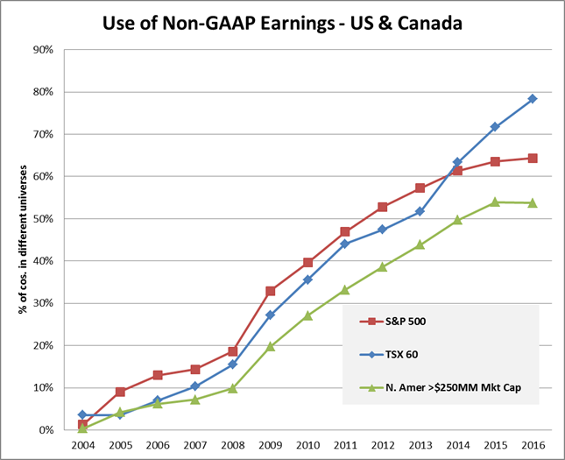
Current State Of Non-GAAP
Source: Bloomberg; Veritas Calculations
Notes:
Investors belief in non-GAAP metrics has been reinforced by the prevalence of their use

Slide 23
2015 Study: Adjustments are Upwardly Biased
Non-GAAP vs. GAAP Cumulative Differential Over Five Years
 | EBITDA |  | Net Income
 | Resource | Non-resource | Resource | Non-resource
% increase in adjusted metric vs GAAP | 107% | 9% | 5788% | 16%
Over 80% of adjustments are favourable
Non-GAAP and GAAP earnings difference is material
If the ‘earnings’ are inflated…what about valuations
Valuation voodoo: If management can convince a sufficient amount of investors that the ‘true’ earnings of a company is higher, then valuation is likely to follow
Source: Bloomberg; Veritas Calculations; 2015 Filings
Notes:
The discussion related to non-GAAP metrics is important to valuation.

Slide 24
2015 Study: Non-GAAP Guidelines Need Enforcement
# | CSA Staff Notice 52-306 (OSC Guideline) | # of Issues
1 | State explicitly that the non-GAAP financial measure does not have any standardized meaning under the issuer's GAAP and therefore may not be comparable to similar measure presented by other issuers. | 2
2 | Name the non-GAAP financial measure in a way that distinguishes it from disclosure items specified, defined or determined under an issuer's GAAP and in a way that is not misleading. | 5
3 | Explain why the non-GAAP financial measure provides useful information to investors and the additional purposes, if any, for which management uses the non-GAAP financial measure. | 2
4 | Present with equal or greater prominence to that of the non-GAAP financial measure, the most directly comparable measure specified, defined or determined under the issuer's GAAP presented in its financial statements. | 3
5 | Provide a clear quantitative reconciliation from the non-GAAP financial measure to the most directly comparable measure determined under the issuer's GAAP and presented in its financial statements, referencing to the reconciliation when the non-GAAP financial measure first appears in the document. | 14
6 | Ensure that the non-GAAP financial measure does not describe adjustments as non-recurring, infrequent or unusual, when a similar loss or gain is reasonably likely to occur within the next two years or occurred during the prior two years. | 6
7 | Present the non-GAAP financial measure on a consistent basis from period to period; however, where an issue changes the composition of the non-GAAP financial measure, explain the reason for the change and restate any comparative period presented. | 0
Source: Bloomberg; Veritas Calculations; 2015 Filings
~35% of TSX 60 members have potential non-GAAP regulatory concerns based on current guidelines

Slide 25
Types of Adjustments

Slide 26
Non-Cash Expenses
Virtually all expenses are cash. The difference is usually timing.
Examples of common ‘non-cash’ expenses:
  Amortization/Depreciation
  Impairments
  Deferred taxes
  Share based compensation
If management claims an expense is non-cash, what exactly is management spending and what are the accountants counting?

Slide 27
Concordia: Considering Amortization Costs
Growth by acquisitions, no R&D, old drugs, negative organic growth
Amortization reflects the loss of economic value
Use amortization as a proxy for maintenance capex
Estimated Maintenance Capex
(Amounts in thousands of US dollars)
 | 2015 | 2014
Adjusted net income, continuing operations | 163,935 | 47,618
Amortization (product rights, IP), net of tax | (56,099) | (7,666)
Normalized Adj. net income | 107,836 | 39,952
% impact on Adj. net income | -34% | -16%
Notes:
Goodwill

Slide 28
Share Based Awards - Non-Cash Fallacy
Question for management: If you had to replace your entire stock compensation scheme with cash, how much would it cost the company?

Slide 29
MDA: Stock Based Compensation Avoids Earnings
MDA routinely excluded cash-based SARs from its Operating Earnings
These are recurring and material costs
Stock Based Costs Should Not Be Ignored
(Amounts in millions of Canadian dollars)
 | F15 | F14 | F13 | F12 | F11 | F10
Average cash outlay per year | 35 | 34 | 26 | 27 | 16 | 17
Operating Earnings | 221 | 208 | 180 | 127 | 117 | 100
% Impact on Operating Earnings | 19% | 20% | 17% | 27% | 16% | 21%

Slide 30
Asset Impairments
Asset impairments represent real loss.
Capital misallocation is a real business cost and can be incorporated into financial models.
Investors can gauge the size of the impact by comparing the impairment to the current share price. Had the asset not been purchased, the company would have cash on hand and be worth more today
Kinross Red Back example:
  Kinross bought Red Back in 2010 and subsequently wrote down ~US$7.5B of a ~US$8.7B acquisition.
  Current market capitalization of Kinross: ~US$5.2B

Slide 31
Asset Impairments – Valuation Considerations
Should investors build capital misallocation costs into their valuation? Things to consider:
Are the people who approved the asset acquisition still in place?
Do the people who approved the asset acquisition have a track record of asset impairments?
Has the company produced returns on equity/capital, using GAAP net income (which incorporates the cost of asset impairments), which are above the investors’ hurdle rate, cumulatively over the last 10 years? How do those returns compare to peers?
Has management addressed the impairment with shareholders directly and taken ownership of the decision or do they couch it in the language of non-cash, non-recurring, etc?
Is the impairment due to volatile economics of the industry, and therefore potentially temporary in nature? (e.g. commodity businesses)?
Has the company changed its processes related to investment projects?

Slide 32
Non-Recurring Expenses – Bell Canada
 |  |  | F11 | F12 | F13 | F14 | F15
EBITDA, adjusted |  |  | 7,629 | 7,888 | 8,089 | 8,303 | 8,551
Adjustments:
Severance, acquisition and other costs |  |  | (409) | (133) | (406) | (216) | (446)
Depreciation |  |  | (2,538) | (2,678) | (2,734) | (2,880) | (2,890)
Amortization |  |  | (723) | (714) | (646) | (572) | (530)
Interest Expense |  |  | (853) | (865) | (931) | (929) | (909)
Interest on post-employment benefit obligations |  |  | (973) | (131) | (150) | (101) | (110)
Expected return on post-employment benefit plan asset |  |  | 1,032 | - | - | - | -
Other expense (income) |  |  | 129 | 269 | -6 | 42 | (12)
Income taxes |  |  | (720) | (760) | (828) | (929) | (924)
Total adjustments |  |  | -5,055 | -5,012 | -5,701 | -5,585 | -5,821
Net income, reported |  |  | 2,574 | 2,876 | 2,388 | 2,718 | 2,730
BCE states “We use adjusted EBITDA and adjusted EBITDA margin to evaluate the performance of our businesses as they reflect their ongoing profitability.”
If a company incurs an expense every year for 5 years, isn’t that part of ‘ongoing profitability’?
Part of the severance costs are for the wireline business, which is declining. How are restructuring costs for a declining business not part of ongoing operations?

Slide 33
Non-Recurring Expenses – Investor Considerations
Is the same or similar expense likely to recur within 2 years? If yes, don’t adjust.
Has the same or similar expense been incurred in the most recent 2 years? If yes, don’t adjust.
Does the expense relate to otherwise normal business activity even if the expense happens infrequently? If yes, don’t adjust.
Does it appear that management is proposing an adjustment for a business expense simply because it is unusually large in the current period? If yes, don’t adjust.
Does it relate to an event where real business value has been lost (i.e. loss of patent, impairment of asset, etc)? If yes, an adjustment may be appropriate, however investors need to also consider where to capture the loss in their assessment of value.
Was the expenditure a result of actions within management’s control? If yes, don’t adjust.

Slide 34
Other Financial KPIs

Slide 35
Retailers: Same-Store-Sales Growth (SSSG)
Used to measure sales growth generated by a company’s existing store network, open for one-year
 | SSSG explained? | Exclude remodeled/expanded stores? | Includes Digital sales?
Metro | ✗ | - No explanation | N/A
Loblaw | ✓ | ✓ | N/A
Empire | ✓ | - No explanation | N/A
Canadian Tire | ✓ | ✓ | ✓
Dollarama | ✓ | ✗ - Include relocated/expanded stores open for 13 months. | N/A
Jean Coutu | ✓ | - No explanation | N/A
Hudson’s Bay Co. | ✓ | ✗ - remain in the comparable sales calculation | ✓
Macy’s | ✓ | ✗ - remain in the comparable sales calculation | ✓
Restaurant Brands | ✓ | - No explanation | N/A
Source: Company Annual reports.
Clear Explanation? Remodeled Stores. Digital Sales?

Slide 36
Gold Miners: All-In Sustaining Cost (AISC)
Costs required to “sustain” current operating production plan
World Gold Council provided a guideline in 2013
Guidelines for AISC Calculation | Source | Expense Type
Cash Costs (on a sales basis) | Income Statement | Cash
+ Corporate G&A Costs (incl. share based comp) | Income Statement | Cash and Non-Cash
+ Reclamation & Remediation Accretion (operating sites) | Income Statement | Non-Cash
+ Exploration and Study Expense (sustaining) | Income Statement | Cash
+ Capitalized Exploration (sustaining) | Cash Flow Statement | Cash
+ Capitalized Stripping (sustaining) | Cash Flow Statement | Cash
+ Capital Expenditure (sustaining) | Cash Flow Statement | Cash
= All-In Sustaining Costs (AISC)
Source: WGC, Veritas
An incomplete picture since AISC excludes taxes and financing costs

Slide 37
Gold Miners: AISC - Exclusions and Adjustments
Production vs. Sales: Show AISC/oz on ounces produced instead of ounces sold as per guideline
Inventory Adjustments: Including them to reduce costs
Processing Costs: Treatment and Refining Costs excluded
G&A Adjustments: Share-based compensation excluded
Exploration: Brown-field exploration costs excluded
Other: Development costs due to geological and technical issues excluded
To make comparisons we need to know what costs companies exclude

Slide 38
Results: Barrick, Newmont, Goldcorp Follow
Agnico, IAMGOLD, Yamana Don’t
Reported AISC and Impact of Adjustments in 2016
AISC | Adjustment | 2016 AISC Reported ($/oz) | Impact of Adjustment ($/oz) | % Impact
AEM | Ounces produced, Excludes Project and Exploration Expense | 820 | 82 | 10%
IAG | Excludes Westwood Restructuring cost for one year | 1,057 | 33 | 3%
AUY | Ounces produced, Excludes stock based compensation and other undisclosed items, reclamation amortization | 911 | 35 | 4%
Source: Company Reports, Veritas estimates
Reported figures are not comparable without further adjustment

Slide 39
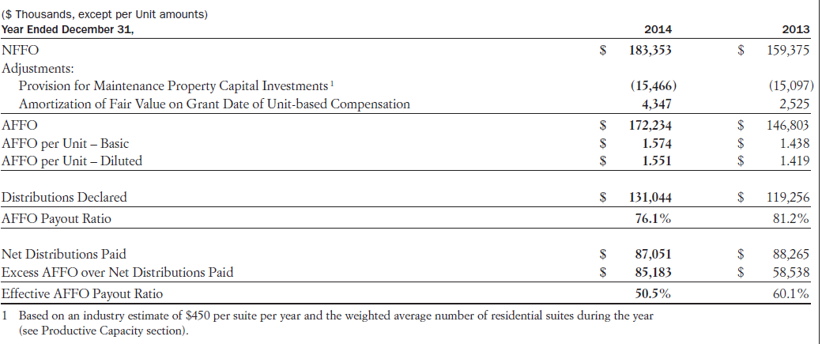
REITs AFFO: Capex - Maintenance vs. Growth
CAPREIT Page 45 2014 YE MD&A
Provision as a % of Actual Maintenance-related Capex
2014: 30%
2013: 35%

Slide 40
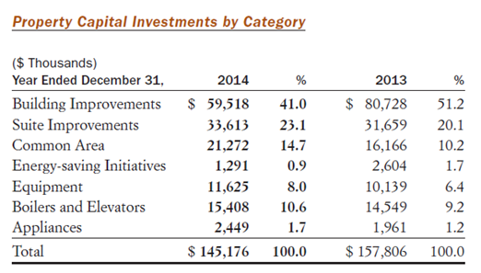
REITs AFFO: Capex - Maintenance vs. Growth
CAPREIT, 2014 YE MD&A Page 46
2014 Veritas Estimated Maintenance Capex = $50,754
2013 Veritas Estimated Maintenance Capex = $42,815

Slide 41
Evaluating Non-GAAP Metrics
  Understand the metric used by the market and how it is calculated
  Is there anything abnormal/different from peers?
  Has the calculation changed?
  Do the adjustments make common business sense?
  Is compensation or covenants tied to the market’s metric?
  What will move the market’s belief to your number?
Notes:
Temporary differences may become permanent in practice:
Cost capitalization with low amortization rate
Deferred income taxes

Slide 42
Advise For Users
Don’t blindly accept non-GAAP metrics
If an adjustment doesn’t make common business sense, don’t use it!
Scrutinize adjustments based on management objectives
Compare valuation/performance metrics using both GAAP and non-GAAP measures

Slide 43
Non-GAAP Recommendations to Regulators
Issue a detailed guidance (s.a. SEC’s Compliance & Disclosure Interpretation)
Explicitly prohibit certain adjustments
Each adjustment separately explained
All inputs reconciling to GAAP figures must be provided
Strong regulatory enforcement for non-compliance
Audit compliance with regulatory standards
Publicize correspondence with companies

Slide 44
A Word On How Audit Can Help
Improve perception of assurance
Clearly label what is audited in financial filings
Compliance with Non-GAAP Regulatory Standards (CSA)
Compliance with compensation programs

Slide 45
Questions

Slide 46
Veritas Investment Research Corporation ("Veritas") its directors, officers, employees and their immediate families are prohibited from trading any position in the securities profiled in a report thirty (30) days before and five (5) days after the publication date where the report involves coverage initiation or a change of opinion. Veritas has not offered any consulting, financial advisory, investment banking or underwriting services to the companies mentioned. Veritas does not accept research fees from the companies profiled herein. The information contained in this report has been obtained from sources believed reliable however the accuracy and/or completeness of the information is not guaranteed by Veritas, nor does Veritas assume any responsibility or liability whatsoever. All opinions expressed are subject to change without notification. This report is for information purposes only and does not constitute and should in no way be construed as a solicitation to buy or sell any of the securities mentioned herein. The intention of this report is to provide a forthright discussion of business, accounting and financial reporting issues, as well as generally accepted accounting principles and the limits of their usefulness to investors. As such, please do not infer from this report that the accounting policies of any company mentioned herein are not allowed within the broad range of generally accepted accounting principles, or that the policies employed by that company were not approved by its auditor(s). This report may not be reproduced in whole or in part without the express prior written consent of Veritas. Veritas is a 100% employee owned firm.
©2017 Veritas Investment Research Corporation

