Slide 1
Professional Accounting Futures Annual Conference
Risk Management &
Performance Disclosures
Brian Fiedler

Slide 2
Notice
The views expressed in this presentation are those of the speaker and do not necessarily represent those of Give & Go Prepared Food Corp. or other companies referenced. Examples shown are for illustrative purposes only.

Slide 3
Discussion Scope
In Scope
Enterprise Risk Management Disclosures in AIF / MD&A (and U.S. equivalents)
Non-GAAP based performance measures and metrics in MD&A and Earnings Releases
Outside Scope;
IFRS/GAAP based measures in financial statements or notes thereto
Integrated Reporting <IR>
Environmental/Social/Governance Reporting (ESG)
Global Reporting Initiative (GRI)
Carbon Disclosure Project

Slide 4


Trends Contributing to a Riskier Business Environment
International Economic Contagion (interconnected supply chains and economies).
Increased Incidence of Cyber Sabotage.
Increased Incidence & Severity of Natural Disasters (some related to Climate Change).
M&A Integration Risk.
More Complex Regulatory Environment.

Slide 5

Findings of 2016 CPA Canada / CFERF Study on Enterprise Risk Management
20% of Canadian survey participants indicated no documented risk management program
While a high degree of confidence in Board and Senior Management in understanding risks, far less so in front line employees
61% of Canadian companies surveyed do not have a Chief Risk Officer or equivalent
On other hand – 93% of organizations addressed risks (formally or informally) in new ventures (acquisitions, geographic expansions, new lines of business etc.)

Slide 6
What are Investors Looking for in Disclosures on Enterprise Risk Management?
Clear description of the Principle Risks specific to the company’s business/industry.
The Board’s Risk Tolerance level (quantitative & qualitative).
Brief description of the company’s Enterprise Risk Management program structure, accountabilities and disciplines, as well as which Risk Framework the company has adopted.
Confirmation that all key risk types are within scope of the ERM program (Strategic, Operational, Financial, External).

Slide 7
What are Investors Looking for in Disclosures on Enterprise Risk Management?
Company’s strategy for dealing with the principle risks (combination of avoidance, prevention, mitigation, insurance/hedging and acceptance) to help ensure net residual risk is within tolerance level.
Indication of how less tangible risks (eg. Reputational) are addressed.
Whether and how risk management effectiveness is explicitly incorporated into management compensation incentive programs and performance assessment.
Indication of newly emerging risks (if any) and preliminary indication of how the company will deal with those.

Slide 8
Location of Risk Disclosures
Annual Information Form (AIF)
Quarterly and Annual Management Discussion & Analysis (MD&A)
Quarterly Earnings Releases
Comprehensive discussion to be in AIF ( many also include in annual MD&A)
Occurrence of major risk event, changes to ERM program or material emerging risk to be highlighted in quarterly MD&A (and possibly Earnings Release).
Can cross reference ER and MD&A to AIF.

Slide 9
Non-GAAP (and IFRS) Performance Disclosures – the Why
GAAP-based measures alone apparently insufficient for users (especially analysts looking to populate models).
Allows a more comprehensive view of company performance, liquidity, Balance Sheet strength.
Increasingly complex accounting not well understood by users (and arguably some accountants!) – embedded derivatives, bifurcations, what to do with elements of comprehensive income etc.
Peer pressure (other industry participants disclosing).
Complex and evolving business models (eg. Social network platform metrics)
Partial offset to inherent conservatism in GAAP (eg. Differing realization thresholds on income and expense items)
Some latitude/ineffectiveness in regulations.

Slide 10

Common Non-GAAP Measures
Adjusted EBITDA (note: EBITDA as reported should not be a non-GAAP measure!)
Free Cash Flow
Sales per square foot
Same store sales
Customer attrition/retention rates
Order Backlog
Average Cost/Claim
Proven Reserves
Development Cost/Ton
Etc.

Slide 11
Quality Attributes of Non-GAAP measures
Economic relevance (driver in the organizations value chain)
Comparability (vs. others in same industry)
Transparency (clarity of inputs)
Consistency (across periods)
Reliability (in explaining current results or leading indicator for future results)

Slide 12
CPA Paper “Non-GAAP Measures – a 20 Year Echo” 2016
Addresses non-GAAP measures in terms of reporting quality (noted above)
Governance (strategic and risk aspects of non-GAAP measures)
Regulation (impact on willingness to use certain measures even though convey relevant info.)
Industry-specific usage

Slide 13
Shifting Regulatory Responses to Non-GAAP Performance Measures
Amendments to CSA Staff Notice 52-306 in 2016;
Certain performance measures not considered non-GAAP measures (non-financial metrics such as subscriber counts or ones using financial info.as presented in financial statements such as sales per square foot*)
Must name NGM in way that distinguishes them from other disclosure items specified and not misleading.
Acknowledges that GAAP may allow/require additional subtotals in the core financial statements
Continued issues with reporters using these in press releases, corporate websites etc. where presentation of most comparable GAAP-based measure and resulting reconciliation not provided (when required).

Slide 14
What Management Can Do to Support NGM Reporting
Ensure non-GAAP performance measures provide incremental useful information not available from GAAP-based financial statements.
Ensure measure cannot be mis-interpreted / misleading.
Subject the calculation of the metric to a robust internal control process
Ensure reporting of the metric conforms to regulatory requirements

Slide 15
Ways to Improve Risk Management & Non-GAAP Performance Reporting
Stay on top of regulatory amendments in these areas (eg. CSA staff notices and outreach activities by the Board and Regulators (and they do a lot!)).
Review annual reports of award-winning corporate reporters.
Review annual reports of competitors within same or similar industries.
Follow developments in alternative/supplementary reporting frameworks (eg. <IR>)
Always look through the eyes of users that have invested hard earned capital – ultimately they are the judges!

Slide 16
Appendix 1

Slide 17
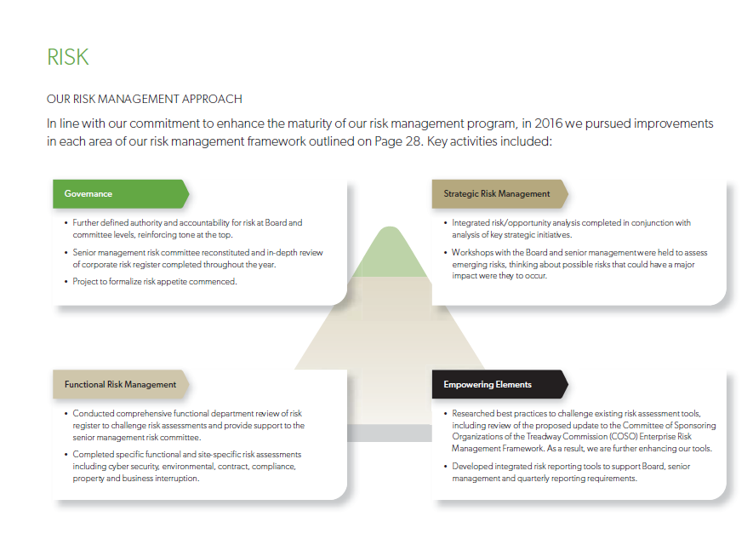

Potash – Risk Management Approach

Slide 18
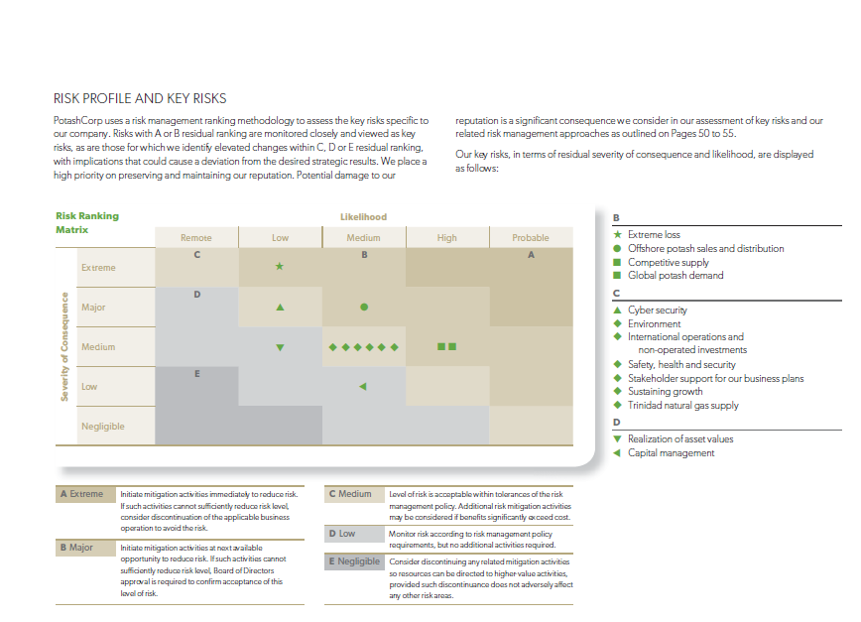
Potash – Risk Profile and Key Risks

Slide 19
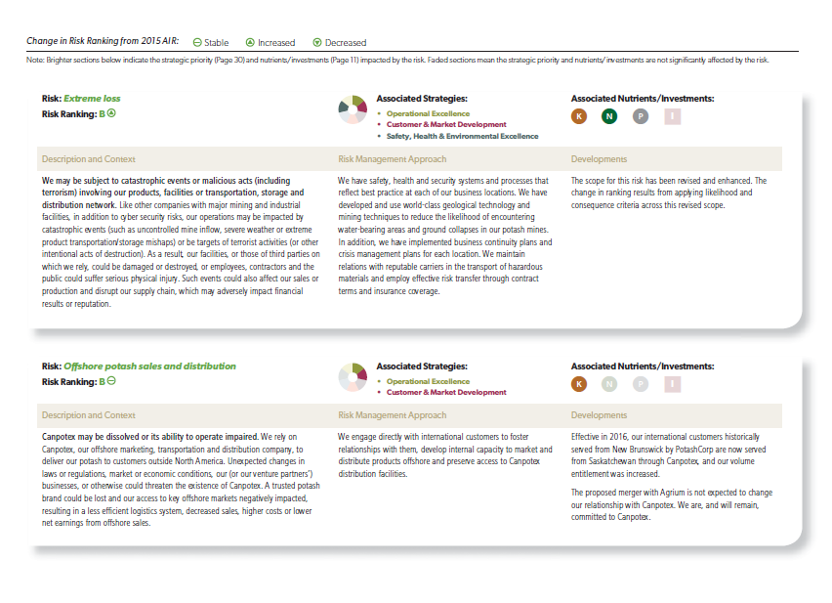
Potash – Change in Risk Ranking from 2015 A/R

Slide 20
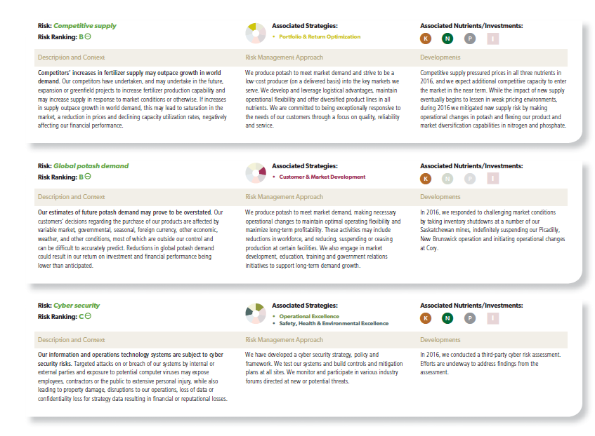
Potash -Change in Risk Ranking from 2015 A/R ( cont’d)

Slide 21
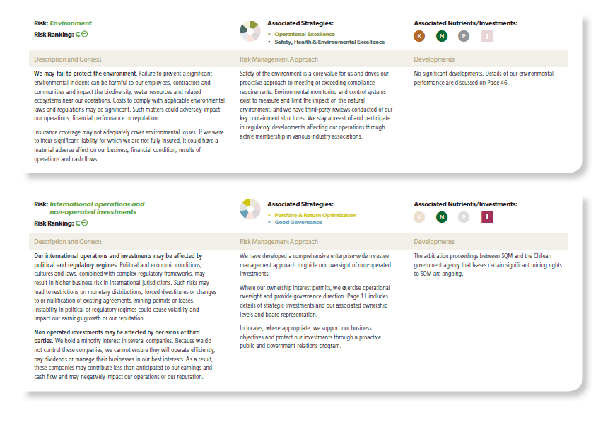
Potash -Change in Risk Ranking from 2015 A/R ( cont’d)

Slide 22
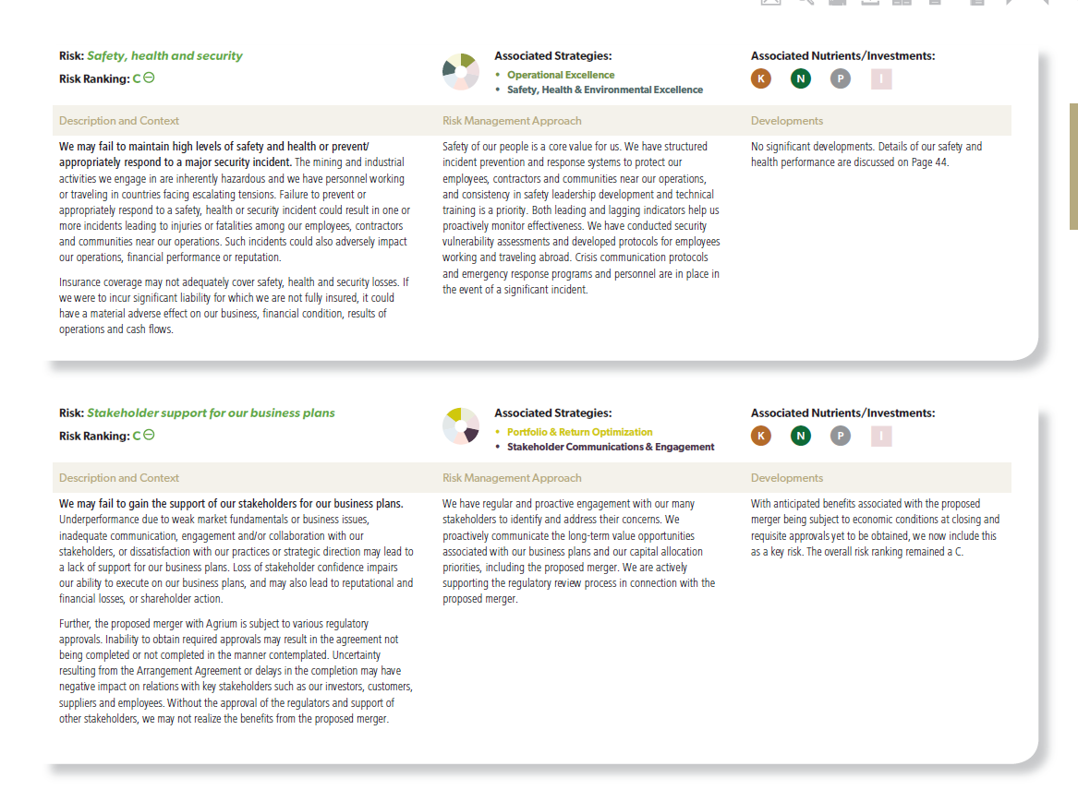
Potash -Change in Risk Ranking from 2015 A/R ( cont’d)

Slide 23
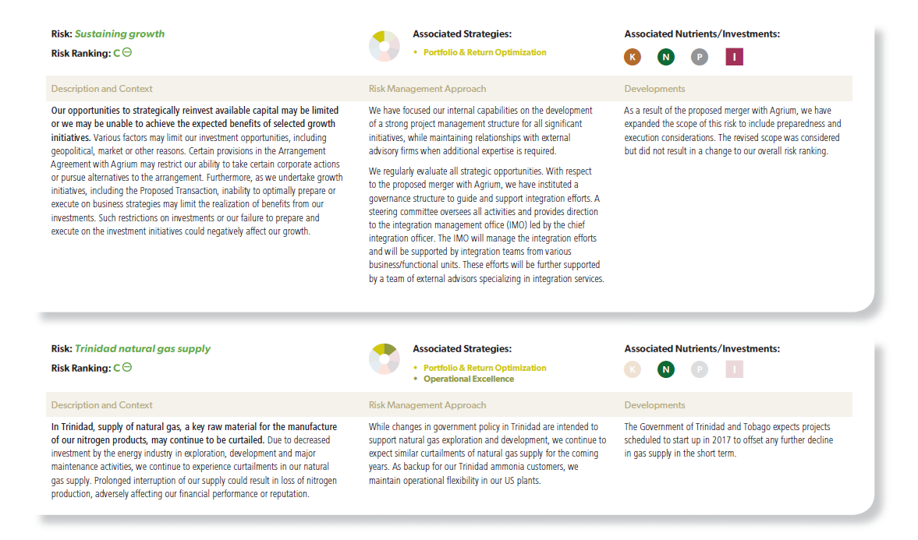
Potash -Change in Risk Ranking from 2015 A/R ( cont’d)

Slide 24
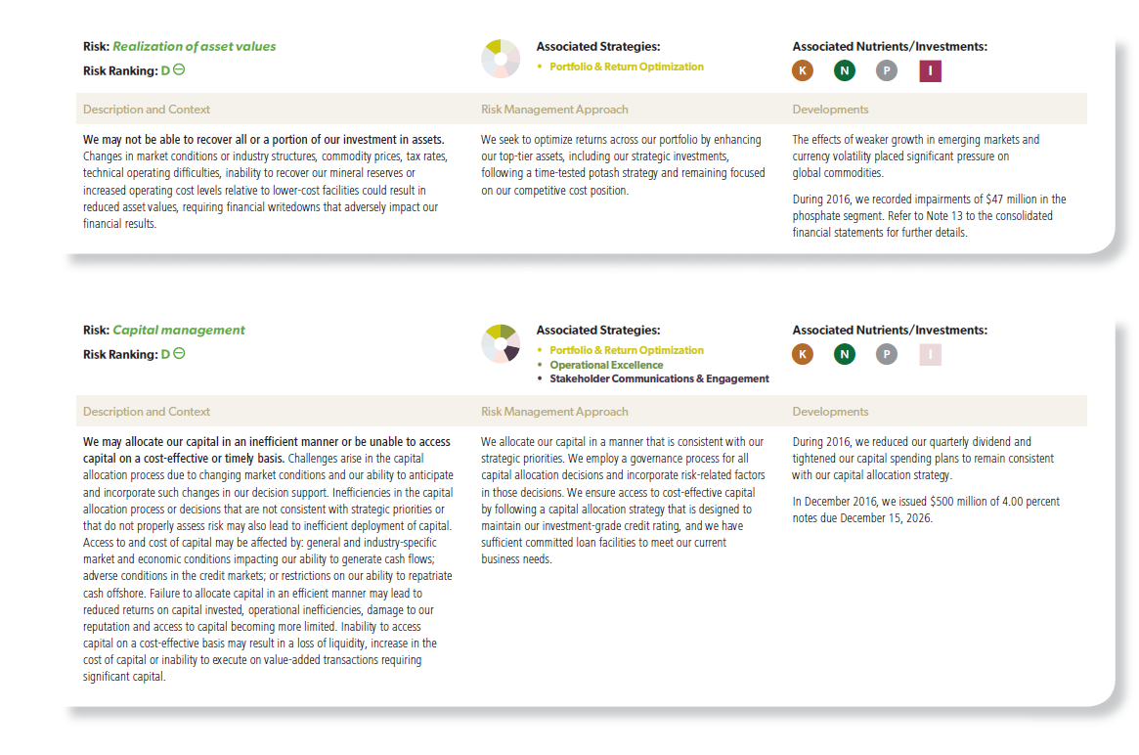
Potash -Change in Risk Ranking from 2015 A/R ( cont’d)

Slide 25
Appendix 2

Slide 26

Canadian Tire MD&A- 2016
11.3 Key operating performance measures and non-GAAP financial measures
The Company uses certain key operating performance measures and non-GAAP financial measures and believes that they provide useful information to both Management and investors in measuring the financial performance and financial condition of the Company for the reasons outlined below.
Some of these measures do not have a standardized meaning prescribed by GAAP and therefore may not be comparable to similarly-titled measurespresented by other publicly-traded companies. They should not be construed as an alternative to other financial measures determined in accordance with GAAP

Slide 27
Canadian Tire MD&A- 2016
11.3.1 Key operating performance measures
Retail sales
Retail sales refers to the POS (i.e. cash register) value of all goods and services sold to retail customers at stores operated by Dealers, Mark’s and FGL Sports franchisees, and Petroleum retailers, at corporately-owned stores across all retail banners, of services provided as part of the Home Services offering, and of goods sold through the Company’s online sales channels, and in aggregate does not form part of the Company’s consolidated financial statements. An aspiration with respect to retail sales has been included as one of the Company’s financial aspirations. Sales definitions for the Retail banners can be found in the footnotes to the table contained within section 7.2.1 of this MD&A.
Management believes that retail sales and related year-over-year comparisons provide meaningful information to investors and are expected and valued by them to help assess the size and financial health of the Company’s retail network of stores. These measures also serve as an indicator of the strength of the Company’s brand, which ultimately impacts its consolidated financial performance.
Revenue, as reported in the Company’s consolidated financial statements, comprises primarily the sale of goods to Dealers and to franchisees of Mark’s and FGL Sports, the sale of gasoline through Petroleum retailers, the sale of goods to retail customers by stores that are corporately-owned under the Mark’s, PartSource, and FGL Sports banners, the sale of services through the Home Services business, the sale of goods to customers through INA, a business-to-business operation of FGL Sports, and through the Company’s online sales channels, as well as revenue generated from interest, service charges, interchange and other fees and from insurance products sold to credit card holders in the Financial Services segment, and rent paid by third-party tenants in the CT REIT segment.

Slide 28
Canadian Tire MD&A- 2016
Same-store sales
Same-store sales is a metric used by Management and is also commonly used in the retail industry to identify sales growth generated by a Company’s existing store network and removes the effect of opening and closing stores in the period. For Canadian Tire stores, the calculation excludes stores that have been retrofitted, replaced, or expanded where the percentage change in square footage exceeds 25 percent of the original store size, and includes sales from all stores that have been open for a minimum of one year and one week as well as eCommerce sales. For Mark’s and FGL Sports, same-store sales include sales from all stores that have been open since at least the beginning of the comparative month in the prior year and include eCommerce sales. In Q2 2015, to better reflect how the Company manages operations, the same-store sales definition at Mark’s and FGL Sports was refined to reflect stores opening at the beginning of the comparative month versus the beginning of the comparative quarter. Prior period same-store sales growth was not restated as the impact was not material. The Company also reviews consolidated same-store sales which include same-store sales at Canadian Tire (including PartSource), FGL Sports, and Mark’s but excludes same-store sales at Petroleum. Additional information on same-store sales and retail sales growth definitions for Canadian Tire, Mark’s, and FGL Sports can be found in section 7.2.1 of this MD&A.

Slide 29
Canadian Tire MD&A- 2016
Sales per square foot
Management and investors use comparisons of sales per square foot metrics over several periods to help identify whether existing assets are being made more productive by the Company’s introduction of new store layouts and merchandising strategies. Sales per square foot definitions for Canadian Tire, Mark’s, and FGL Sports can be found in section 7.2.1 of this MD&A and in the glossary contained in the Company’s 2016 Report to Shareholders.
Retail return on invested capital
The Company believes that Retail ROIC is useful in assessing the return on capital invested in its retail assets. Retail ROIC is calculated as the rolling 12-months retail earnings divided by average invested retail capital. Retail earnings are defined as Retail segment after-tax earnings excluding interest expense, inter-segment earnings, minimum lease payments and non-controlling interests. Average invested capital is defined as Retail segment total assets, including operating leases capitalized at a factor of eight, less Retail segment current liabilities and inter-segment balances for the current and prior year. A three-year Retail ROIC aspiration has been included as one of the Company’s financial aspirations.
Return on receivables
ROR is used by Management to assess the profitability of the Financial Services’ total portfolio of receivables. ROR is calculated by dividing income before income tax and gains/losses on disposal of property and equipment by the average total-managed portfolio over a 12-month period. A ROR aspiration has been included as one of the Company’s financial aspirations, to be achieved on an annual basis over the three-year period from 2015 to 2017.

Slide 30
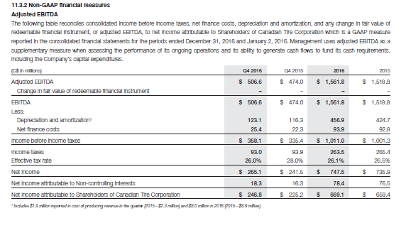
Canadian Tire MD&A- 2016

Slide 31
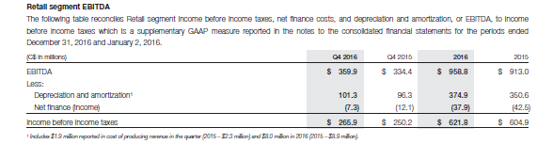
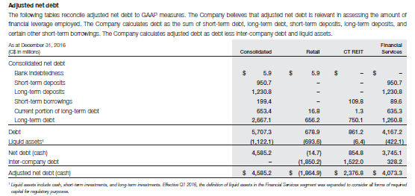
Canadian Tire MD&A- 2016

Slide 32
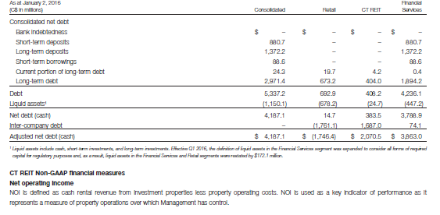
Canadian Tire MD&A- 2016

Slide 33
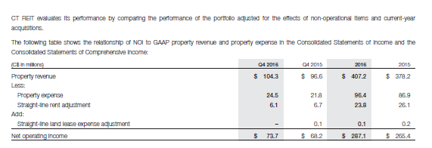
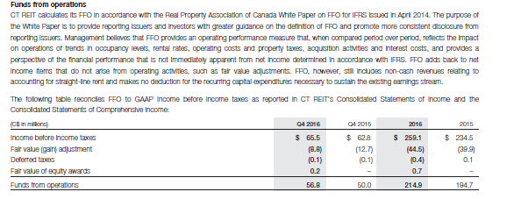
Canadian Tire MD&A- 2016

Slide 34
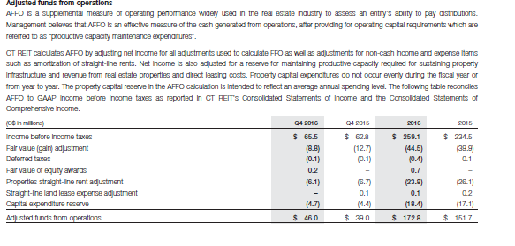
Canadian Tire MD&A- 2016

