Slide 1

PAC ANNUAL CONFERENCE
Professional Accounting Futures
October 28, 2021
Financial Reporting and Disclosure Challenges -
CFO Perspective
Mandeep Chawla
CFO Celestica

Slide 2

Professional Accounting Futures Conference
Guest speaker: Mandeep Chawla

Slide 3

Contents
1 | Celestica Overview
2 | Sleep Country Overview
3 | Discussion on reporting & disclosure challenges
4 | Questions

Slide 4
Celestica Overview

Slide 5












Celestica at a glance
Key Statistics
The Markets We Serve (FY20)
Our Customers
$5.7B 2020 Revenue | >100 Customers Across Multiple Markets
13 Countries Served | 51% Lifecycle Solutions Revenue† as % of Total Revenue (FY20)
38 Locations | ~$1.1B Market Cap***
$2.1B
Advanced Technology
Solutions (ATS) Revenue
$3.7B
Connectivity & Cloud Solutions (CCS) Revenue
CCS
Communications
Enterprise*
ATS
Aerospace & Defense
HealthTech
Industrial & Energy
Capital Equipment**
† Represents aggregate ATS segment and Hardware Platform Solutions revenue
* Consists of our servers and storage businesses
** Consists of our semiconductor, display, and power and signal equipment businesses
*** Market cap as of June 8,2021

Slide 6
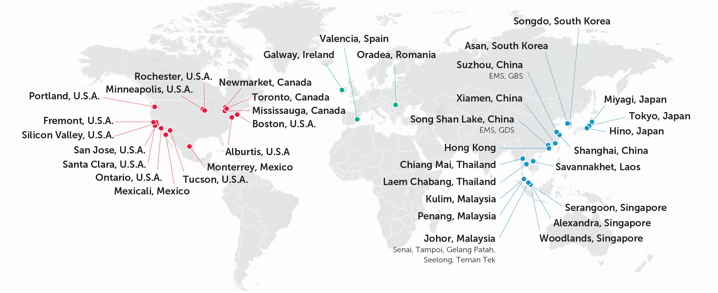
Strategic network tailored to meet market and customer product lifecycle requirements
38 locations and more than 20,000 employees across the globe
NORTH AMERICA (~20% of 2020 revenue produced)
EUROPE (~10%)
ASIA (~70%)
Complex highly regulated product manufacturing
Silicon Valley Customer Experience Center
ITAR for defense production
ISO 13485 for Medical
Design and Engineering
Complex highly regulated product manufacturing
Automated manufacturing
ITAR for defense production
FDA and ISO 13485 for Medical
Design & Engineering for ATS markets
Automated Manufacturing
FDA and ISO 13485 for Medical
Optical capability
Hardware Platform Solutions Centre
Design and Engineering

Slide 7

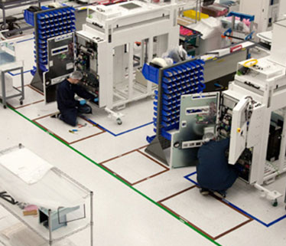
ATS at a glance
A trusted lifecycle solutions provider offering integrated capabilities from design to manufacturing to after-market services
2Q21 LTM Financials | Revenue: $2.1B | Segment Income*: $84M | Segment Margin*: 3.9%
Aerospace & Defense
Industrial &
Energy
HealthTech
Capital Equipment
Electronics manufacturing services provider with capabilities to deliver
end-to-end solutions
Partnering with healthcare companies to bring critical medical devices to market
Expertise in high volume automated manufacturing & complex product enablement
Market leader in providing highly specialized solutions for capital equipment industries
Bolstering strong organic growth with disciplined, on-strategy acquisitions to accelerate growth
* See the Appendix for a description of how segment income and margin are calculated, as well as a reconciliation of segment income to IFRS earnings before income taxes for 2020

Slide 8
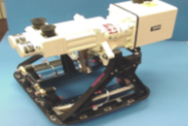
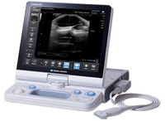
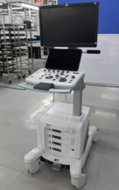

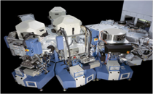
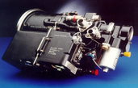
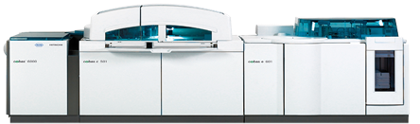





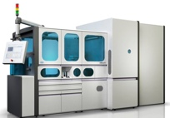
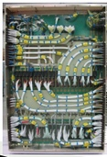
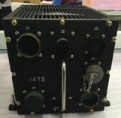
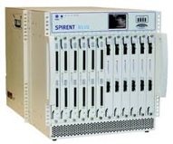

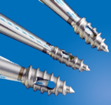
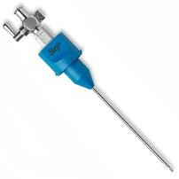

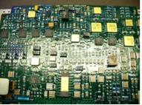
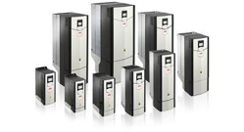
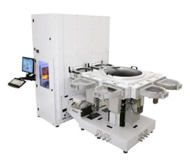
End markets and products
End Markets | Aerospace & Defense | HealthTech | Industrial & Energy | Capital Equipment
Product Examples
Diagnostic imaging & patient monitoring
Cabin pressure controls
LiDAR modules, in-car computing and ethernet connectivity
Wafer processing systems
Engine power generation & controls
Process automation/ robots
Smart meters
Machined parts and sheet metal
Power & signal distribution
In-vitro diagnostics & life sciences / critical diagnostics
Flight
Controllers
Communications test equipment
Cable and wire harness
Power distribution
Single use finished goods: surgical instruments
Vacuum transfer assembly
Tool interface system
Wire harness
Circuit card assembly
Low voltage AC drives

Slide 9


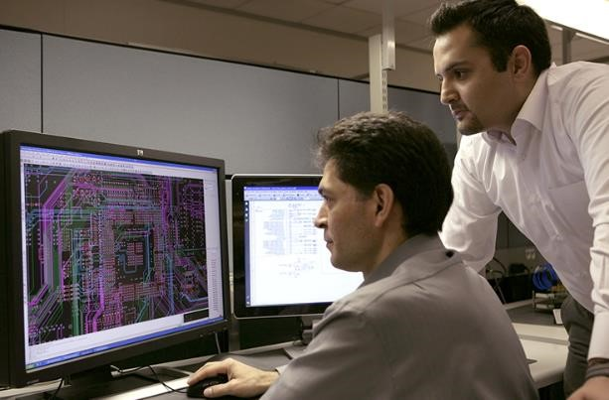
CCS at a glance
Communications & Enterprise Solutions, including Hardware Platform Solutions
2Q21 LTM Financials | Revenue: $3.5B | Segment Income*: $124M | Segment Margin*: 3.6%
Communications
Hardware Platform Solutions (HPS)
Enterprise
Strong legacy of designing, building and repairing highly complex communications products
Reputation for innovative solutions with storage, servers and converged technologies
Established hardware platform solutions for datacenter and network infrastructure markets
Focused on enabling customers with innovative hardware, manufacturing and support services
* See the Appendix for a description of how segment income and margin are calculated, as well as a reconciliation of segment income to IFRS earnings before income taxes for 2020

Slide 10
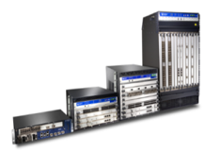

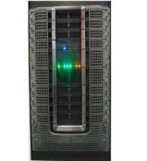

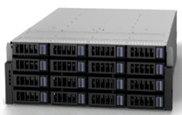
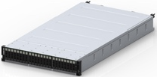
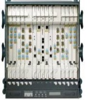

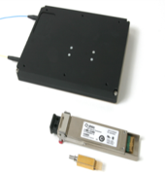
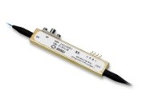
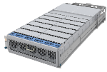
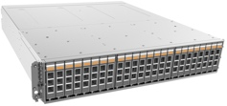
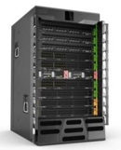

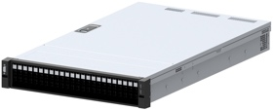
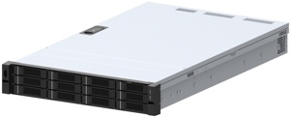

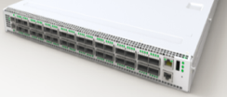
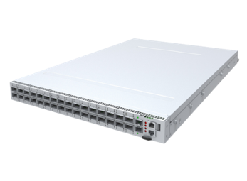
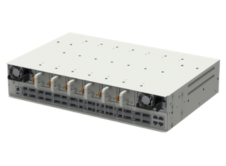


End markets and products
End Markets | Communications Solutions | Enterprise Solutions
Product Examples
Hardware Platform Solutions
Routing Core/Edge
Optical Systems & Components
Storage
Networking
Compute
Tyr™
High performance, flexible configuration 2U server
Euclid™
All flash array NVMeoF 2U system
Edgestone™
Short Form Factor 100GbE Switch for the Edge
Silverstone™
400GbE Datacenter Infrastructure Switch

Slide 11
Sleep Country Overview

Slide 12
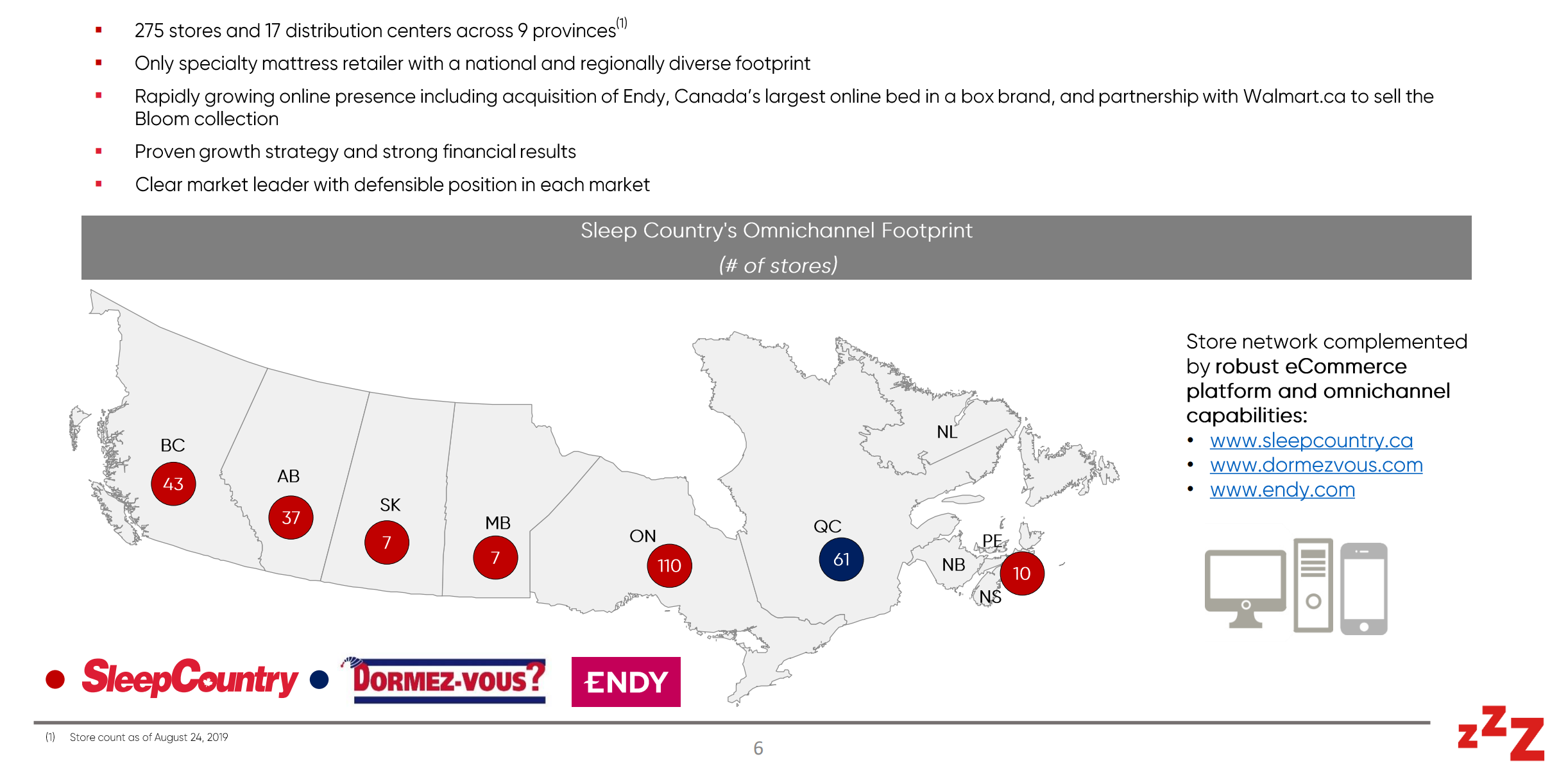
Sleep Country is Canada’s leading omnichannel mattress & bedding retailer

Slide 13
Challenges in a fast changing & chaotic environment

Slide 14
Significant economic challenges in 2020 and 2021 have required companies to take an “all hands on deck” approach to minimize impacts to customers, employees and shareholders
Operational readiness
  Environmental health & safety
  Supply chain management
  Manufacturing operations
  Government relations
Financial stewardship
& reporting
  Customer contracts & litigation
  Liquidity analysis
  Customer credit analysis
Financial controls
& reporting
  Impairment analysis
  Auditing & controls in a remote environment
  Acquisition diligence
Financial disclosures
  Guidance
  Revenue impacts (present and future)
  Government support

Slide 15


Slide 16
PAC ANNUAL CONFERENCE
Professional Accounting Futures
October 28 & 29, 2021
Thank you for attending
Visit our PAC website at
https://www.utm.utoronto.ca/pac/
Please join us tomorrow

